Slide 1
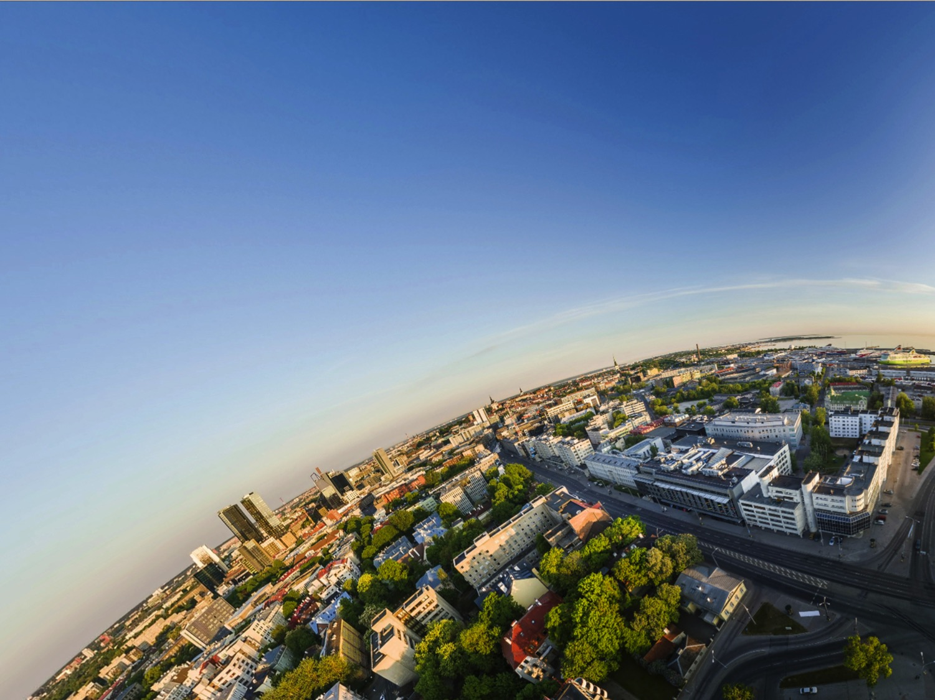
REWIR
Kuidas
kollektiivsete töösuhete kaudu
(Saab) Toetada
(Tagasi) Tööle tulekut
Pärast haigu(se saami)st
13.06.2019

Slide 2
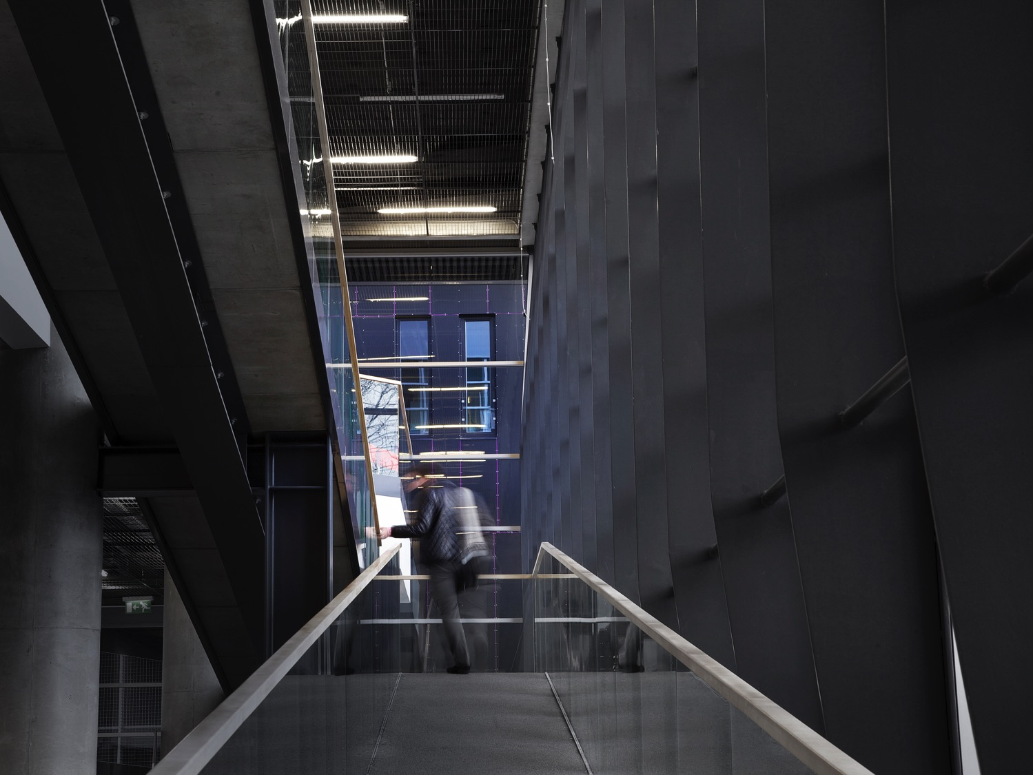
KES?
Kus?

Slide 3

Notes:
Miks TLÜ?

Slide 4


Slide 5

Platformtööjõud linnakeskkonnas: õiglus, heaolu ja areng (PLUS)
PLUS tegeleb platformimajanduse mõjuga töö olemusele, heaolule ja sotsiaalkaitsele (Barcelona, Berliin, Bologna, Lissabon, London, Pariis, Tallinn). Projekt panustab tööjõu digitaliseerumise mõistmisesse ning sellega seotud väljakutsetega toimetulekusse.
Kestus: 2019-2021
Eelarve: € 2 992 377,50 (€ 187 750)
Rahastaja: Euroopa Komisjon, Horisont 2020

Slide 6

Tehnoloogiline ebavõrdsus - mõtestades tehnoloogiliste uuenduste ja sotsiaalse ebavõrdsuse seoseid (TECHNEQUALITY)
TECHNEQUALITY tegeleb tehnoloogiliste uuenduste mõjuga sotsiaalsele ebavõrdsusele. Projekt läheb kaugemale traditsioonilisest küsimusest, kas automatiseerimine loob või kaotab töökohti ja püüab mõista, milliste oskustega saab edu tööturul ja laiemalt ühiskonnas tulevikus seotud olema.
Kestus: 2019-2021
Eelarve: € 2 999 136,25 (€ 243 000)
Rahastaja: Euroopa Komisjon, Horisont 2020

Slide 7

REWIR:
Läbirääkimised tööle naasmise üle kollektiivsete töösuhete kaudu demograafiliste muutuste ajastuL
REWIR uurib, kuidas sotsiaalpartnerid saavad panustada tööle naasmise poliitikate kujundamisse ja rakendamisse ning analüüsib teiste sidusgruppide ja üksikute töötajate kogemusi tööle naasmisega. Projekti taustaks on vananeva ühiskonna ja töökarjääri pikenemise temaatika.
Kestus: 2018-2022
Eelarve: € 425 478,60 (€ 32 035,16)
Rahastaja: Euroopa Komisjon

Slide 8



Partnerid

Slide 9
MIs?

Slide 10
Negotiating return to work in the age of demographic change through Industrial Relations
- REWIR -
kuidas
kollektiivsete töösuhete kaudu (saab) toetada
(tagasi) tööle tulekut
/pärast haigu(se saami)st/
With financial support from the EC, Project No. VS/2019/0075

Slide 11
Fookuses:
kroonilise haigusega (uuesti) tööellu lülitumine

Slide 12
Miks?
Elanikkonnastruktuuri muutused:
- elanikkonna vananemine
- krooniliste haiguste sagenemine (4 rühma: kardiovaskulaarsed; kasvajad; luu- ja lihaskonna haigused; vaimse tervisega seonduvad)
  - poliitikaprobleem: kuidas hoida rahvas (kauem) terve ja aktiivne
Töö ja tööturul osalemisega seotud muutused:
Osas riikides madal tööturul osalemine
Digitaliseerimise mõju ja tuleviku töö
Uued töö vormid, kasvav paindlikkus
  poliitikaprobleem: kuidas tagada (kauem) seotus tööturuga

Slide 13
REWIR eesmärk
Mõista,
  mis roll on kollektiivsetel töösuhetel
  EL kodanike tööelu pikendamisel
  keskendudes tööle (tagasi) tulemisele
  pärast püsivamate, krooniliste tervisemuredega kokkupuutumist
  arvestades demograafilisi ja tehnoloogilisi muutusi
Euroopa, riigi ja organisatsiooni tasandil

Slide 14
Project objectives
Strengthen expertise on the role of social partners in designing and implementing return to work policies at the European and national levels through social dialogue initiatives.
Analyse the implementation of particular targets of Europe 2020, such as the agenda in promoting a healthier Europe and active and healthy ageing.
Enhance knowledge on information, consultation and co-determination of employee representatives at company level in issues that are relevant to an increasing part of the work force and enable work retention of people exposed to chronic diseases.
Extend the knowledge on preventing risk of marginalisation, discrimination and the threat of poverty for workers that suffer(ed) from long-term illness; and enabling their return to work and interest representation at the labour market. This aim highlights the relevance of industrial relations for the Commission’s flagship initiative European platform against poverty and social exclusion.
Rethink how industrial relations play a role in the (re)definition of concepts as ‘intergenerational fairness’, ‘longer labour market involvement’, ’job performance’, ‘presence at work’, and ’fitness for work’ (some of which are priorities of Europe 2020) by raising awareness on transformations in the world of work flowing from technological, organisational, and demographic changes.

Slide 15
Conceptual and analytical framework
Actor-centered institutionalism (Scharpf 1997)
understanding the role that stakeholders play in shaping policies
key stakeholders and their perceptions and experiences at the core of the project
social phenomena can be explained as the outcomes of interactions among actors, acknowledging that such interactions are structured and that outcomes are shaped by the characteristics of the institutional setting in which they occur (Scharpf, 1997).

Slide 16
Conceptual and analytical framework
ideas, activities, priorities, and relations and interactions between representatives of unions, employers, governments and others cannot be disentangled from the diversity in industrial relations practices and return to work policies across the EU

Slide 17
Conceptual and analytical framework
Acknowledging diversity in:
- industrial relations systems
- frameworks/policies for return to work (RTW)
How do different IR systems approach RTW, and vice versa, how similar RTW policies are designed and implemented in countries with radically different IR?
How will the relevant IR stakeholders deal with RTW policies and practice in different IR systems?

Slide 18
Research scope – countries for in-depth analysis and benchmark studies (in brackets)
Industrial relations system* | Frameworks for return to work policies and systems
 | Inclusive system, effective policy coordination | Developed policies but limited policy coordination | Limited institutional support and ad hoc policy initiatives | Generally limited return to work framework for promoting labour market access
Liberal/Anglo-Saxon/Anglophone |  | (UK) | Ireland
Southern statist |  | Italy (France)
Negotiated social partnership | (Germany) | Belgium
Central and Eastern European neoliberal |  |  | Estonia, Romania
Central and Eastern European embedded neoliberal |  |  |  | Slovakia
Source: Bechter et al. 2012 (193, 196), European Commission (2009: 49-50), EU-OSCHA

Slide 19
Methodology
Data collection focusing on all 27 EU member states:
EU level: 15 interviews with employers’ representatives and trade union representatives in European social dialogue councils (ESD) and European sectoral social dialogue councils (ESSD) on the actual and perceived role of social dialogue in shaping return to work policies. WP2, Task 2.2.
National level: EU-wide survey among national-level social partners: approaches to and experiences of employers’ associations and trade unions in shaping and implementing EU-level and country-specific policies aiming to facilitate return to work. WP2, Task 2.1.

Slide 20
Methodology
Data collection covering 6 EU member states:
  National level: 25-30 Interviews with governments and other relevant national-level stakeholders
  will be done to supplement the EU-wide survey (5-6 per country). Respondents include government representatives, patients’ organisations, employment offices, social security authorities, NGOs and charities that participate in shaping and/or implementing return to work policies. WP2, Task 2.3.

Slide 21
Methodology
Company level (WP3, Tasks 3.2, 3.3 and 3.4):
  Stakeholder group discussions, which inform the design of a company-level survey: Each partner will conduct 1 group discussion with selected employers and 1 with selected company-level trade union representatives (6-8 representatives from companies with developed company-level bargaining). The aim of these discussions is to identify topics relevant for employers and unions in maintaining employment through return to work policies.

Slide 22
Methodology
Company level (WP3, Tasks 3.2, 3.3 and 3.4):
  Survey among line managers and company trade union representatives (target is 60 responses per country). The aim is to analyse how company-level industrial relations (can) facilitate RTW, and whether the attitudes, priorities and experiences of social partners on RTW issues differ across various levels of study.

Slide 23
Methodology
Company level (WP3, Tasks 3.2, 3.3 and 3.4):
  Web-based survey among individual workers to collect evidence on the perceptions of individual workers returning to work after long-term illness. The web survey is to be distributed through the national WageIndicator websites (by associated organisation WageIndicator Foundation). Target is 50 responses per country. The survey will be advertised using search engine optimisation.

Slide 24
Methodology
Data collection for benchmark case studies covering France, Germany, and the UK:
  The purpose of these case studies is to expand our sample, by adding large countries that have a significant impact on the EU-level policy agenda, diverse industrial relations systems and developed institutionalised return to work frameworks, and investigate where EU-level policy preferences in return to work originate from, and how they influence social partners’ attitudes. These case studies will be conducted by Ziv Amir via desk research
  WP2, Task 2.4.

Slide 25
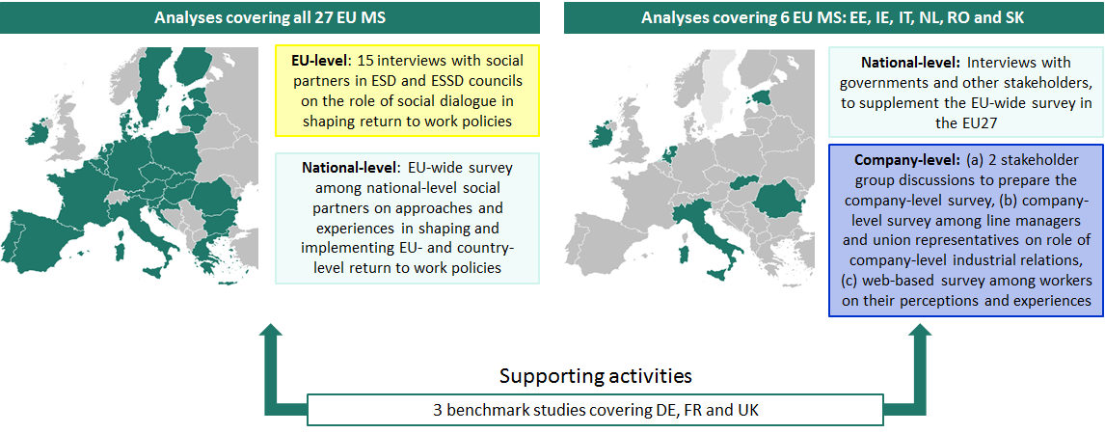
Methodology summary

Slide 26
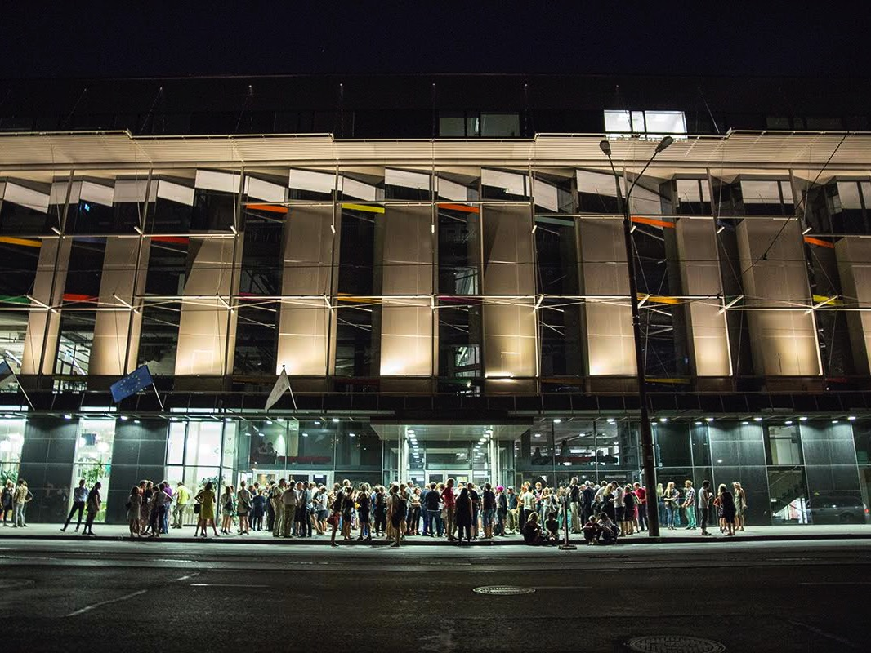

Slide 27
Küsimusi projekti kohta?

Slide 28
Täname!
Marti Taru | marti.taru@tlu.ee
Triin Roosalu | triin.roosalu@tlu.ee

