Slide 1
EESDA
First progress meeting
Tartu, Estonia
11 July 2018

Slide 2
Deliverable WP1.1
EESDA Tartu meeting, 11.7.2018
Chapter 1: Social dialogue articulation in context
Conceptualization of social dialogue and its articulation
Context of European diversity of industrial relations systems
Overview of social dialogue agenda at the EU and national level

Slide 3
Deliverable WP1.1
EESDA Tartu meeting, 11.7.2018
Chapter 2: Analytical framework
2.1 A multi-level governance approach
2.1.1. Concepts
2.1.2. Operationalization
2.2 Effectiveness of social dialogue
2.2.1. Concepts
2.2.2. How to measure effectiveness of social dialogue?
2.3 Summary

Slide 4
Deliverable WP1.1
EESDA Tartu meeting, 11.7.2018
Chapter 3
3.1 Survey methodology
3.1.1. EU-wide survey of social partners
3.1.2. Tentative questionnaire for the EU-wide survey of social partners
3.2 Interviews
3.2.2. Overview of national-level interview respondents
3.2.3. Tentative questionnaire for national-level interviews
3.3 Case studies
3.3.1. Overview of national-level case studies
3.3.2. Tentative questionnaire for case study interviews
3.4 Network analysis
3.4.1. The use of network analysis for studying social dialogue articulation
3.4.2. Operationalization and source of data
3.5 Summary

Slide 5
Chapter 1 – context/definitions
EESDA Tartu meeting, 11.7.2018
Social dialogue: interactions, such as negotiation, consultation or exchange of information, between or among social partners and public authorities
Social dialogue articulation: ways in which social dialogue between public and private actors at different levels functions and the channels through which EU level social dialogue influences decisions, outcomes and positions of actors at the national and sub-national levels and vice versa
Effective social dialogue: social dialogue that produces relevant outcomes that are then implemented at the European and/or national levels. Outcomes result from meetings/negotiations/interactions in a reasonable timespan.

Slide 6
Chapter 1 – context/definitions
EESDA Tartu meeting, 11.7.2018
Outcomes of social dialogue:
a) binding outcomes
serving the purpose of legislative implementation (e.g., Council Directives, Autonomous agreements of EU-level social partners, national-level legislation)
serving the purpose of implementation in form of collective agreements (national or sectoral)
b) non-binding outcomes (voluntary implementation by social partners)
process-oriented texts (frameworks for action, guidelines, codes of conduct, policy orientation)
joint opinions and tools (declarations, guides, handbooks, websites, tools)
other

Slide 7
Chapter 1 – context/definitions
EESDA Tartu meeting, 11.7.2018
Structure of EU-level social dialogue:
a) tripartite
Tripartite social summit - relates to Council meetings and involves the President of the EU council, the President of the Commission and the President of the Council in office
European semester - macroeconomic policy debates between the social partners and EU representatives; involves the EU Council, the Commission and the European Central Bank
b) bipartite:
European Social Dialogue (ESD) committee
European Sectoral Social Dialogue (ESSD) committees

Slide 8
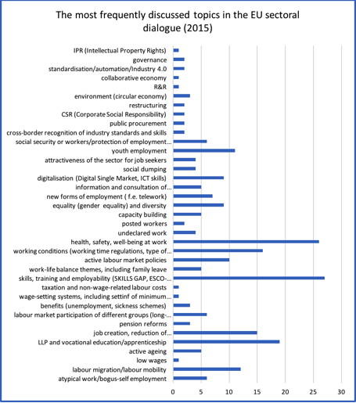
Topics in EU-level SD
EESDA Tartu meeting, 11.7.2018
1. skills, training and employability
2. health, safety, well-being at work
3. working conditions (working time regulations, type of contracts etc.)

Slide 9
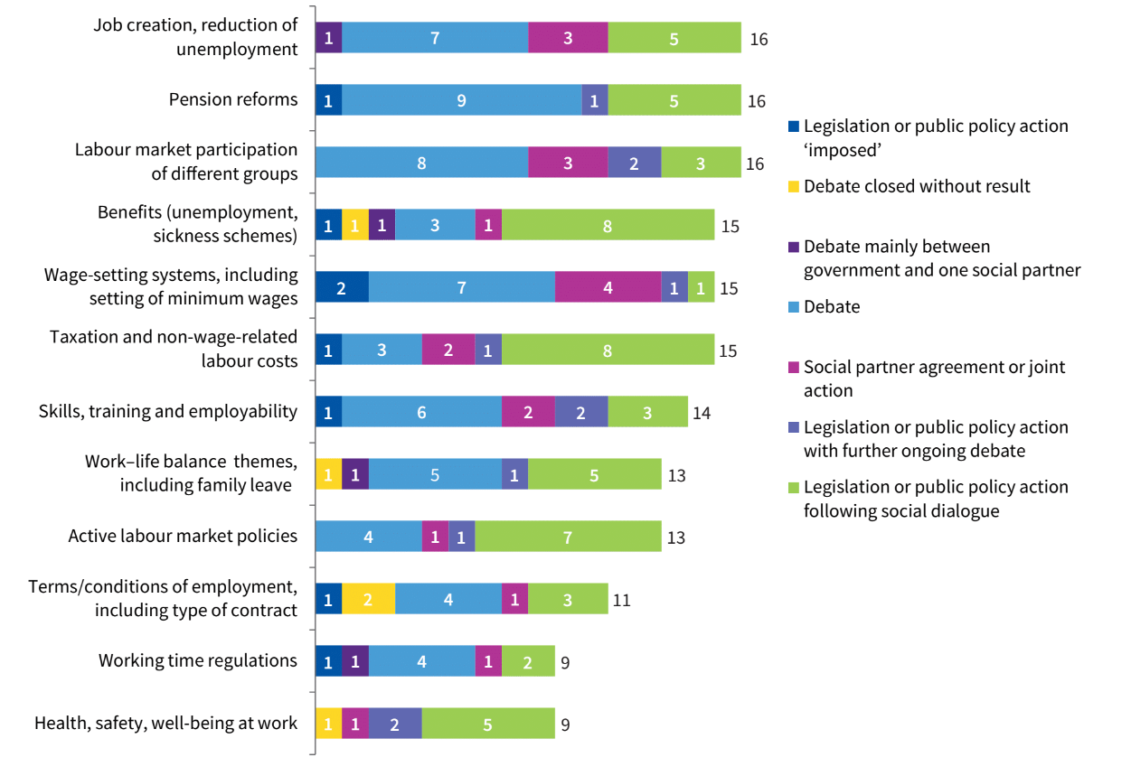
Topics in national-level SD (Eurofound)
EESDA Tartu meeting, 11.7.2018

Slide 10
Chapter 1 – national context
EESDA Tartu meeting, 11.7.2018
Eurofound 2018 – follow this or follow older institutionalist categorizations?
5 country clusters, based on their industrial relations and with regards to their geographical location:
„-‘organised corporatism’ in the Nordic cluster (Denmark, Finland and Sweden);
-‘social partnership’ in the Centre-west cluster (Austria, Belgium, Germany, Luxembourg, the Netherlands and Slovenia);
-‘state-centred’ in the South cluster (Greece, France, Italy, Portugal and Spain);
-‘liberal pluralism’ in the West cluster (Cyprus, Ireland, Malta and the UK)
- ‘transition economies’ (‘mixed model’) in the Centre-east cluster (Bulgaria, Croatia, the Czech Republic, Estonia, Hungary, Latvia, Lithuania, Poland, Romania and Slovakia).“
(Eurofound, 2018a).

Slide 11
Chapter 2 – MLG Approach
EESDA Tartu meeting, 11.7.2018
Relational/network perspective
Identify actors and the ways they are involved in SD
Actors’ power resources: institutional, organizational, structural (do we need this in the approach?)
Intensity of SD - information, consultation, negotiation
Form of interaction: control, cooperation, value-sharing, interactive bargaining
Outcomes: binding/non-binding
Modes of implementing the outcome: legislation, collective agreements, other forms
Effectiveness of SD – how to measure? Kenworthy/Kittel (2003) – mostly institutional variables, not relevant for EU-level SD articulation.
Focus: impact on policy making, capacity to implement SD outcome into policies (both at EU-level and national level)

Slide 12
Thank you for your attention!
marta.kahancova@celsi.sk

