Slide 1
Negotiating return to work in the age of demographic change through IR
(REWIR)
Kick-off meeting 6-7 March, 2019
Bratislava, Slovakia
Analytical framework and methodology
With financial support from the EC, Project No. VS/2019/0075

Slide 2
Motivation
REWIR kick-off meeting Bratislava 6-7.3.2019
Change in population structure and characteristics:
- ageing population across the EU
- chronic diseases on the rise (4 large groups: cardiovascular, cancer, musculoskeletal and mental)
- policy relevance: how to keep populations healthy and active
Changes related to labour market participation and the character of work:
Low participation rates in some countries
digitalization’s impact on the future of work
- new forms of work and flexibility
- policy relevance: how to assure longer labour market involvement

Slide 3
REWIR aim
REWIR kick-off meeting Bratislava 6-7.3.2019
To study
the role that industrial relations play in
extending the working lives of EU citizens
through work retention and integration
after exposure to chronic conditions, against a background of demographic and technological change
Level of IR relevant for our analysis: EU-level, national-level and company-level

Slide 4
Project objectives
REWIR kick-off meeting Bratislava 6-7.3.2019
Strengthen expertise on the role of social partners in designing and implementing return to work policies at the European and national levels through social dialogue initiatives.
Analyse the implementation of particular targets of Europe 2020, such as the agenda in promoting a healthier Europe and active and healthy ageing.
Enhance knowledge on information, consultation and co-determination of employee representatives at company level in issues that are relevant to an increasing part of the work force and enable work retention of people exposed to chronic diseases.
Extend the knowledge on preventing risk of marginalisation, discrimination and the threat of poverty for workers that suffer(ed) from long-term illness; and enabling their return to work and interest representation at the labour market. This aim highlights the relevance of industrial relations for the Commission’s flagship initiative European platform against poverty and social exclusion.
Rethink how industrial relations play a role in the (re)definition of concepts as ‘intergenerational fairness’, ‘longer labour market involvement’, ’job performance’, ‘presence at work’, and ’fitness for work’ (some of which are priorities of Europe 2020) by raising awareness on transformations in the world of work flowing from technological, organisational, and demographic changes.

Slide 5
Conceptual and analytical framework
REWIR kick-off meeting Bratislava 6-7.3.2019
Actor-centered institutionalism (Scharpf 1997)
understanding the role that stakeholders play in shaping policies
key stakeholders and their perceptions and experiences at the core of the project
social phenomena can be explained as the outcomes of interactions among actors, acknowledging that such interactions are structured and that outcomes are shaped by the characteristics of the institutional setting in which they occur (Scharpf, 1997).

Slide 6
Conceptual and analytical framework
REWIR kick-off meeting Bratislava 6-7.3.2019
ideas, activities, priorities, and relations and interactions between representatives of unions, employers, governments and others cannot be disentangled from the diversity in industrial relations practices and return to work policies across the EU

Slide 7
Conceptual and analytical framework
REWIR kick-off meeting Bratislava 6-7.3.2019
Acknowledging diversity in:
- industrial relations systems
- frameworks/policies for return to work (RTW)
How do different IR systems approach RTW, and vice versa, how similar RTW policies are designed and implemented in countries with radically different IR?
How will the relevant IR stakeholders deal with RTW policies and practice in different IR systems?

Slide 8
REWIR kick-off meeting Bratislava 6-7.3.2019
Research scope – countries for in-depth analysis and benchmark studies (in brackets)
Industrial relations system* | Frameworks for return to work policies and systems
 | Inclusive system, effective policy coordination | Developed policies but limited policy coordination | Limited institutional support and ad hoc policy initiatives | Generally limited return to work framework for promoting labour market access
Liberal/Anglo-Saxon/Anglophone |  | (UK) | Ireland
Southern statist |  | Italy (France)
Negotiated social partnership | (Germany) | Belgium
Central and Eastern European neoliberal |  |  | Estonia, Romania
Central and Eastern European embedded neoliberal |  |  |  | Slovakia
Source: Bechter et al. 2012 (193, 196), European Commission (2009: 49-50), EU-OSCHA

Slide 9
Methodology
REWIR kick-off meeting Bratislava 6-7.3.2019
Data collection focusing on all 27 EU member states:
EU level: 15 interviews with employers’ representatives and trade union representatives in European social dialogue councils (ESD) and European sectoral social dialogue councils (ESSD) on the actual and perceived role of social dialogue in shaping return to work policies. WP2, Task 2.2.
National level: EU-wide survey among national-level social partners: approaches to and experiences of employers’ associations and trade unions in shaping and implementing EU-level and country-specific policies aiming to facilitate return to work. WP2, Task 2.1.

Slide 10
Methodology
REWIR kick-off meeting Bratislava 6-7.3.2019
Data collection covering 6 EU member states:
National level: 25-30 Interviews with governments and other relevant national-level stakeholders
will be done to supplement the EU-wide survey (5-6 per country). Respondents include government representatives, patients’ organisations, employment offices, social security authorities, NGOs and charities that participate in shaping and/or implementing return to work policies. WP2, Task 2.3.

Slide 11
Methodology
REWIR kick-off meeting Bratislava 6-7.3.2019
Company level (WP3, Tasks 3.2, 3.3 and 3.4):
Stakeholder group discussions, which inform the design of a company-level survey: Each partner will conduct 1 group discussion with selected employers and 1 with selected company-level trade union representatives (6-8 representatives from companies with developed company-level bargaining). The aim of these discussions is to identify topics relevant for employers and unions in maintaining employment through return to work policies.

Slide 12
Methodology
REWIR kick-off meeting Bratislava 6-7.3.2019
Company level (WP3, Tasks 3.2, 3.3 and 3.4):
Survey among line managers and company trade union representatives (target is 60 responses per country). The aim is to analyse how company-level industrial relations (can) facilitate RTW, and whether the attitudes, priorities and experiences of social partners on RTW issues differ across various levels of study.

Slide 13
Methodology
REWIR kick-off meeting Bratislava 6-7.3.2019
Company level (WP3, Tasks 3.2, 3.3 and 3.4):
Web-based survey among individual workers to collect evidence on the perceptions of individual workers returning to work after long-term illness. The web survey is to be distributed through the national WageIndicator websites (by associated organisation WageIndicator Foundation). Target is 50 responses per country. The survey will be advertised using search engine optimisation.

Slide 14
Methodology
REWIR kick-off meeting Bratislava 6-7.3.2019
Data collection for benchmark case studies covering France, Germany, and the UK:
The purpose of these case studies is to expand our sample, by adding large countries that have a significant impact on the EU-level policy agenda, diverse industrial relations systems and developed institutionalised return to work frameworks, and investigate where EU-level policy preferences in return to work originate from, and how they influence social partners’ attitudes. These case studies will be conducted by Ziv Amir via desk research
WP2, Task 2.4.

Slide 15
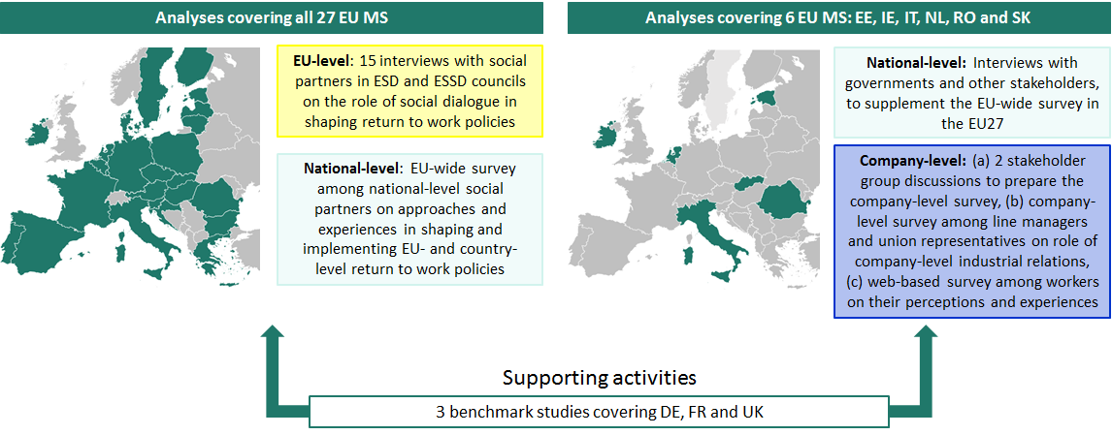
Methodology - summary
REWIR kick-off meeting Bratislava 6-7.3.2019

Slide 16
Thank you for your attention!
marta.kahancova@celsi.sk

