Slide 1
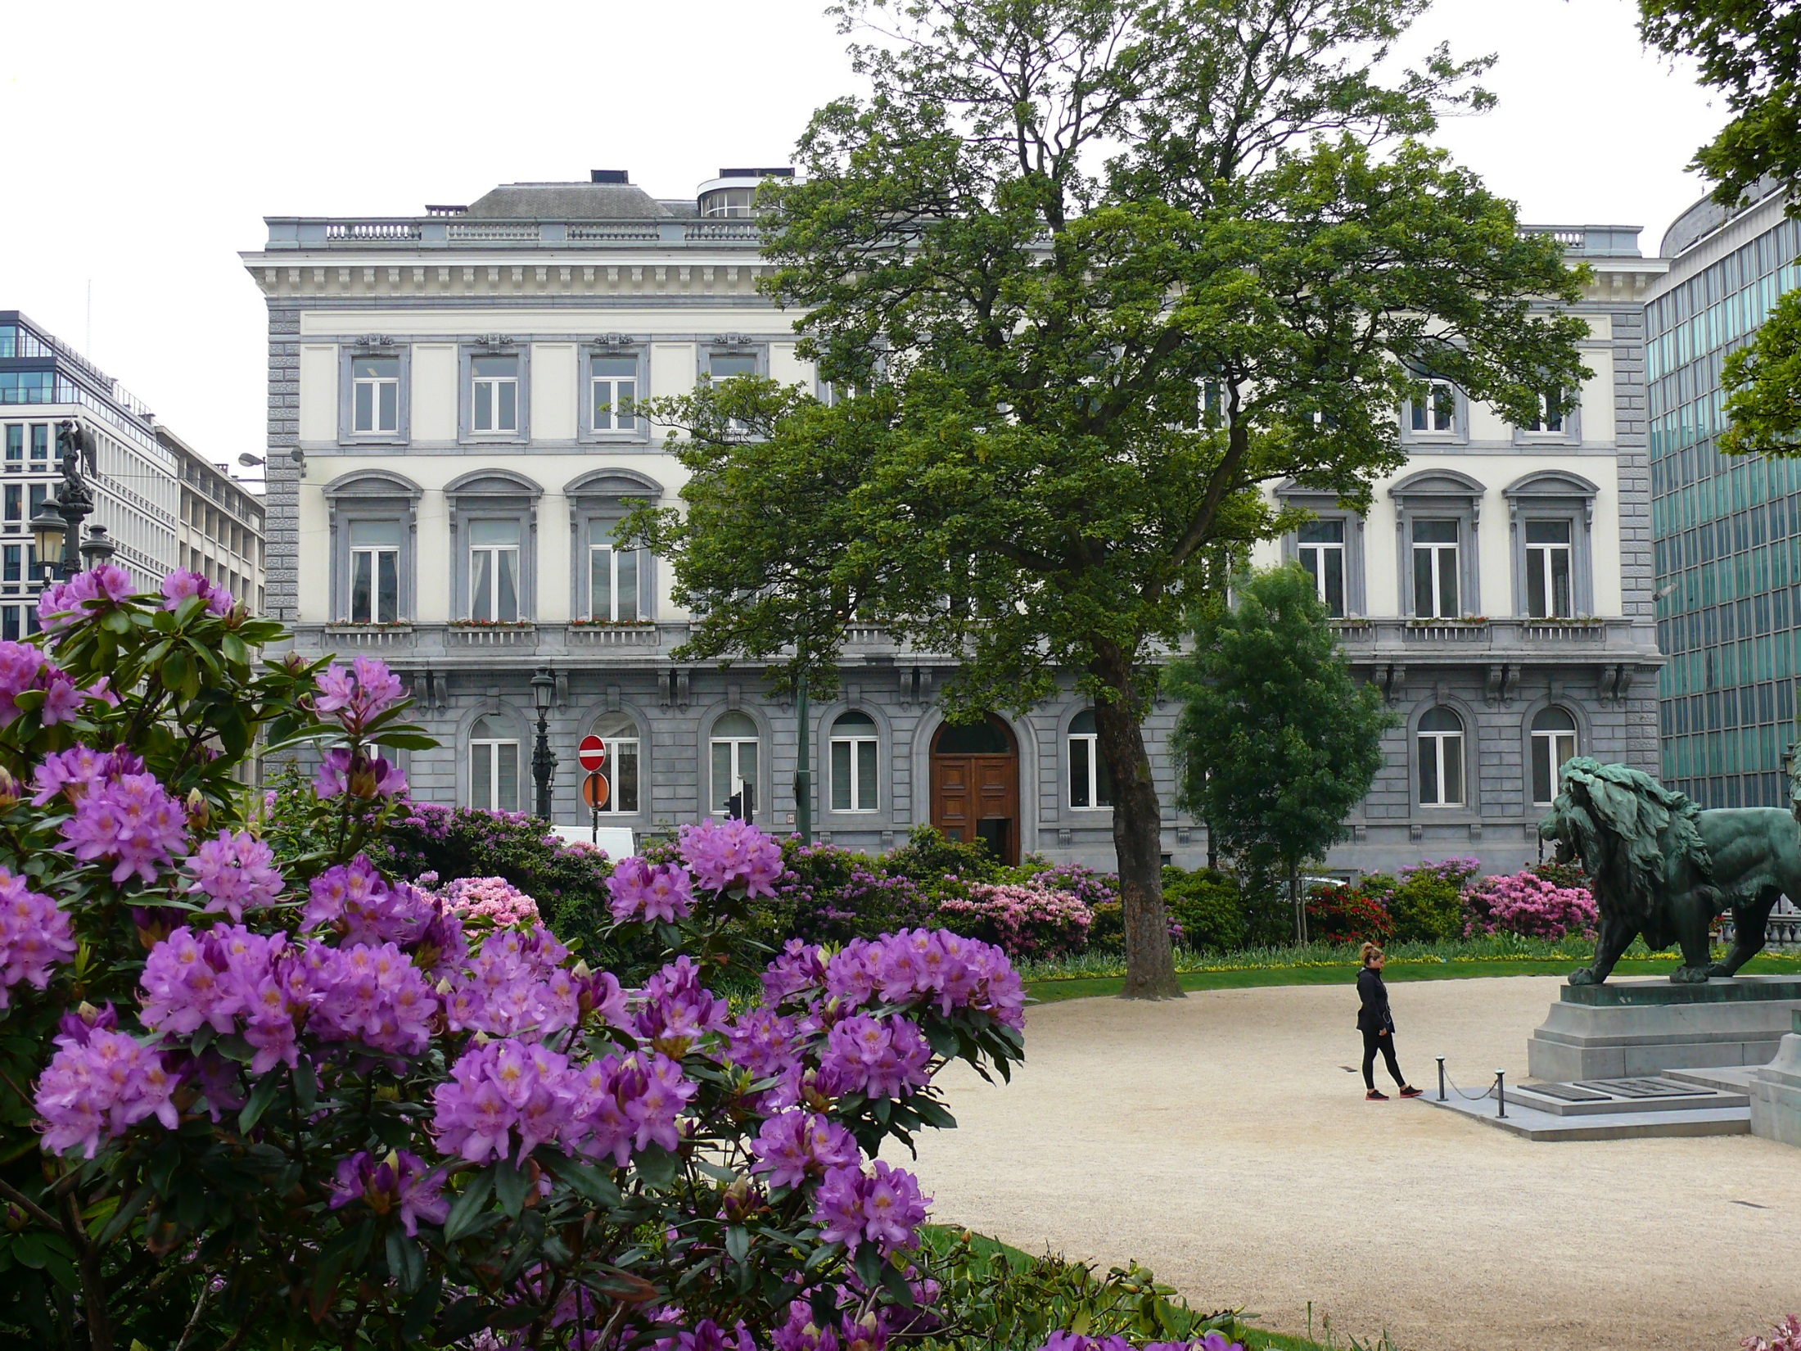
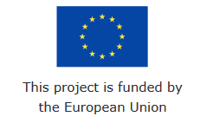
Enhancing Effectiveness of Social Dialogue Articulation in Europe (EESDA)
(with support from the European Commission Grant Agreement VS/2017/0434)
Mehtap Akgüç & Manon Jacquot
4th July 2019
Brussels
@CEPS_thinktank

Slide 2
Plan
Update on project status (M19)
Presentation of D2.1, discussion and revisions
Updates from country case studies
Estonia
France + Ireland
Portugal
Slovakia
Sweden
Lunch break
Final conference (agenda, keynote, participants)
Comparative report, policy briefs + additional dissemination tools
Lunchtime meetings + webinars

Slide 3
SESSION 1- Update on 2nd deliverable

Slide 4
D2.1 Stakeholders’ views on articulation and effectiveness of social dialogue
Long document with four main pillars:
Analysis of interviews with EU stakeholders (CEPS)
Analysis of EU-wide survey (CELSI)
Network analysis (Carl)
National inputs (all partners)
Coherence
How to make sure that different pieces fit together?
Emphasize the different layers of SD considered and how findings could be complementary or overlapping in some cases
Discussion & conclusions
Not a comparative report, but some elements of comparison would be useful – to be added
Highlighting the added-value (e.g. survey and empirical analysis, diversity of IR systems covered) and innovative parts (e.g. network analysis)

Slide 5
D2.1: EU stakeholders’ inputs (1)
We interviewed 5 employee organisations and 5 employers’ organisations at European level (including the peak-level 4 organisations)
All inputs are anonymized – comments welcome (warning that this section has already being largely revised after sharing with you!)

Slide 6
D2.1: EU stakeholders’ inputs (2)
Similarities with national analyses so far:
Employee organisations more engaged – collective action, dispute mechanisms
TUs favour binding outcomes more than non-binding ones; vice versa for employers’ organizations
Informal ties are being promoted – if not to set agenda or adapt priorities of organisations, at least to start having a dialogue, understanding the other side
Capacity building and funding issues highlighted
Differences with national analyses so far:
Topics of interest diverge : also a consequence of some of the topics addressed under national competence only
Employers’ organisations are less willing to participate in interviews at national level than European level

Slide 7
D2.1: Short national inputs – comments
Thank you all for your contributions
For balanced reading, we might need to cut down longer inputs – will check/coordinate with respective partner
Please revise the parts where you have received specific comment/question(s) in the document (still being revised, edited, formatted etc.)
For national inputs: we need to follow the headings as agreed in the last meeting and expand on those based on lit-rev + interview per country
Emphasize the inputs coming from first-phase interviews
Aim at finalization of the paper by mid July (1,5 month delay than planned)

Slide 8
SESSION 2:
Updates on country case studies

Slide 9
Case study: Ireland (1)
Initial challenges to get to conduct the interviews by distance
Outsourced it to an expert in Irish industrial relations
First-stage national interviews: 10/10 done
National input already integrated to D2.1
Second-stage sectoral interviews: ongoing
So far 5/16 done, at least 4 more planned for next week
Aim to finalize all by 3rd week of July

Slide 10
Case study: Ireland (2)
Social dialogue Ireland used to be very developed, based on a series of Social Partnership agreements
Big collapse of major industrial relations structures after the economic crisis of 2008-2009
Since then, things are never as before
Lack of interest in government to take much part in social dialogue at national level
Most of remaining social dialogue is happening at sectoral level, rather than at national level
One of the challenges: employers’ organisations are less willing to participate in interviews than TUs

Slide 11
Case study: Ireland (3)
Education sector :
National level SD with government to agree on “Public Service Agreements” (very formal structure)
Sectoral level (e.g. university teachers): more informal and irregular meetings with HR managers, individual universities and some group discussions – still effective
Effectiveness: media, going public, more political support, importance of informal ties (easier in a small country!)
Health sector :
Part of Public Service Agreement (signed between employers and govt)
Collective agreements are preferred to legislative changes (TU perspective)
Informal ties are important, but one needs to be clear with priorities (not to be diluted)
Construction sector :
Sectoral SD: a lot seems to be going on compared to other sectors, Sectoral Employment Orders (SEOs)
“Construction Safety Partnership” & “Safe pass” successful examples: TUs firm position to defend workers

Slide 12
Case study: France (1)
Challenges to reach out to social partners (7 out of 10 completed in the 1st phase!)
Reflecting on possible solutions, further chasing stakeholders (maybe also regional ones?)
Local support ?
Another challenge: unable to get the largest unions/employers’ associations to respond
Need to be precautious about the sample when drawing conclusions from interviews
Almost all of the social dialogue structures are described int the legislation and actors are formally recognized by state
Some of the first stage interviews were from construction sector -> some idea on one of the sectoral case studies

Slide 13
Case study: France (2)
Construction sector:
Employers’ perspective:
Topics interested: posting of workers, social dumping, health & safety, training
Negotiations on salary, working conditions – new reforms by Macron favoured by employers
Ask for more flexibility in work contracts
Preference for legislative changes, but more targeted ones than too general ones (e.g. failure in negotiations in unemployment insurance)

Slide 14
SESSION 3:
Final Conference organisation and dissemination activities

Slide 15
Next steps – Dissemination and communication
WP5: dissemination and communication
Final conference in Portugal (21 November 2019):
Organised by CCP with the collaboration of all partners
Budget:
CCP has budget for 15 guests +/-
All partners for 4p.
CCP has budget for leaflets and conference material (500 EUR) -> think about the information to be shared
+/- 2500EUR for the room&catering
+4500 EUR for interpretation (3 languages to be decided)

Slide 16
EESDA Final Conference
Deciding on the event structure?
Proposal: Project Presentation + Keynote + Panel discussion
Interaction with audience: instant polls, questions (e.g. slido)
Who to invite?
Keynote to be invited before mid-July
Suggested list for review
List of participants and save the date message to be sent early September
Target: min 30p. Including consortium members
With financial support
from the European Union

Slide 17
Next steps – Dissemination and communication
WP5: dissemination and communication
Webinars: all partners (until December 2019)
Ideally do them until final conference
Host webinars on a specific project topic – allocation among partners?
In English
Short videos (10 minutes); online/offline
Videos will be uploaded on the project website
Budget: 500 EUR
Lunchtime meetings: all partners (until December 2019, ideally in October)
Organize a series of events with 1-2 speakers to debate on a core topic of the project
Like a national workshop, in local language
Budget: 500 EUR

Slide 18
Next steps – Dissemination and communication
WP5: dissemination and communication
Other tools of dissemination
Publish research on project website
Submit to academic journals – internal discussion on interests
Leaflets to disseminate at final event*
One for network analysis + EU survey results
One per country
Attractive visualizations to distribute at final event – Marta’s contact

Slide 19
SESSION 4: Next steps and closing remarks

Slide 20
Next steps – research activities (1)
WP3: case studies
4 cases studies (1 case study per sector) for each country
4 interviews per sector and per country -> 16 interviews per country
Drafting the case studies per sector and country
Deliverables:
List of interviewed social partners and stakeholders for case studies (August 2019)
6 national reports presenting the 4 sectoral case studies (August 2019)
6 national policy briefs (English and national language) summarizing national reports (August 2019)

Slide 21
Next steps – research activities (2)
WP4: comparative research
Drafting comparative report and policy brief (CELSI with contributions from all partners)
Deliverable: Comparative report – October 2019
Comparative policy brief – October 2019
Policy recommendations (CEPS, with inputs from all partners)
Report presenting policy recommendations on SD articulation and effectiveness, future challenges – October 2019

Slide 22
Next steps – project management (1)
Reporting:
We are not spending enough
Spending review per partner/foreseen budget will be shared before mid-July
Networking days DG EMPL:
Emphasis on communication and dissemination activities
Logo changes will be distributed to all partners
Feeding the project website regularly is important

Slide 23
Next steps – project management (2) EESDA Final Report
Financial Report + Final Technical Implementation Report
60 days after the project end: 28 February 2020
EC has 60 days to approve: 30 April 2020
CEPS will pay the balance according to the final approvals from the EC:
Based on actual incurred costs!
Request for payment sent to CEPS (30 days for payment)

Slide 24
Final technical implementation report
Results: list the original goals and objectives of the action as set out in the grant agreement, and explain how they were met → CEPS will do this!
Summary of progress of the action: plan vs changes → all partners need to point out changes in plan (dates, methods, etc.)
Implemented: description of the activities + results → CEPS will ask for inputs if needed
Outcomes as lessons learned → Partners shall provide bullet points of main outcomes

Slide 25
Final technical implementation report
News or best practices → Partners should send a list (if applicable) of project best practices that can be used by others
Dissemination of findings → Partners shall provide description of the project impact at national level (events)
Send to CEPS: all articles or publications resulting from this projects → make sure to aknowledge EU funding + list of participants of all events

Slide 26
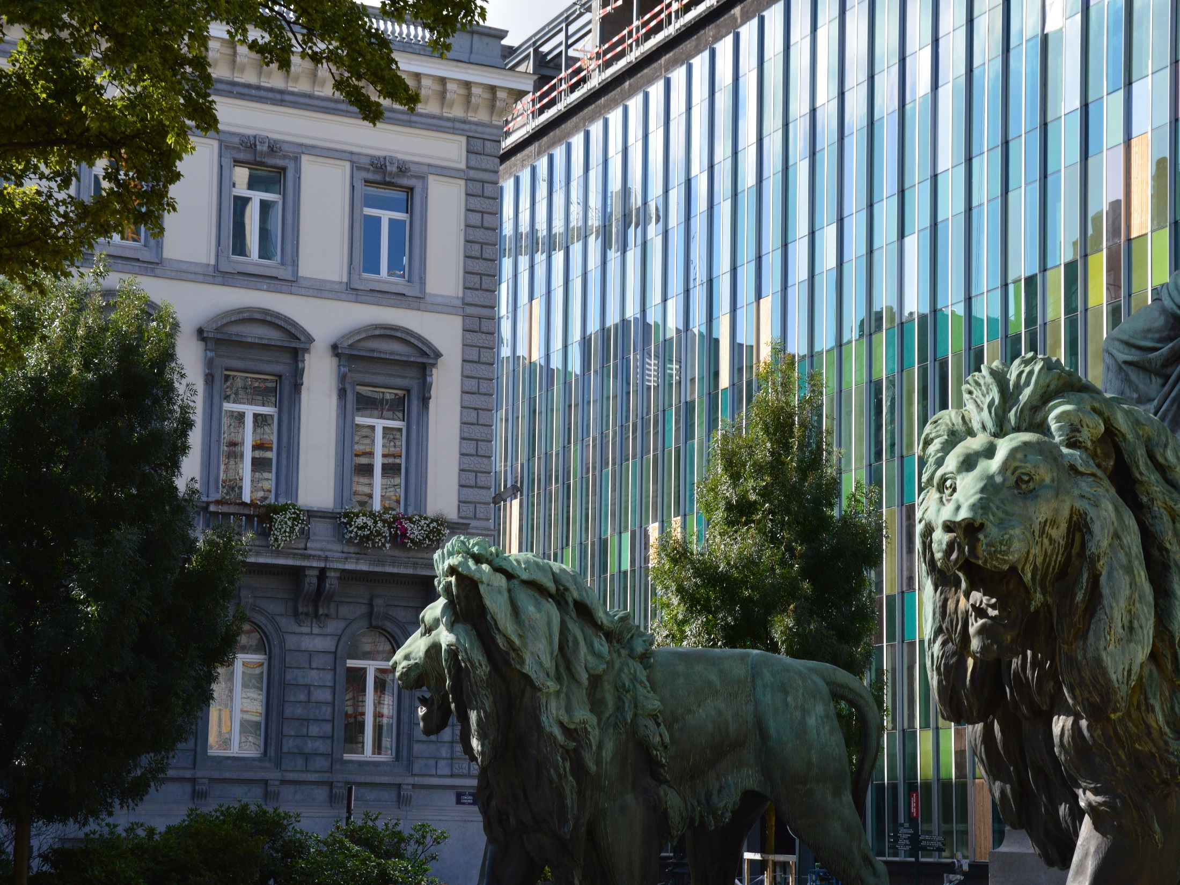
@CEPS_ThinkTank
info@ceps.eu
Thank you!
1 Place du Congres, 1000 Brussels
Tel: (+32 2)229 39 11

