Slide 1

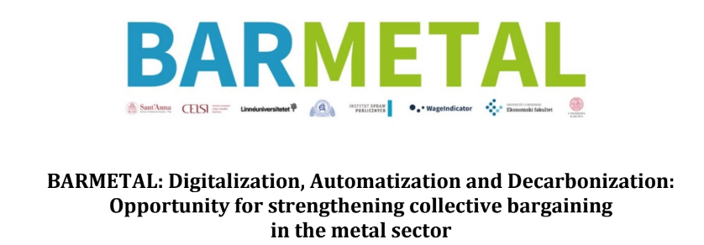
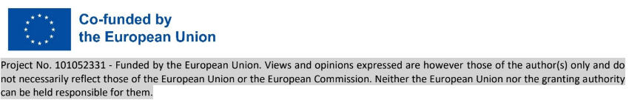
BARMETAL: Hungary
Research team: Tibor T. Meszmann, Pavol Bors
BARMETAL Mid-term workshop, December 1, 2023

Slide 2
Main features of industrial relations (in metal)
National level social dialogue – weak, in crisis (no c.b.!)
in manufacturing sectors: CBA and social dialogue decentralised to the company level
Weak employer organisations, union density rate 10%, competitive pluralism, coverage est. 20%
the role of the state via measures/programmes (nontransparent) + centralised national legislation and regulation have a decisive impact - special decrees on decarbonisation but also packages to attract/keep investment (direct/indirect financialisation)
=> affecting both the content and security of social dialogue and CBA on the company level
consultation/social dialogue regarding the introduction of new technologies:
in the domain of works councils and not trade unions - social dialogue and not collective bargaining.
works councils per se weak, only if trade union delegates present in WC
Collective agreements: outdated system of collection, do not have clauses on DAD introduced/amended

Slide 3
General developments in production, DAD in metal and coll. bargaining
High dependency on investments, a “roller-coaster” of manufacturing output (grew in 2022 compared to 2021, fell in 2023)
except OEM comparatively little new tech investment at existing plants (new shop)
Greenfield investments with newer technology/”green” products - but no union presence
Delay in overall tech (and productivity) development: “in the long term, it could threaten the low-skilled. Not for the time being, because for the time being there is only so much digitalisation and automation, as far as this will replace labour shortages, lack of labour” (ER)...
besides bottlenecks in investment/productivity also in skill formation for the new economy (large MNC centric s.f.)
Possible direction: huge company segmentation between top of chain companies, with high transformation (limited employment, high skill, high standards/productivity) and its (depressed) supplier ecosystem with low qualification requirements/high competition/high insecurity/flexibility
DAD: no or few mentions at highest level social dialogue body
no (at best a peripheral) issue in collective (wage) bargaining (agreements)
Collective wage bargaining dominant form: informed/pressed by investments/ costs (CO2 quota)
Green production/energy infra / if introduced, not as result of CBA or social dialogue (e.g. solar panels etc.)

Slide 4
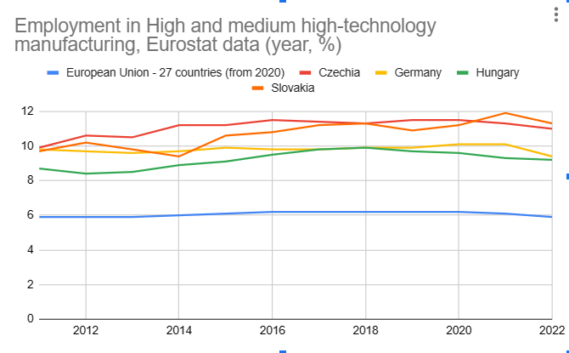

Slide 5
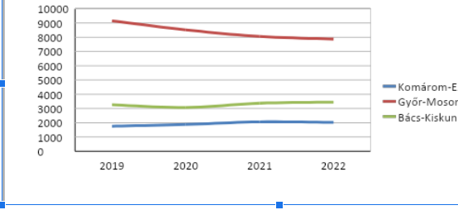
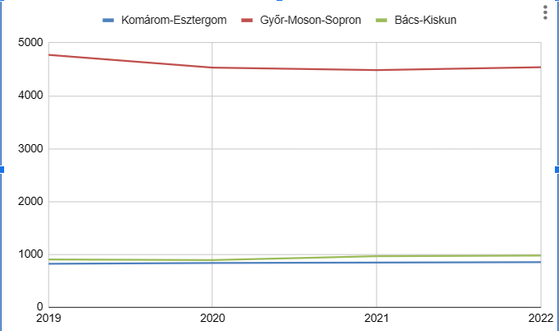
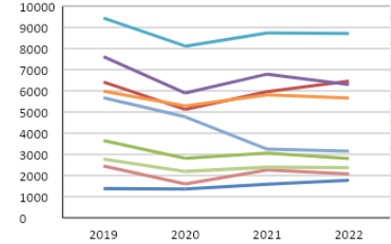
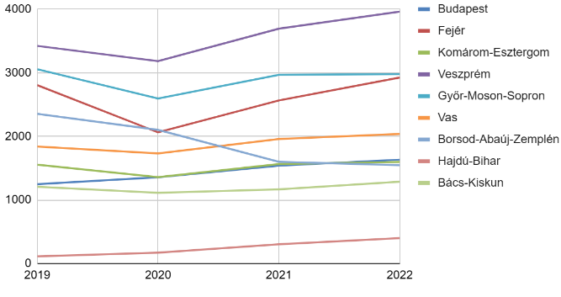
Average employment of white and blue collars at carmakers and automotive suppliers by cohorts of white and blue collar workers in selected NACE 3 regions (year, number of employees), data for 2022 first 3 quarters. Data source: Hungarian Statistical Office, own presentation
Blue collars at carmakers White collars at carmakers
white collars at suppliers
Blue collars at suppliers

Slide 6
Average employment of white and blue collars at carmakers and automotive suppliers by cohorts of white and blue collar workers in selected NACE 3 regions 2019-2022, Data source: Hungarian Statistical Office, own presentation

Slide 7
OEM level of DAD, changes in the past and planned
Body shop (Press)
Assembly shop
Paint shop
Starting level of digitalisation/automatisation - changes in last 10 years - planned changes (new product/production)
Employed 4600/TU1-3: 1200-460-50, WC election fail intermezzo (2021-2023), established IR, communication

Slide 8
OEM: changes on work and employment and CBA
overview of measures adopted in response to technological change,
(Preparation for) Tech change uneven - more dynamic at the level of high-skilled (R+D, production design)
Preparation for major change: Training at Leitwerke of selected crew, internal skill formation induced, functional flexiblity rewarded in assembly shop via working time arrangement (1 shift)
to what extent are these topics being integrated in collective bargaining
Topics emerge only indirectly shaping collective (wage) bargaining, associated with profit sharing (innovation share), employment security, career development, income levels, skill formation and (re)qualification
obstacles to bargaining
Limited, delayed information (also due to problems in works council elections)
management change, collective bargaining limited to wage and certain period (issue did not emerge till 2023)
Initiated changes to CBA - slow or no reaction from management
plans for expanding bargaining with these topics,
ongoing information sharing and social dialogue involving all employees (company communique November, December 4: extended union meeting )
alternative mechanisms of implementing the identified policies if bargaining is not a viable option, etc.
NA

Slide 9
Case 2(s) automotive subcontractors and basic metals
Overall regional representative and interviews with unions/workers at 5 (4) companies
Most significant changes in recent years in DA: logistics - work processes and jobs in Dc: basic metals
Insecurities dominate: Ownership change/financialisation OR dependency on headquarters (limited investment or transfer of production technology) OR Dependency on contractors (loss of tender - huge competition in logistics)
Issues (for individual/collective bargaining): solving internal training / requalification (part of working time?), skill formation, turnover
Most acute financialisation pressure due to decarbonisation: basic metal - iron (Case 2)
Bankruptcy - privatisation measures - recent special legislation
Plans to start production based on new green technology
Problems of skills: in the years of insecurities the most skilled highest tendency to leave
Cooperation with new owners on promising path
Collective bargaining and collective bargaining agreement at the table

