Slide 1


Smart bargaining in the services sector: overview, challenges, opportunities
(second meeting )
7 May 2024
Funded by the European Union, 101126532

Slide 2
Agenda
Update in the BARSERVICE team and mailing list (Marta)
Proposed approach to the conceptual framework on 'smart bargaining' (Marta)
Preliminary idea for a data grid (unions, bargaining level, coverage, etc.) and interview guidelines (Marta)
Update on progress with the collection of collective agreements (Gabriele/Dani/Fiona)
Agreeing on dates of upcoming regular project meetings (everyone)
Other issues
Funded by the European Union, 101126532

Slide 3
Conceptual work
Smart bargaining
Inductive approach instead of a deductive approach
Conceptualize ‘smart bargaining’ only after interviews
Formal change of D1.1 (due June 30, 2024)
Funded by the European Union, 101126532

Slide 4
Data grid
Define variables to include for each sector
Unions and employers associations
Union density
EO density
Bargaining coverage
Bargaining level
Funded by the European Union, 101126532

Slide 5
Draft interview guideline
Funded by the European Union, 101126532

Slide 6
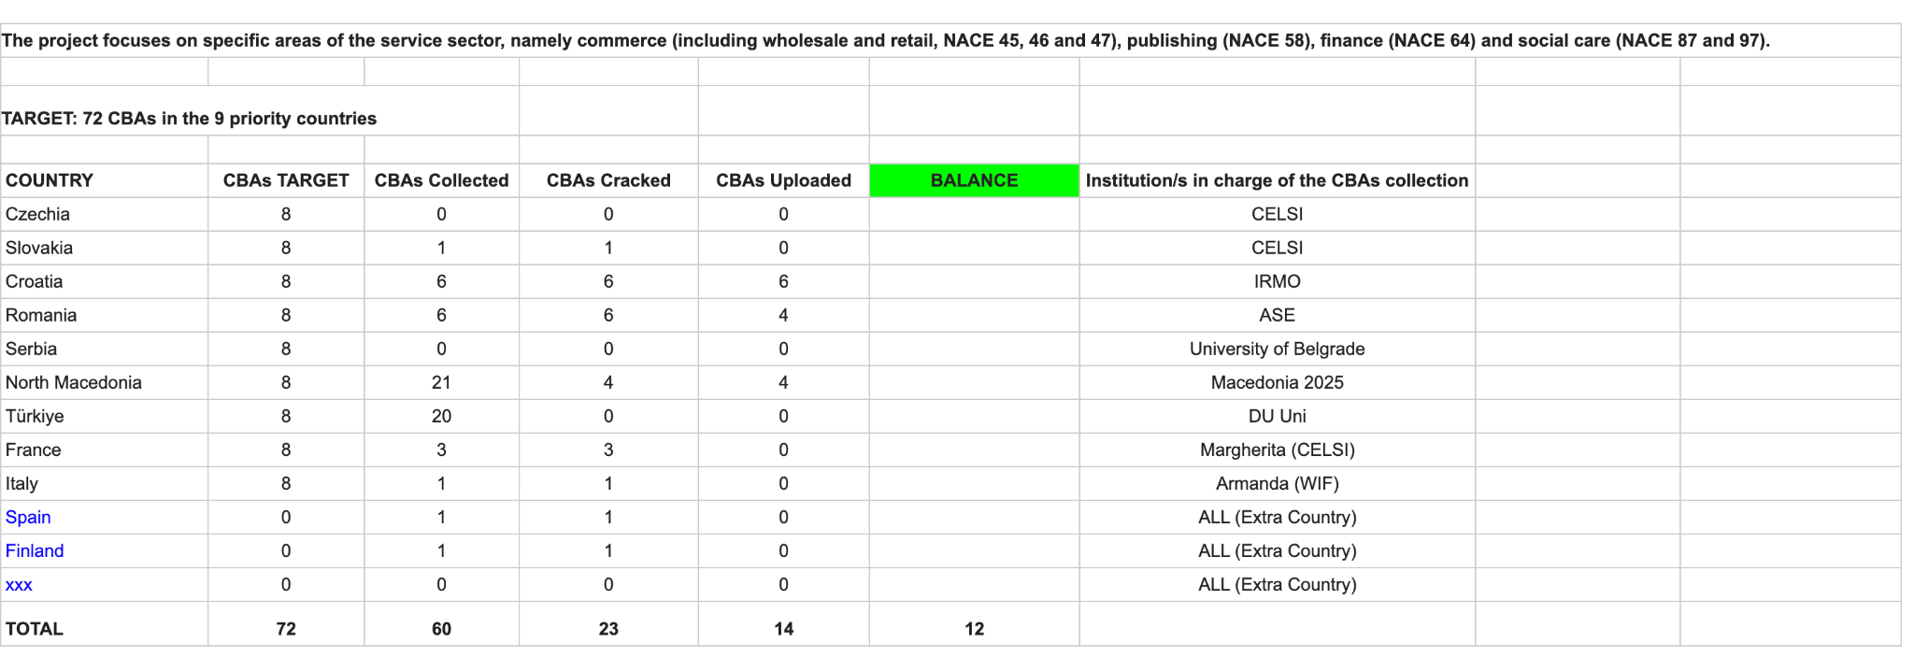
CBA collection progress
Funded by the European Union, 101126532

Slide 7
Next project meetings
Other issues
Funded by the European Union, 101126532

Slide 8
Methodology
Data Collection:
Desk research (academic literature, media, newsletters, policy reports, social partner documents)
Interviews in 9 countries (at least 15 per country)
Collective agreements – 72 (8 per country, 2 per subsector per country), sector, multi-employer or single-employer, up to 100 also from other countries
Data Analysis:
Framework: power resources, actor-centered institutionalism, the concept of ‘smart bargaining’
Interview text analysis – coding (?)
CBA analysis – existing stipulations on a set of variables, comparative analysis across 9 countries
Comparative analysis of all country cases (9+3)
Data Dissemination:
Website, social media
Three mutual learning events, one final conference
Academic publications

Slide 9
Work packages
WP1: Conceptual and analytical framework on the service sector in a comparative
perspective (M1-6), CELSI
WP2: Understanding the challenges in the services sector (M7-12), CELSI and UNI Europa
WP3: Analysing and comparing collective agreements in the services sector (M5-20), WIF
WP4: Tackling undeclared work in the services sector (M7-18), CELSI
WP5: Building capacity for collective bargaining (M8-20), UNI Europa
WP6: Dissemination of findings, policy recommendations and overall results (M12-23), WIF
WP7: Project management and quality assurance (M1-24), CELSI and external evaluator

Slide 10
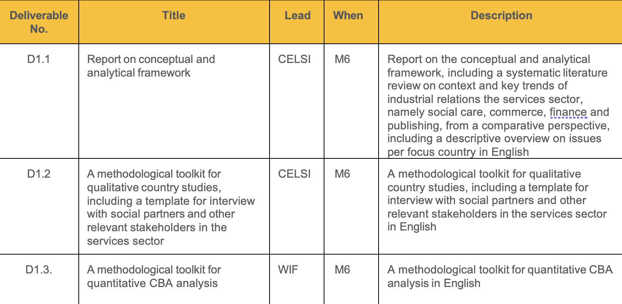
Deliverables1

Slide 11
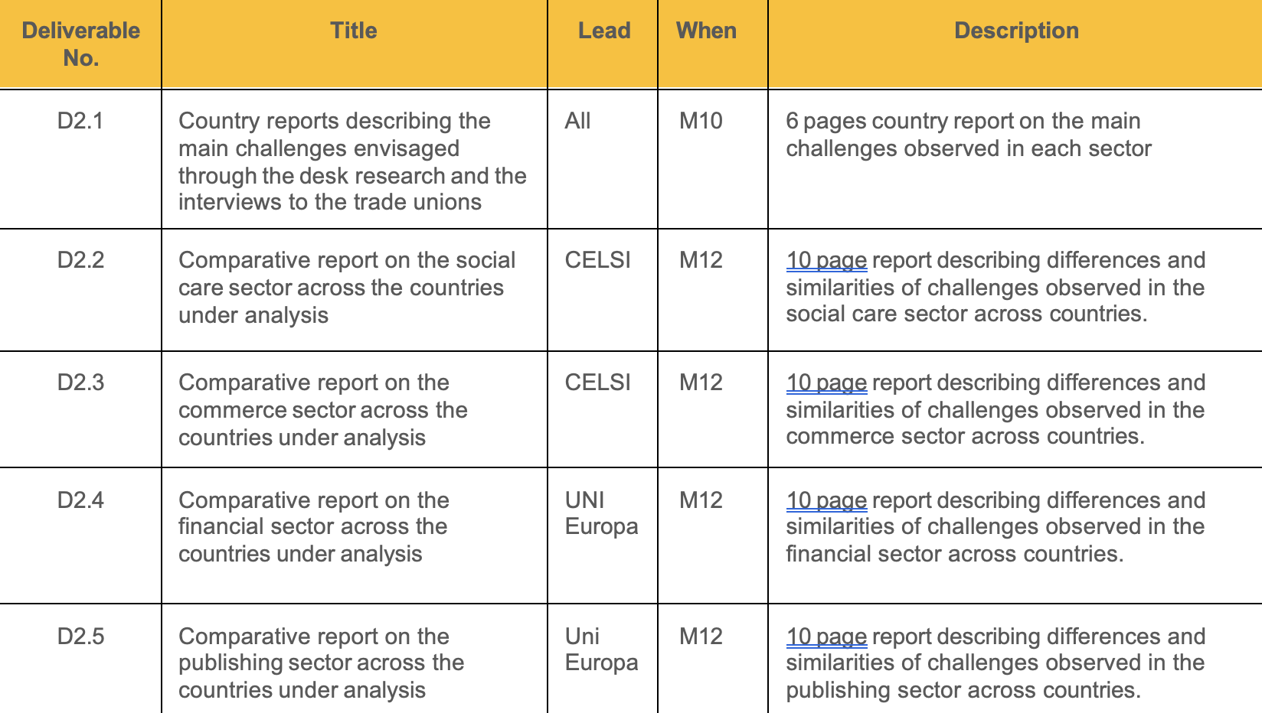
Deliverables2

Slide 12
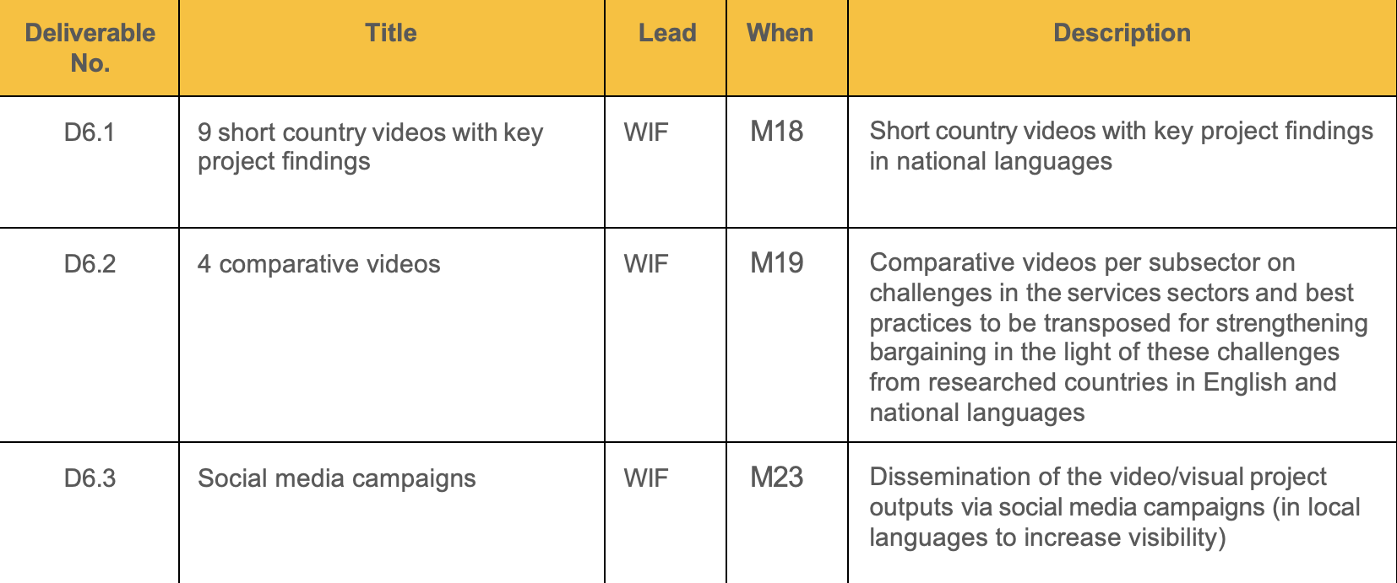
Deliverables 6

Slide 13

Thank you all!

