Slide 1


Smart bargaining in the services sector: overview, challenges, opportunities (BARSERVICE)
Funded by the European Union, 101126532
Kick off meeting BARSERVICE, 8-9.2.2024, University of Belgrade and online

Slide 2
Programme
Day 1: Thursday, February 8
13:00 – 13:15 Welcome by the organizers and the project coordinator, tour de table
Galjina Ognjanov and Marta Kahancová
13:15 – 14:15 Introduction of the BARSERVICE project: research questions, aims, framework,
methodology
Marta Kahancová, project coordinator
14:15 – 14:45 Coffee break
14:45 – 15:30 State of the art: the service sector across the studied countries
15:30 – 17:30 Work packages
17:30 – 18:00 Discussion on any outstanding issues on the project content
18.00 End of the meeting Day 1
Funded by the European Union, 101126532

Slide 3
Programme
Day 2: Friday, February 9
09:00 – 10:00 Practical project management (timeline, deadlines, consortium meetings, sharing files
and data, division of tasks etc.)
10:00 – 10:30 Ethical issues and communication
10:30 – 10:45 Coffee break
10:45 – 11:30 Project administration and reporting
Soňa Polakovič, CELSI project officer (on zoom)
11:30 – 12.30 Discussion (including any outstanding issues) and closing remarks
12:30 End of the meeting
Funded by the European Union, 101126532

Slide 4
Introduction of the project
Research
Understanding current bargaining practices, structure and power relations between unions and employers, the effective coverage of collective agreements, and the content of collective agreements
Identify where undeclared work in services is located and strategies to mitigate it
Mapping challenges and opportunities for smart bargaining
Funded by the European Union, 101126532

Slide 5
Introduction of the project
Capacity building
Support collective bargaining in the services sector
mutual exchange, co-creation and interactive learning for social partners in countries where bargaining in services needs to be enhanced and strengthened
Funded by the European Union, 101126532

Slide 6
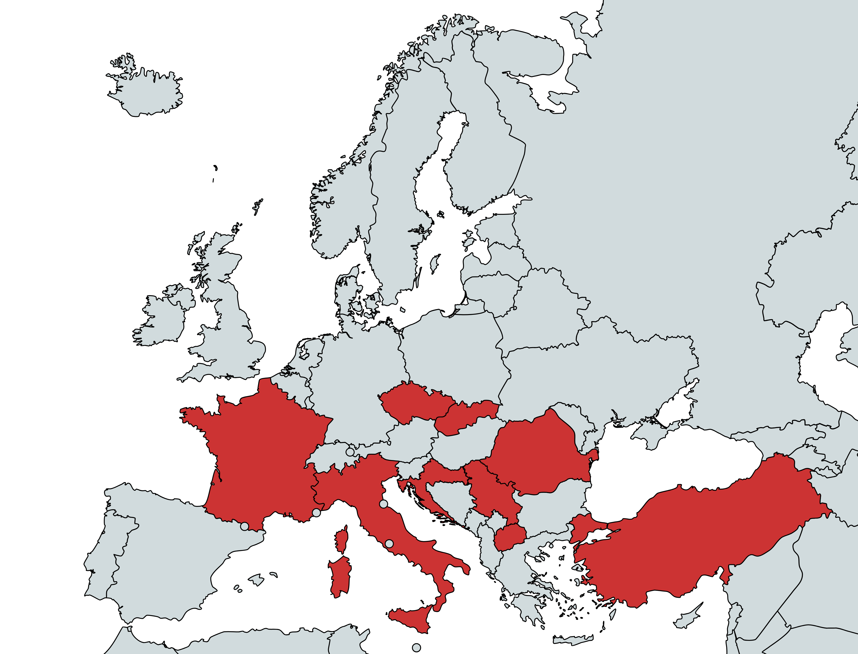
Countries
Funded by the European Union, 101126532

Slide 7
Subsectors
Commerce
(retail and wholesale, NACE 45, 46 and 47)
Publishing (NACE 58)
Finance (NACE 64)
Social care (NACE 87, 97)
Funded by the European Union, 101126532

Slide 8
Research questions
RQ1: What are the fundamental characteristics of economic structures, work, social dialogue and collective bargaining in the services sector across 9 countries?
Subquestions to RQ1:
Which are the economic characteristics and recent trends of the studied subsectors - social care, finance, commerce and publishing?
How is the employment structure divided in terms of jobs and skills?
What is the workforce composition in terms of gender, age and geographical origin?
Which are the working conditions and wage levels in the different sectors and countries?
Who are the main actors in the sectors and what role do they play in industrial relations?
What are the power relations between social actors?
Which are the most important levels of negotiation in the different countries (i.e. firm-level, sectoral level, national level)?

Slide 9
Research questions
RQ2: What are the common and different challenges for trade union organising and employer organising in the service sector in 9 countries?
Subquestions to RQ2:
What are the similarities and differences across the service sectors in each country and within the same sector across countries when it comes to the main challenges (deregulation, gender segregation, lack of workers’ rights and digitalization)?
Are there specific challenges related to vulnerable groups (women, young and migrant workers) and how are various stakeholders and policies responding to these challenges?
What is the role played by institutions and public procurement in addressing these issues?
Which are the main opportunities and risks that emerged after the explosion of the pandemic?

Slide 10
Research questions
RQ3: What do existing collective agreements in the service sector stipulate and is their content similar across subsectors and countries?
Additional questions to RQ3:
What explains the differences found in CBA content?
What is the current scope of industrial relations and collective bargaining agreements across selected sectors and countries?

Slide 11
Research questions
RQ4: What are the specific challenges related to undeclared work in some subsectors of the service sector?
Subquestions to RQ4:
What are the challenges specific for vulnerable groups such as migrant workers, youth and female workers that fall out of bargaining scope and legal employment?
How do the different actors such as enforcement authorities, labour inspectors and social partners address and view these challenges and how do they aim to address these?
Which empirical and methodological tools could be adopted by trade unions in order to better prevent and deter undeclared and under-declared work in services?

Slide 12
Research questions
RQ5: What can trade unions and employers learn from the analysis to develop their capacity for collective bargaining?
How can they address identified challenges and overcome obstacles to reaching a higher bargaining coverage?
How can trade unions design strategies to engage with employers and their associations?
What are common grounds for social dialogue?
How can institutional obstacles be overcome to engage in multi-employer bargaining?

Slide 13
Research questions
RQ5: What can trade unions and employers learn from the analysis to develop their capacity for collective bargaining?
Is it possible to identify national good practices of industrial relations and collective bargaining?
Is it possible to favour mutual learning and cooperation among trade unions operating in the same sectors in different countries? How can EU level sectoral social partners develop innovative communication strategies vis-a-vis their affiliates to support organising, strengthening bargaining and bargaining coverage? How do EU-level social partners and national partners support bargaining power, and how can they work together?

Slide 14
Research questions
RQ6: How do institutional and structural differences in labour markets and industrial relations across the studied countries explain similarities and differences in social actors’ strategies vis-a- vis collective bargaining?

Slide 15
Project objectives
State of the art on key trends and deregulation of the labour market in the services sector
Understand the impact of these on working conditions, wages and type of jobs, gender and immigrant segregation, diffusion of undeclared, informal jobs or fictitious self-employment, digitalisation and scarce coverage of collective bargaining and low rate of unionisation in the service sector.
Analyse how the key challenges related to the deregulation of the labour market explain reasons for scarce coverage of collective bargaining and low rate of unionisation in the service sector (up to 15 interviews per country, 9 policy papers and 9 country-specific factsheets, 1 comparative paper)
Compile and analyse a coded, electronic database of 72 collective agreements in the services sector, specifically for social care, publishing, finance and commerce, and analyse what stipulations they include
Identify opportunities for strengthening collective bargaining via mutual learning events, a written learning resources toolkit for social partners’ action and a final conference)

Slide 16
Methodology
Data Collection:
Desk research (academic literature, media, newsletters, policy reports, social partner documents)
Interviews in 9 countries (at least 15 per country)
Collective agreements – 72 (8 per country, 2 per subsector per country), sector, multi-employer or single-employer, up to 100 also from other countries
Data Analysis:
Framework: power resources, actor-centered institutionalism, the concept of ‘smart bargaining’
Interview text analysis – coding (?)
CBA analysis – existing stipulations on a set of variables, comparative analysis across 9 countries
Comparative analysis of all country cases (9+3)
Data Dissemination:
Website, social media
Three mutual learning events, one final conference
Academic publications

Slide 17
Work packages
WP1: Conceptual and analytical framework on the service sector in a comparative
perspective (M1-6), CELSI
WP2: Understanding the challenges in the services sector (M7-12), CELSI and UNI Europa
WP3: Analysing and comparing collective agreements in the services sector (M5-20), WIF
WP4: Tackling undeclared work in the services sector (M7-18), CELSI
WP5: Building capacity for collective bargaining (M8-20), UNI Europa
WP6: Dissemination of findings, policy recommendations and overall results (M12-23), WIF
WP7: Project management and quality assurance (M1-24), CELSI and external evaluator

Slide 18
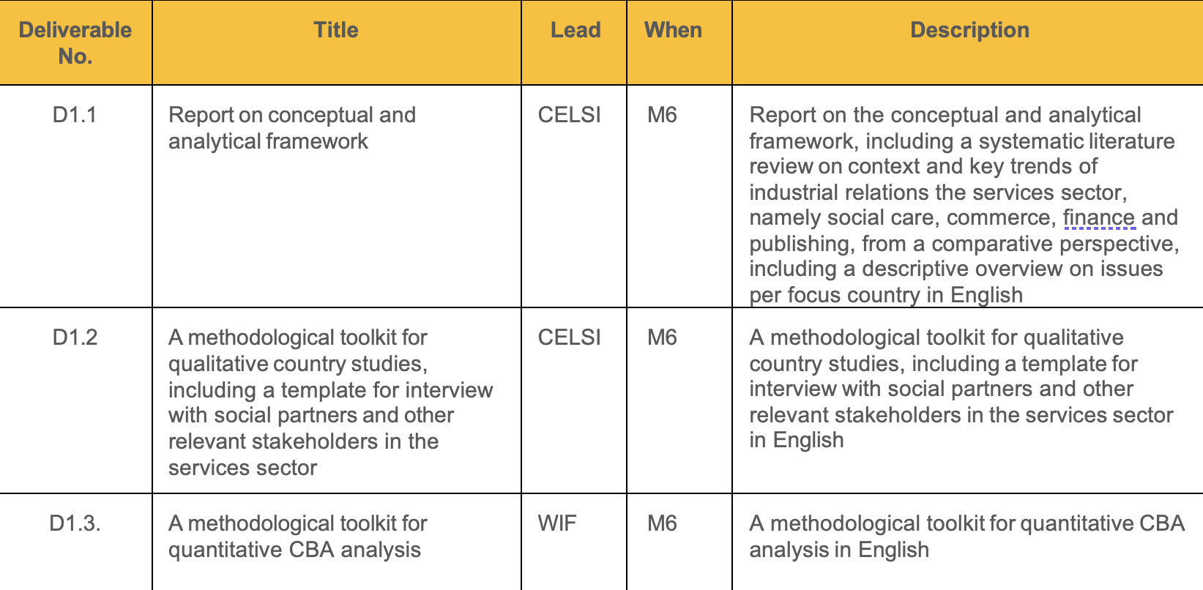
Deliverables1

Slide 19
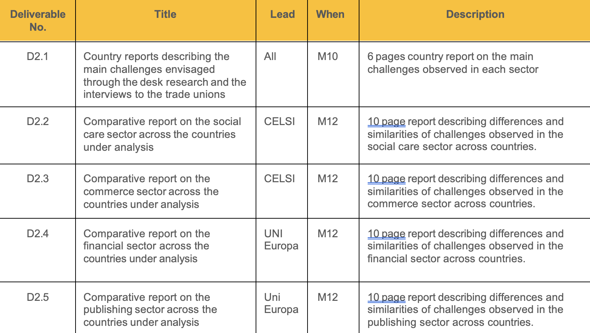
Deliverables2

Slide 20
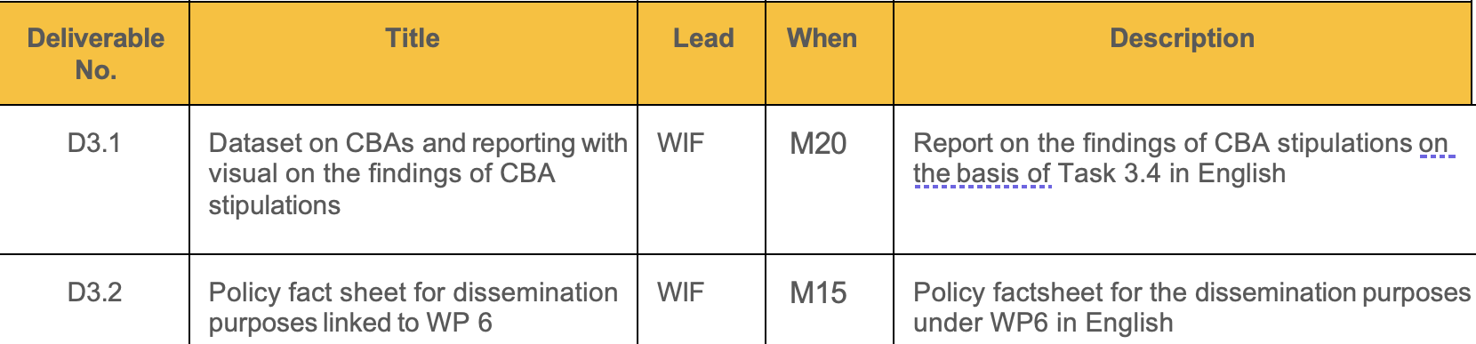
Deliverables3

Slide 21
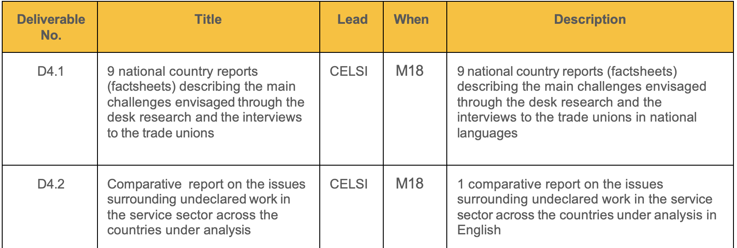
Deliverables 4

Slide 22
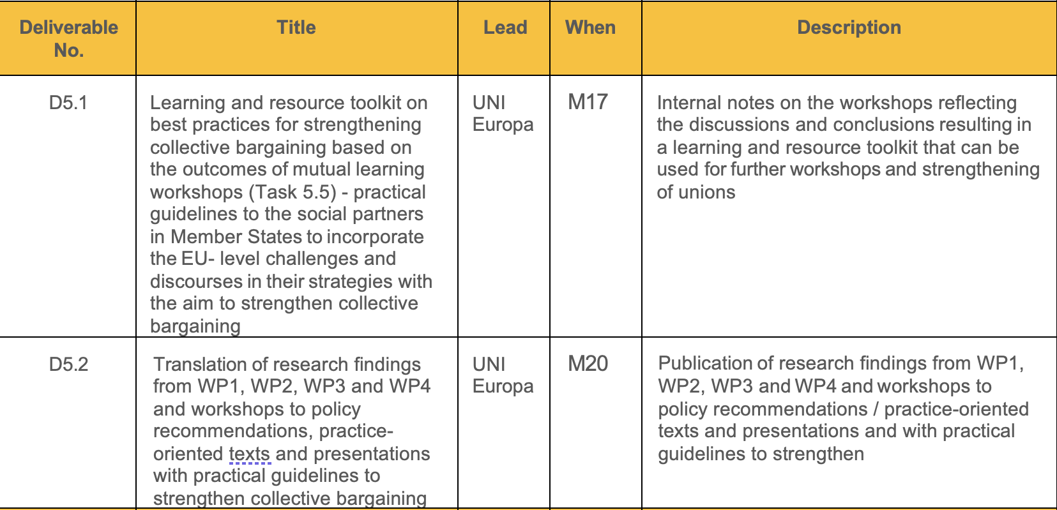
Deliverables 5

Slide 23
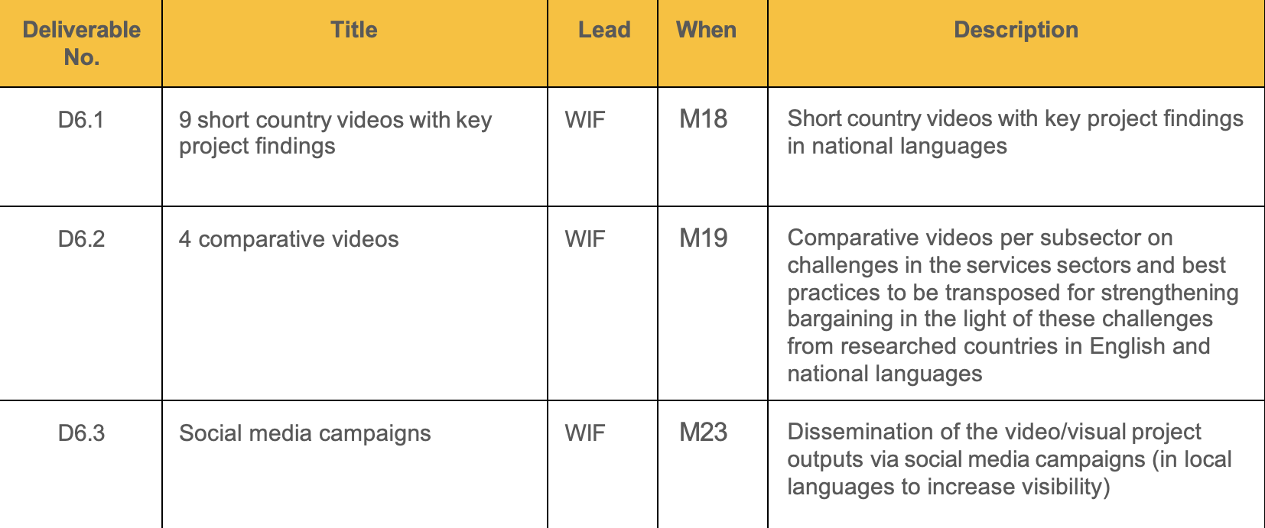
Deliverables 6

Slide 24
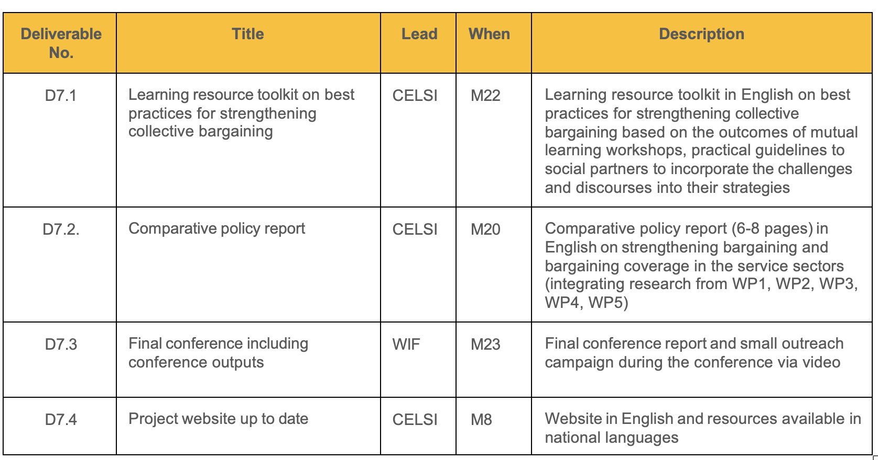
Deliverables 7

Slide 25

Thank you all!

Slide 26
Coordination - Division of tasks
CELSI coordinates (research and administration)
All partners responsible for the national cases & reguired collaboration for the comparative cases & dissemination

Slide 27
Ethical issues and communication
Ethical committee clearance - needed for interviews (and publishing)?
Does this suffice for all partner institutions?

Slide 28
The ethical committee requires the following documents
Cover letter. Justification for the request for an opinion and contact details of the person responsible for the study and the signature of the investigator-in-charge.
Rationale for a Research Ethics Request Form. An example of the Research Ethics Request Basis Form is available online.
Research plan and its summary. In the case of an English-language study, the abstract must be submitted in Finnish or Swedish.
Evaluation of the ethics of the research by the person responsible for the research
Notice to subjects. If the study deviates from the principle of informed consent, the reasons for the decision shall be set out in the evaluation of the ethics of the study.
Consent form to be signed by the subjects. A consent form is required in addition to the bulletin if the research material is analyzed in an identifiable manner and the material contains sensitive information.
Other material to be provided to subjects. For example, interview frame, diaries, questionnaires.
Material Management Plan. Material processing, storage and archiving plan.
Scientific Research Privacy Statement. Required as an annex to the request for an opinion, if the investigation collects any personal data and if identification is possible, for example by combining the data.

Slide 29
Communication
Dropbox? Teams? Moodle?
Monthly meetings (a regular time to be discussed)

Slide 30
Discussion
Next meetings – Month 6, Month 12 (draft findings), Month 15, Month 23 final conference
Online storage for files
Tasks for the coming months

Slide 31
Thank you all!

