Slide 1
Barmetal national report – Denmark
Bengt Larsson
Lars Graadal

Slide 2
Danish Labour market/ industrial relations
Denmark is a small open economy dependent on exporting industries. Many more small companies than SE: Pharmacy, machineries and food products are large sectors, metal is moderate and automotive is small (in the semi-periphery of Eur automotive ind (Pavlinek 2021)). Around 10-11 % of Danish employees are in manufacturing (incl. mining), which is close to the EU-27 mean
Industrial relations is characterized by strong trade unions and employer associations negotiating collective agreements at sectoral level with adj locally - a high degree of autonomy from the state (some tripartite corporatism in employment policies and vocational training).
TU density is 63% overall (58% in blue collar/private) – some ”yellow unions”. Collective bargaining coverage overall is 82% (priv sector 73%), appr 52% of enterprises have local union reps (single channel).
There is a large welfare state based on social democratic traditions, however, as in other Nordic countries Denmark have seen the introduction of more liberal features, ”flexicurity”, ie. Easy to hire/fire, but generous benefits/access to education for unemployed.
Danis trade unions are strong and are by tradition on an organized primarily on an occupational/industry basis, and previously three class-based confederations – but Blue and white collar confederations merged in 2019 into FH/Danish TU conf.

Slide 3
National policies and the role of social dialogue
for shaping DAD policies
There is a very strong political and social partner commitment from Danish employers and unions regarding digitalization/automation, and also strong decarbonization ambitions → to stay ahead in development and stay competitive
General and sectoral collective agreements do not specifically regulate DAD issues, but, aspects such as further education/training, and H&S of course relates to this.
Partners have agreed to cooperate on ed/training, and have a joint Technology and cooperation committee, to
”follow the technological development and support information, guidance and development work to promote cooperation in the companies, including the use of new technology” (2020-23)
“green transition is a central theme for TEKSAM in the coming years (2020-23)

Slide 4
Sectoral relevance of DAD –
which challenges does it pose to the sector?
Both employers and unions have much consensus in that they advocate further digitalization, automation, and decarbonization to keep up with international competition and save jobs.
Compared to Sweden there seems to be less discussion of risks for employees/jobs in by Danish TUS – very strong focus on automation and robotization to – but rather that this may both bring plants home to Denmark and improve working conditions (reduce heavy and monotonous tasks.
Green transition is also seen as a means to create jobs and improve Danish industries competitiveness – and it is very much seen as part of the digitalization development
I.e. joint social partner cooperation on DAD is thought to benefit both companies, and employees and strengthen Danish economic development – the Challenge is mostly framed as not losing their leading position.

Slide 5
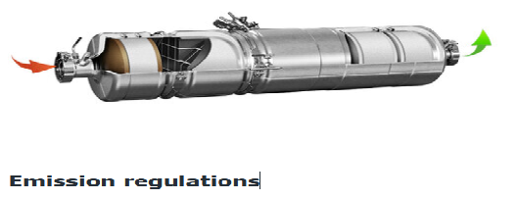
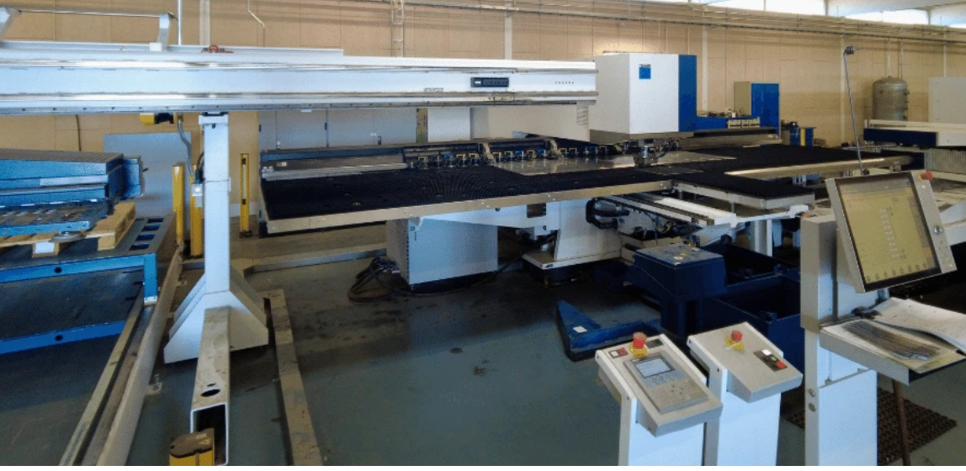
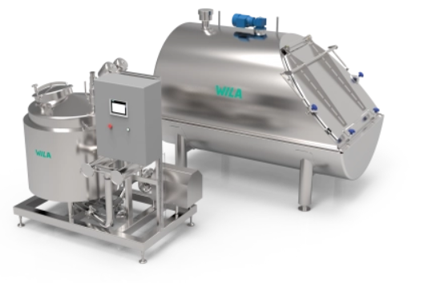
CASE STUDIES
Three company case studies and an additional interview with EO at sectoral level were used for the analysis.
Company 1: DINEX, produces catalysts for combustion engines, with appr. 2000 employees. (highly automated) Interviews with HR-manager, sustainability manager, shop floor worker
Company 2. TRECO produces various things from atomated luggage screening systems, to box systems for parcels. Appr 400 employees in four plants. Interviews with HR-manager, Technical prod-Manager two shop stewards and a shop floor worker.
Company 3. WILA, produces steel equipment for food industries. (the least automated comp). Appr 100 employees. Interviews with Int CFO, HR-manager, shop steward and shop floor worker.

Slide 6
Company-level case studies: DA
All three companies digital technology in the adm. systems such as finances, HR, and enterprise resource planning systems, ERP systems, as well simple automation (Robotics/CNC machines) in production.
The two larger have digitalized customer relations, and more advanced robots, and both aim for (AI-based) automation for the future
Main reasons for new technologies are straightforward: with increasing productivity, cost efficiency and expand businesses.. Robots/automation is also to increase quality, and improve production flow – and replace/release workers from monotonous tasks
Additional ”driving forces” are requirements from customers, and in “lower-level bottom-up improvements” suggestions from the employees.
Only in the largest company did local TU have any consultative role: BUT employees had some influece on implementation – because of experiences of failed implementation when that was not the case
Just as on sectoral level, local level TU reps seem to agree on the need for automation
Further education/training is the big local issue: The send out their own knowledgeable workers, bring in education from the supplier of technology and one company finance external further education for 12 employees/year too “top up” their education/training as blacksmiths/technicians etc.

Slide 7
Company-level case studies: Decarbonization
Decarbonization is less developed in the companies The largest one (#1) has a formal sustainability policy since 2021. The smallest started its journey by completing its first Climate Report two weeks prior to the interview.
The companies are still only in their start-up process in relation to decarbonization, but:
Company #1 producing catalyst have started producing a Fuel cell – to adapt to the decarbonization of vehicles.
Company #2, introduction of new more energy effective machinery and a planned installation of solar cells later this year
Company #3, have started to discuss both now machinery and solar cells.

