Slide 1
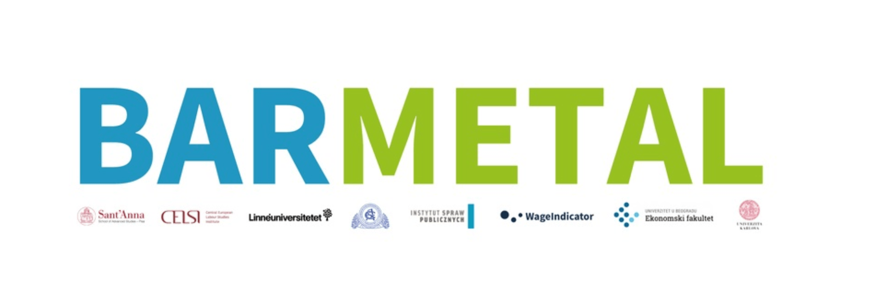

Country Report Germany
Barmetal
Mid-term conference, Monday 25 March 2024, Scuola Superiore Sant’Anna PISA
Gerhard Bosch, IAQ University Duisburg-Essen

Slide 2
Employment and Industrial Relations
Industry's share of GVA (with 24%) in Germany higher than in most other industrialised countries (USA 14%, FR 13.3%, IT 20.5%, UK 13.4%, Japan 23.4%)
Metal industry with 3.934 million employees (2022) largest sector: share of GVA 15.2%.
Metal-industry - predominantly qualified workforce: 66,4% skilled, 10,5% unskilled, 18.4% tertiary education – skilled means 3 year standardized vocational apprenticeships
Decrease of the coverage by collective agreements in DE and trade union density, less in the metal industry. Institutional power through co-determination
Industry wide CA’s in the metal industry – strong coordination and enforcement of CA’s through omnipresent works councillors (except SME’s)
Indicators of collective bargaining policy in Germany and in the metal industry in per cent (2019 - 2022)
 | Trade union density | Employer’s density | Coverage byCA’s | Bargaining levels
Metal-industry | approx. 40,0 | 46,6% (62,9%) * | approx. 64,0 | Sectoral, company, plant
Overall economy | 16,3 | 67,9 | 49,0 | Sectoral, company. plant
*With collective bargaining coverage in brackets including companies without collective bargaining coverage

Slide 3
Digitalisation and Decarbonisation
The social dialogue in national discourses
Term Industry 4.0 invented by German industry to focus on a common goal
Unions represented in the Industry 4.0 platform at the Federal Ministry of Economics, the Coal Commission, the National Hydrogen Council and the Committee for the Future Fund for the Automotive Industry.
Broad agenda in these commissions: Training and retraining, technical projects, the socially responsible phase-out of lignite by 2038, financing of regional transformation networks with up to € 200 million. Transformation networks have now been established in 27 automotive regions, 25 of which were initiated by IG Metall locals
Social partners decide on the occupational curricula in the dual apprenticeship system: Last reform of the metal occupations in 2018 included an update of the content about Industry 4.0. Next reform in work: (Company case studies in the evaluation of the reform show that the tasks of skilled workers are rarely characterised solely by metalworking, electrical engineering or information technology. The authors therefore propose the development of a new qualification profile focussing on industrial mechatronics).
Paradigm shift in national labour market policy from Work-First to Train-First: At the initiative of IG Metall, a training allowance was introduced for companies in which more than 20% of employees require further training due to the transformation.

Slide 4
Role of collective bargaining
The protection of employees against the risks of structural change through industry-wide collective bargaining has a long tradition
In the 1960s and 1970s CA’s on rationalisation protection, which gave priority to internal transfers and further training over redundancies
Since the 1990`s following the Volkswagen example all regional collective agreements in the metal industry allow for temporary reductions in working hours to 30 hrs per week
Since the early 2000’s agreements on individual entitlement to an annual qualification discussion with the line manager, in which the level of qualification and necessary further training measures are recorded – evaluation shows low effects
Between 2004 and 2020 dominantly use of opening clauses: in exchange for location or investment commitments and a waiver of compulsory redundancies longer working hrs and lower wages
Since 2016 experimental trade union projects to get out of the defensive situation and to develop strategic competence in the design of DAD
2021 IG Metall succeeded in negotiating framework collective agreements in all regions for the agreement of company future oriented CA’s

Slide 5
Future oriented collective agreements (FOCA)
The first FOCA concluded for Volkswagen AG in 2009: protection against dismissal, two innovation funds, a high degree of working time flexibility, strong works council involvement, needs-based training, ambitious targets for innovative forms of work organisation.
Since 2020 many new FOCA’s on
  withdrawal of the closure decision, preservation of the site (Faurecia)
  Exclusion of compulsory redundancies
  participation: involvement of IG Metall and works councils in the early involvement strategic and economic direction of the company e.g. Bosch Mobility and Schaeffler AG
  collective qualification agreements for planned reorganisations (Atos, Trilux)
  differentiation regulations in favour of IG Metall members
  additional resources for IG Metall to train its shop stewards and informing its members

Slide 6
Findings in comparative view (I)
Weakening of social dialogue through declining coverage of CB‘s – but compared to Eastern Europe high levels of coordination especially in the metal industry
    with strong and not fragmented actors (IG Metall and Gesamtmetall)
    institutional resources through works councillors
At national level unions represented in national platforms on DAD with clear impact (financing of 25 regional tranformation networks) – not pro forma consultations like in PL or HU
3 years standardized apprenticeship training / modernization by social partners: – similar to DK / Because of differences in initial training systems figures on particitaption in LLL across countries not comparable

Slide 7
Findings in comparative view (II)
Polititical windows of opportunities in the last two governments: Unions with SPD and the Greens driver in the paradigm shift in labour market policy to Train First – DE now has a comparable well designed and financed system of LLL with an active labor market policy like in DK and rant/loan systems for adult learning like in DK and SWE
After a period of concession bargaining IG Metall is now trying to proactively shape DAD in companies with future oriented collective agreements – stronger involvement in co-management than in other countries but only in big companies

