Slide 1


Digitalisation, Automatisation and Decarbonisation: Current trends in Europe and expected labour market effects
Barmetal: Online conference for experts, social partners and policy stakeholders
20 September 2024, 9.00 – 12.45 CEST
Gerhard Bosch IAQ University Duisburg-Essen

Slide 2
Difference between structural change and transformation
Structural change
  Shift of employees between sectors: the result of many independent market decisions
Transformation
  Upheaval due to several simultaneous trends: digitalization, automatization and decarbonization (and in EU demographic change)
  Intended and thought from the end: based on policy goals, decisions and regulations: Reduction of CO2 emissions by 2050: requires complete restructuring of the economy with new regulations and huge investments in an increasingly competitive environment
  Long planning lead, more opportunities and more time for decisions on national, regional, company and plant level
  Affects several generations of employees, many of them not yet in the labor market

Slide 3
DAD has a strong impact on the manufacturing industry
Manufacturing is the leading sector for the development of industry 4.0 and for decarbonization
Far-reaching decisions on decarbonization in the metal industry already taken like EU ban on the sale of new petrol and diesel cars from 2035 – requires reorganization of the whole value chain
The 12 countries in our panel
  have strong manufacturing industries
  in nearly all countries the automotive industry most important subsector
  main difference: DE, FR, IT, SE have its own OEMs, Central and Eastern European countries belong to the “integrated periphery in the automotive industry” with high foreign ownership
Central and Eastern European countries mostly “production hubs” with high shares of blue-collar workers
Concentration of strategic services like R&D and high value-added products in countries of origin of the OEM

Slide 4
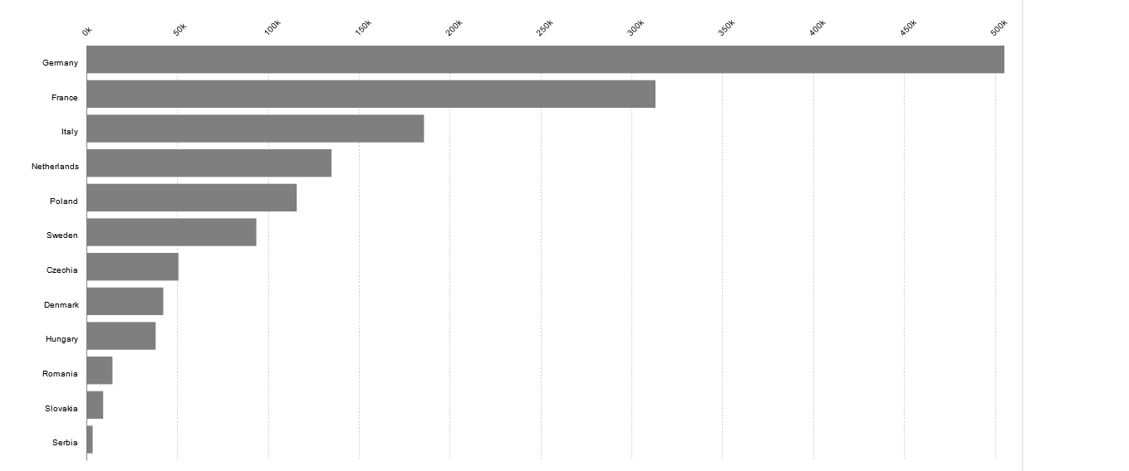
R&D personnel and researchers in business enterprise sector in manufacturing in thousands
Eurostat: rd_p_bempoccr2

Slide 5
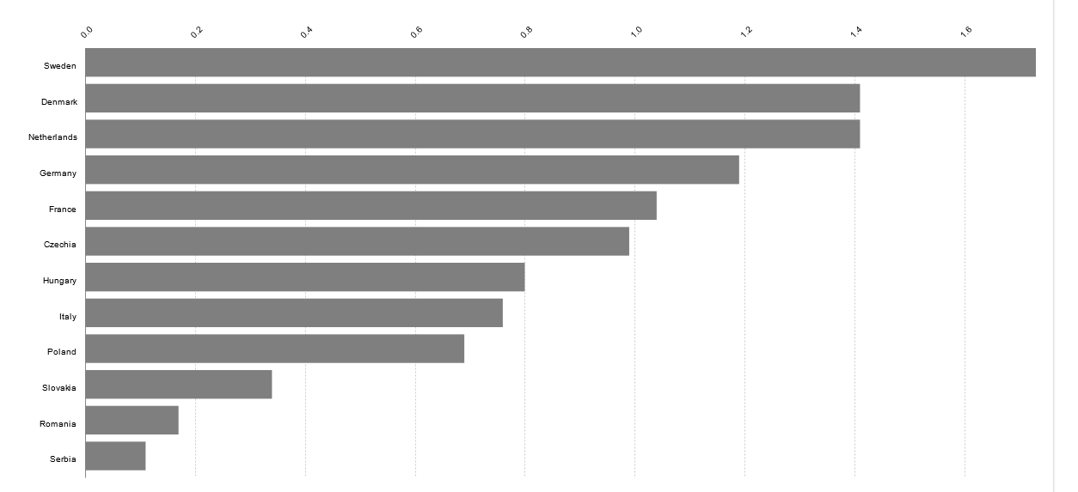
Share of R&D personnel and researchers in the business entreprise sector 2022 in %
Eurostat: rd_p_perslf

Slide 6
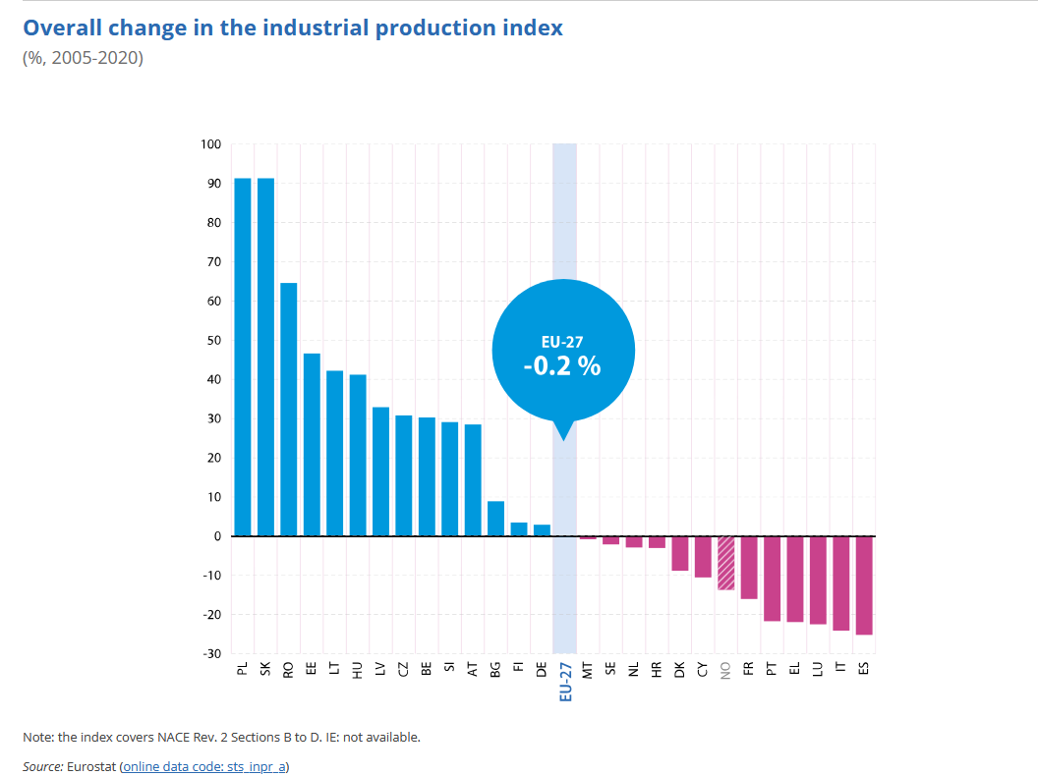
Impact of DAD on employment levels
DAD in the past no or low impact on productivity growth - Robert Solow (1987): „Productivity paradoxon“
Production and employment in manufacturing grew in most of the 12 countries (except FR, IT, SE and DK)
Forecasts show high job risks for producers of components for combustion engines. Open question: will they be avoided by replacement production (batteries)
Job losses and gains in countries may also be the result of relocations and shrinking sales not only of DAD.
Successful implementation of DAD prerequisite for job retention and creation
All countries try to support companies in implementing DAD: The measures range from tax reliefs to direct subsidies, promotion of R&D, expansion of IT infrastructure, targeted regional policy, modernization of VET, and promotion of social dialog - with major differences between countries

Slide 7
New skill requirements
DAD project for several generations: education and initial training as important as retraining
Main trends:
  Higher skill requirements – less demand for unskilled workers
  New qualification profiles, in which several domains and existing occupations (metalworking, electrical engineering or information technology) are combined (like “mechatronics fitter”)
  New skills in battery production: high-voltage electricians (licensed training)
  But not everybody has to be retrained: broad skills often transferable
Revision of occupational profiles: More organized in the Danish and German dual system of apprenticeship by the social partners, starting in other countries in sectoral, regional or national committees – in many countries lack of structured initial and further training
Skill requirements will continue to change: Necessary continuous modernization of the training contents in coming decades
Overall labor shortages: recruitment of foreign workers – Central and Eastern European countries turn to immigration countries

Slide 8
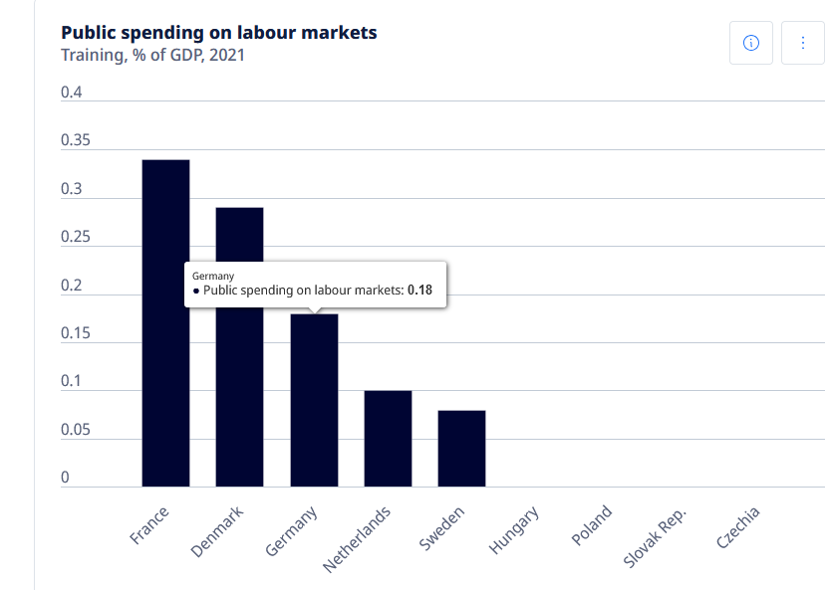
Who is paying for retraining?
Job losses can only be avoided if those affected receive further training and are placed within the company or externally
Only a few countries finance further training via labor market policy - smaller qualification programs via the EU Structural Funds
Individualisation of costs: disadvantage for the low skilled and SMEs
Technology transfer and transfer of training programs (e.g. Volkswagen battery academy) within OEMs but not necessarily to SMEs
Regional networks and regional training centers crucial for transfer to SME‘s: Germany: 27 regional networks financed through the Automotive Industry Future Fund

Slide 9
The role of social dialog and CB? The case of Germany
High trade union density (40%) and coverage by collective agreements (66%, car industry 87%) in the German Metal industry
  Long tradition of industry wide collective agreements on job protection and retraining
  Recently new „Future oriented CBs“ for DAD: Negotiated packages that include job guarantees, investment guarantees, training, and commitments to maintain locations.
  IG Metall represented in the “National platform on Industry 4.0“: Focus on work organization, job protection and training, and „Future Fund for the Automotive Industry”: financing 27 regional transformation networks with a total of 200 million euros from 2022
  Modernization of occupational profiles in the German dual system of vocational training decided by the social partners not the state
Results: 1. Social partners main actors in the transformation. 2. Personnel measures negotiated and not unilaterally determined. 3. Priority given to internal change with further training. 4. Standardized training in broad occupational profiles. 5. Effects of regional networks and “Future Oriented CBs” not yet evaluated
But: impact of market changes: VW terminates the CA on protection against dismissals at the end of the year

Slide 10
Conclusions
Just transition in the common interest of employers, employees and the state:
  necessary to ensure acceptance among employees,
  avoid labor shortages and costly unemployment
Long-term technological transformation requires planning lead time: this gives time for early information of all parties involved and planning of further training and replacements - In practice, however, company case studies often show late information about investments
The costs of the transformation of companies are mainly borne by the companies that also benefit from them – transfer within companies across borders
State support for retraining, replacement and technology transfer to SME’s necessary
Analysis of new skill requirements and updating of training contents together with with social partners more successful

Slide 11
Thank you for your attention

Slide 12
Annex

Slide 13
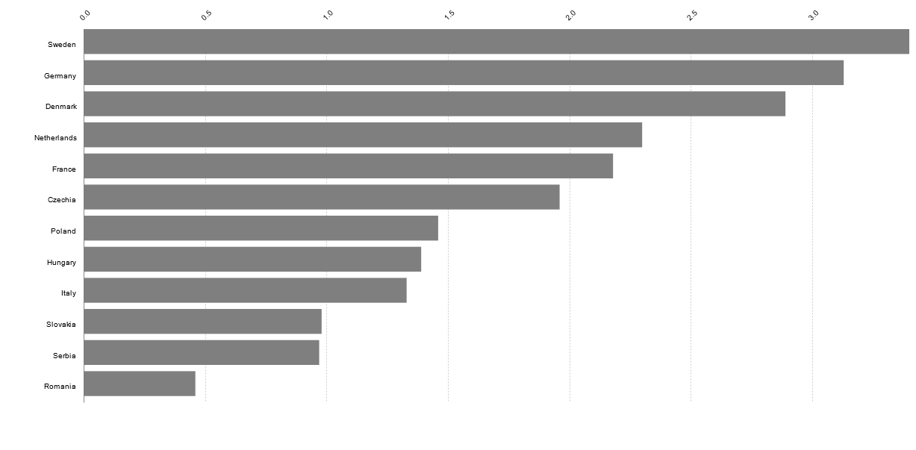
Research and development expenditure in % of GDP
Eurostat

Slide 14
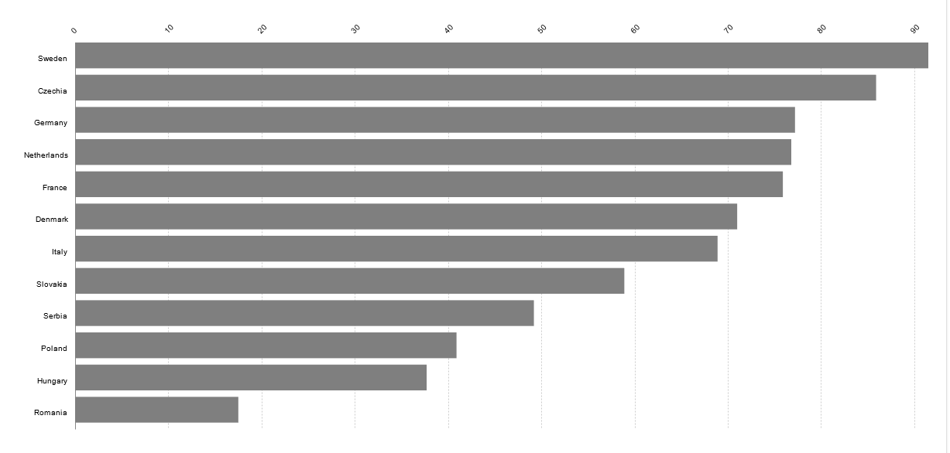
Enterprises providing training - % of all enterprises
Eurostat:trng_cvt_01s, trng_cvt_01n2

Slide 15
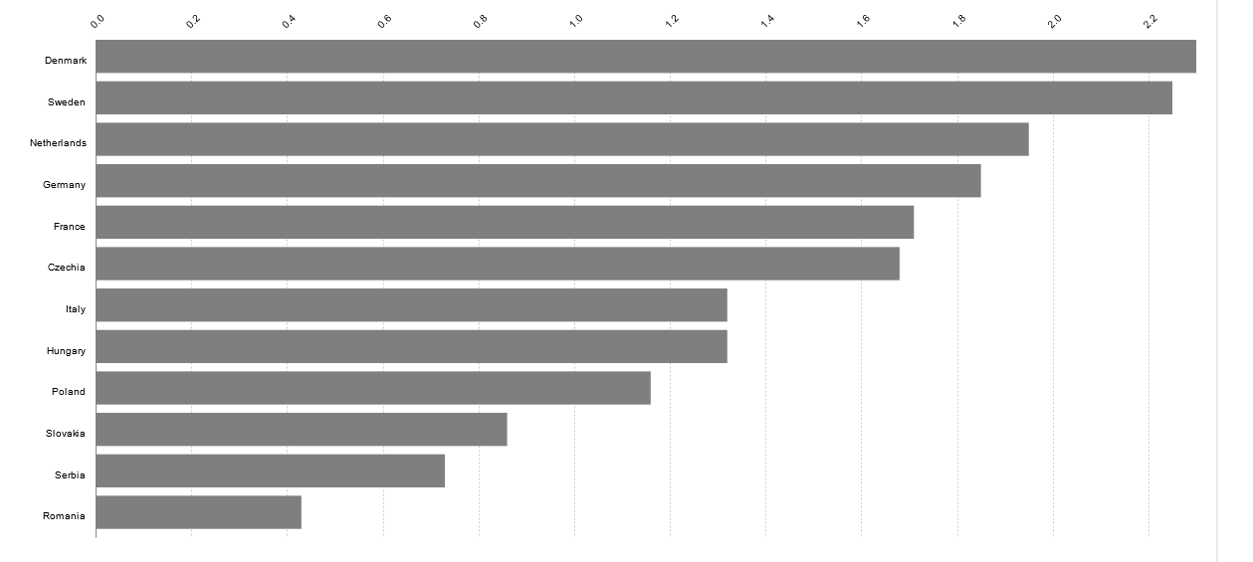
Share of R&D personnel and researchers in total active population
Eurostat

