Slide 1


11
1
1
1
1
1
1
1
1
1
EESDA – Enhancing the Effectiveness of Social Dialogue Articulation in Europe
Kick-off meeting
12 February 2018, Bratislava
With financial support
from the European Union

Slide 2

Agenda kick-off meeting
09:30-10:30 Welcome and brief introduction to the project
Welcome to the consortium partners (Miroslav Beblavý, CEPS)
The EESDA project overview and main goals (Marta Kahancová, CELSI)
10:30 – 10:45 Coffee break
10:45-12:15: Session 1 – Research
WP 1 (Marta Kahancová, CELSI)
WP 2: survey and interviews (Karolien Lenaerts, CEPS)
WP 2: network analysis (Carl Nordlund, LIU)
WP 3: country case studies (Karolien Lenaerts, CEPS)
12:15-13:15: Lunch
13:15-14:30: Session 2 – Research and timeline
WP 4: comparative analysis (Marta Kahancová, CELSI)
WP 5: dissemination activities (Ana Silva, CEPS)
WP6: work allocation and timeline (Marta Kahancová, CELSI)
14:30-14:45 Coffee Break
14:45-15:30 Session 3 – Project management
WP 6: management: financial rules and budget, reporting periods, payments, Consortium Agreement (Ana Silva, CEPS)
With financial support
from the European Union

Slide 3
EESDA project overview and main goals
improve expertise on the articulation of social dialogue in Europe:
study the ways in which social dialogue between public and private actors at at subnational, national and EU level functions
analyse the dynamics of both bottom-up and top-down activities as well as various interactions between involved actors
analyse the factors that determine the effectiveness of social dialogue
enhance the collection and use of comparative evidence on industrial relations and social dialogue articulation in Europe;
gain further understanding of how social dialogue can contribute to tackling social concerns;
promote awareness and exchange information of effective industrial relations practices.
With financial support
from the European Union

Slide 4
Research questions
How is social dialogue in Europe organized, at what levels, and who are the actors involved?
How does social dialogue at the European level affect decisions, outcomes and the position of actors at the national and sub-national levels, and vice versa?
What are the determinants of an effective social dialogue articulation?
How does the experience of countries with different industrial relations traditions and models compare, and what best practices can be identified? What about different sectors?
What lessons can be derived from these insights? What are the future opportunities and risks?
With financial support
from the European Union

Slide 5
Basic concepts
Social dialogue: interactions, such as negotiation, consultation or exchange of information, between or among social partners and public authorities; since long regarded as one of the prime building blocks of Europe’s social model (European Commission)
Social partners: representatives of employers and workers, usually employer organizations and trade unions (OECD)
Collective bargaining: all negotiations which take place between an employer, a group of employers or one or more employer organizations, on the one hand, and one or more worker organizations on the other hand, for
determining working conditions and terms of employment, and/or
regulating relations between employers and workers; and/or
regulating relations between employers and workers on their organizations and a worker organization or workers organizations (OECD)
With financial support
from the European Union

Slide 6
Basic concepts
Civil dialogue: interaction between public institutions and civil society organisations (Act4Europe.org)
Articulation of social dialogue: ways in which social dialogue between public and private actors at different levels functions and the channels through which EU level social dialogue influences decisions, outcomes and positions of actors at the national and sub-national levels and vice versa
Actors, levels, structures, processes, outcomes
Conceptual approach: SD as multi-level governance (Keune/Marginson 2012 and 2015)
vertically integrated EU-specific SD system does not exist
processes within the EU level SD (ESD) and the EU level sectoral SD (ESSD) interact with SD processes in the member states.
to understand how social dialogue is articulated in this complex context, it is crucial to analyez the dynamics of both bottom-up and top-down activities as well as the various interactions between involved actors

Slide 7
Diversity of SD across the EU
Country clusters of national industrial relations systems in selected EU member states
Industrial relations system | Organized corporatism (Nordic) | Social partnership (Central-west) | State-centred (Southern) | Liberal pluralism (West) | Mixed (Central-East)
Countries | DK, FI, SE | AT, BE, DE, LU, NL, SI | ES, FR, GR, IT, PT, | IE, UK, CY, MT | BG, CZ, EE, HR, LV, LT, HU, PL, RO, SK
Source: Bechter et al. 2012 (193, 196), European Commission (2009: 49-50)

Slide 8
Diversity of SD across the EU
Organized corporatism – social partners generally strong; industrial relations less dependent on direct involvement of the state. The state serves as a mediator for direct interaction between the social partners (Mailand 2009, European Commission 2009: 49).
Social partnership – high degree of cooperation between the state, trade unions and employers; the state tends to formulate and implement policies in close cooperation with certain ‘privileged’ societal actors, including business and labour, organized in peak-level associations (ibid.). Bargaining happens predominantly at the sector level. In industrial relations, the state serves as a ‘shadow of hierarchy’ and is more directly involved in social dialogue than in the Nordic countries.
Statist/Southern market economy – state-dominated modes of regulation, policies often designed without a systematic but flexible input from societal actors often based on derogation from the law. If such flexibility is not available, social partners often seek confrontation and develop conflict-based or adversarial interactions. The principal level of bargaining is unstable or variable, and the role of social partners in policy making is irregular and/or politicized (European Commission 2009: 49).

Slide 9
Diversity of SD across the EU
Liberal pluralism –liberal market economy and a residual welfare state; company level bargaining; state interventions in industrial relations and social dialogue is limited. The modes of regulation tend to build extensively on the market forces (neo-liberalism and the will of trade unions and employers’ organizations only (voluntarism) (Mailand 2009). However, there are also cases where the state is rather powerful and may formulate policies without significant input from social partners and other societal organizations. But because the state acts in much more restricted sphere, there is more room left for the society and market forces (European Commission 2009: 49).
Mixed/East Central – depending on the role of the state, the institutionalization of social dialogue and the capacity of labour to mobilize, Bohle/Greskovits (2012) distinguish between: (a) neoliberal countries with minimalist welfare states, fragmented/decentralized bargaining and little role of tripartism; and (b) embedded neoliberal countries with unstable dominant levels for bargaining ranging from fragmented company-level to sectoral and cross-industry bargaining, and established but contested role of tripartite SD (its role limited to consultations between the state and social partners).

Slide 10
WP1 – Literature review and conceptual framework
Led by CELSI
Duration: months 1-7 (Jan – July 2018)
Objectives: shed light on the current state of knowledge on SD articulation, literature review, develop a conceptual framework and guidelines for the project’s empirical part (WP2-4)
Deliverables: Both due in July 2018
D1.1: Working paper - literature review on the articulation of social dialogue between the EU, national and sub-national levels (CELSI)
D2.2: Preparation of the survey, interviews, case studies and network analysis (all partners)
With financial support
from the European Union

Slide 11
WP1 – Literature review and conceptual framework
Task 1.2: Preparation of survey, interviews, case studies and network analysis
Survey: prepare a checklist of questions, set up the survey (technically), compile a data set of potential survey respondents and run a pilot;
Interviews: prepare a list of potential interviewees, guidelines and draft interview questions;
Case studies: identify organisations and experts to be interviewed and prepare a template with interview questions to be completed;
Network analysis: formulate exploratory ideas on how this methodology could be applied to study the horizontal and vertical articulation of social dialogue
CELSI/CEPS, all partners (font in italics), SNA – Carl
Deadline: M7 (July 2018)
With financial support
from the European Union

Slide 12
WP2 – Stakeholders’ views on and experiences with the articulation of social dialogue
Led by CEPS, strong involvement of all partners and Carl Nordlund
Duration: M8-M17 (Aug. 2018 - May 2019)
Objectives: Gather views on the articulation of social dialogue
Deliverables: Both are due in May 2019:
D2.1: List of surveyed and interviewed social partners and stakeholders
D2.2: Working paper presenting findings on stakeholders’ views on and experiences in the articulation of social dialogue -> CEPS leads
With financial support
from the European Union

Slide 13
WP2 – Stakeholders’ views on and experiences with the articulation of social dialogue
Task 2.1: EU-wide survey and analysis
  Broad in scope: all EU MS, not restricted to specific sectors
  Preparation of the survey (WP1):
    Checklist of questions
    Technical set-up
    List potential respondents
    Run a pilot
  Implementation of the survey:
    Distribution of the link to the survey
    Follow-up as needed
  Analysis of the survey results:
    Analysis of data: descriptive statistics, further analysis if sample size allows or it
With financial support
from the European Union

Slide 14
WP2 – Stakeholders’ views on and experiences with the articulation of social dialogue
Task 2.2: Semi-structured interviews and analysis
  6 countries, not restricted to specific sectors
  Mainly to support the survey: use to complete missing information or dig deeper for unexpected findings
  Preparation of the interviews (WP1):
    List potential interviewees (social partners, government, others)
    Draft guidelines and interview questions
  Implementation of the interviews:
    Set-up and conduct interviews in the six countries
    No minimum number indicated in the proposal
  Analysis of the results:
    Interpretation of results, completing of missing information
With financial support
from the European Union

Slide 15
WP3 – Case studies on the articulation of social dialogue
Led by CEPS, strong involvement of all partners
Duration: M12-M20 (Dec. 2018 – Aug. 2019)
Objectives: Deepen the analysis on social dialogue articulation in WP2 by means of case studies (4 sectors, 6 countries)
Deliverables: All are due in Aug. 2019:
D3.1: List of interviewed social partners and other stakeholders
D3.2: 6 national reports, each presenting 4 sector-specific case studies
D3.3: 6 national policy briefs (English and main national language)
With financial support
from the European Union

Slide 16
WP3 – Case studies on the articulation of social dialogue
Task 3.1: Preparation of case studies and data collection
  6 countries, 4 sectors, 4 occupations
  Interviews (min. 4 per sector), desk research, discourse analysis
  Preparation of the case studies (WP1):
    Identify organisations and experts to be interviewed
    Prepare draft interview questions
  Preparation of the case studies (WP3):
    Update the draft interview questions
    Update the list of potenial interviewees
With financial support
from the European Union

Slide 17
WP3 – Case studies on the articulation of social dialogue
Task 3.2: Drafting the case studies: reports and policy briefs
  6 countries, 4 sectors, 4 occupations
  Based on interviews, desk research, discourse analysis
  Drafting of the case studies:
    Analysis of the data from the interviews
    Discourse analysis: how are negotiations and outcomes perceived?
    Comparative overview combining 4 sector analyses
With financial support
from the European Union

Slide 18
WP4 – Comparative research on SD articulation and its contribution to a well-functioning SD
Led by CELSI, strong involvement of all partners
Duration: M17-M22 (May 2019 – Oct. 2019)
Objectives: summarise and integrate EESDA’s findings on the articulation of SD by bringing together results of WPs 1-3
Deliverables: All are due in Oct. 2019:
D4.1: Comparative report, integrating evidence collected as part of WP1-3 (CELSI)
D4.2: Comparative policy brief, integrating evidence collected as part of WP1-3 (CELSI)
D4.3: Report presenting policy recommendations on social dialogue articulation and effectiveness, future challenges and the way ahead (CEPS)
With financial support
from the European Union

Slide 19
WP4 – Comparative research on SD articulation and its contribution to a well-functioning SD
Task 4.1: Drafting a comparative report and a policy brief on project results (CELSI)
  Comparative analysis of results from the literature review, survey, interviews, case studies and network analysis to formulate conclusions on:
  Horizontal and vertical linkages in social dialogue
  Potential improvements to SD functioning and social partners’ capacity
    Task 4.2: Policy recommendations on improving SD articulation (CEPS)
    highlight areas where the articulation of SD could be improved
    initiatives from social partners and other stakeholders to move forward
    feature inputs of social partners, in the form of key takeaways or examples
With financial support
from the European Union

Slide 20
WP5 – Dissemination and communication
Led by CEPS, strong involvement of all partners
Duration: M1-M24 (Jan. 2018 – Dec. 2019)
Objectives: Dissemination and communication of EESDA
Deliverables:
D5.1: Project website (March 2018)
D5.2: Webinars (May 2019 or September 2019)
D5.3: Lunch time meetings (May 2019 or September 2019) and final conference (November 2019)
With financial support
from the European Union

Slide 21
WP5 – Dissemination and communication
Website and sharing folder
  CELSI’s website? Dropbox?
Webinars (all partners, 2x) (uploaded to the website)
Publications (includes academic journals)
Lunch time meetings (all partners, 2x)
Final conference in Lisbon in november 2019
With financial support
from the European Union

Slide 22
WP6 – Management and quality control
Led by CEPS, strong involvement of all partners
Duration: M1-M24 (Jan. 2018 – Dec. 2019)
Objectives: Management and quality control of EESDA
Deliverables: deadlines are listed in timetable:
Next meeting: Brussels, July 2018
D6.1: Kick-off meeting (February 2018), progress meetings (July 2018, January 2019, July 2019)
D6.2: Reporting to the EC (December 2018, December 2019)
With financial support
from the European Union

Slide 23
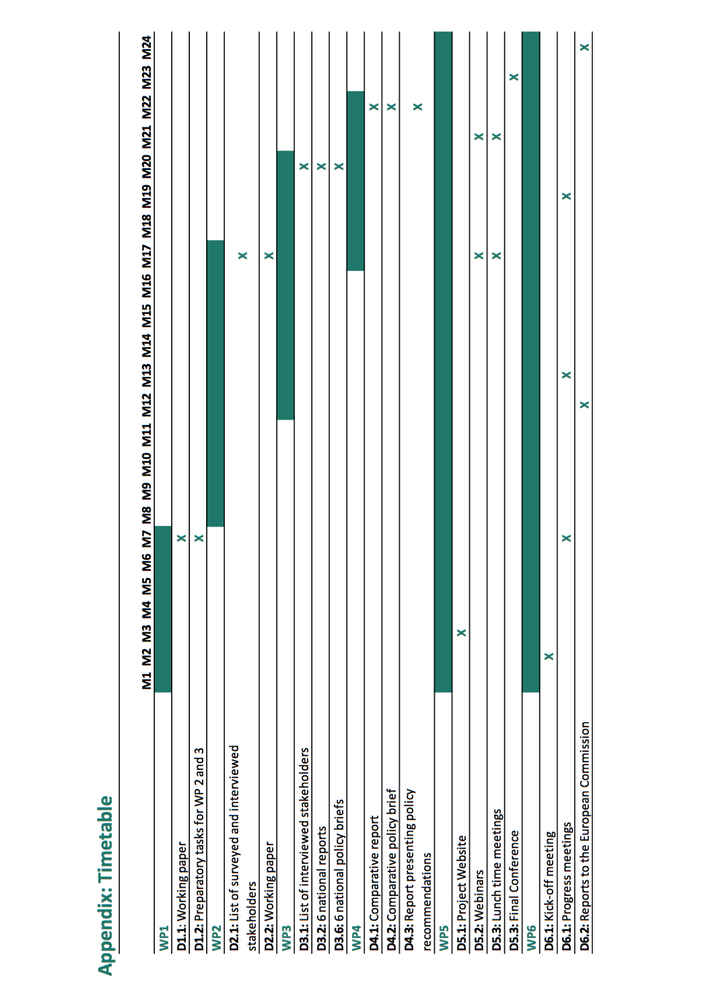
WP6 – Management and quality control
With financial support
from the European Union

Slide 24
Project Managment
5 Partners (CEPS, CELSI, CCP, UGOT, UTARTU) and 1 Sub-contractor (Carl Nordlund, Linköping University
Duration: 24 months. From January 2018 to December 2019.
Funding rate: 90%.
Total grant amount: EUR 378 635,08 (total eligible costs: EUR 420 705,65).
2 reporting periods: at Month 12 (Dec. 2017) and Month 24 (Dec. 2018).
  Report Month 12: Financial Report + written report (60 days)
  Report Month 24: Financial Report + Final Technical Implementation Report + Justification Eligible Costs (60 days)
Partners must contribute to the reporting (financial and technical information). CEPS will provide templates.
With financial support
from the European Union

Slide 25
Budget and Payments 1
PARTNERS | CEPS | CELSI | CCP | UGOT | UTARTU | TOTAL
Total | 171 424.70 | 87 283.97 | 69 522.50 | 48 283.48 | 44 191.00 | 420 705.65
EU contribution | 154 282.23 | 78 555.57 | 62 570.25 | 43 455.13 | 39 771.90 | 378 635.08
Pre-Financing (40% of Union Grant) | 61 712.89 | 31 422.23 | 25 028.10 | 17 382.05 | 15 908.76 | 151 454.03
  2 pre-financing: at the start of the project of 40% of EU grant, and after the 1st report (month 12) of 40% (conditional). Payment of the balance at the end of the project. 2nd Payment and Payment of balance are dependent on submission of the interim and final reports.
  Payments are made to CEPS and then transferred to partners within 30 days (as per the Consortium Agreement). Partners shall invoice CEPS with a request for each payment.
With financial support
from the European Union

Slide 26
Budget and Payments 2
All partners have to keep record of their expenditures and invoices. This will be reported to the Commission at each reporting period.
Budget headings: 1: staff costs; 2: travel, accommodation and subsistence allowances; 3: cost of services; 4: administration costs; 5: overheads.
Changes in the budget: (i) it is possible to transfer money from one heading to the other as it is possible to make changes within the same heading. (ii) the transfer of costs between headings must remain inferior to 10%*. (iii) the type of employment mentioned under staff costs can be changed. (iv) if external services are needed, a change between headings applies. (v) if changes are superior to 10%*, an amendment is needed.
With financial support
from the European Union

Slide 27
Publicity Rules
All grant beneficiaries are required to clearly mention the fact that they have received funding from the European Union in any publication, or promotional materials, and during project activities (conferences or seminars, etc.), for which the grant is used.
The following wording: With financial support from the European Union should be used (Font: Tahoma). The emblem of the European Union should also be visible. It can be found here: http://ec.europa.eu/dgs/communication/services/visual_identity/index_en.htm
When displayed in association with another logo, the European emblem must have appropriate prominence.
With financial support
from the European Union

Slide 28


THANK YOU!
F
With financial support
from the European Union

Slide 29
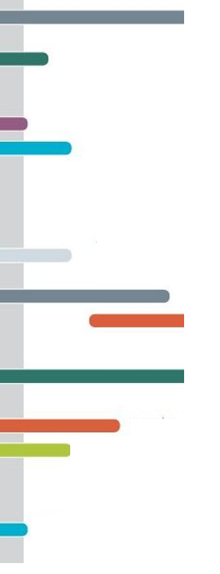




info@ceps.eu
@CEPS_thinktank
www.ceps.eu
F
With financial support
from the European Union
1 Place du Congres, 1000 Brussels
Tel: (+32 2)229 39 11

