Slide 1


The WageIndicator Collective Agreements Database
Gabriele Medas
Manager Collective Agreements Database
WageIndicator Foundation
  gabrielemedas@wageindicator.org
30 September 2022

Slide 2
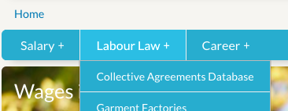

The WageIndicator Collective Agreements Database in numbers
Established in 2012
Currently more than 1800 CBAs from 67 countries all over the world
Agreements are collected, annotated (coding scheme with around 800 variables) and published in WageIndicator national websites, all in national languages
11 main macro-topics

Slide 3
The CBAs Database team
A skilled multilingual team of professionals:
10 people currently involved (annotators and researchers)
13 languages spoken at a mother tongue level
Annotators who are able to manage multiple languages

Slide 4
Collecting, annotating and coding agreements
THE PROCESS OF ANNOTATION
1.
JPEG / PDF / Scanned document
Html navigable text
Word document
OCR software
Html editor
2.
The text is uploaded in WageIndicator system, called COBRA.
3.
Questions are answered and clauses are selected about the following 11 topics.

Slide 5
Collecting, annotating and coding agreements
THE TOPICS CODED IN COBRA
Social security and pensions
Individual employment contracts / job security
Work-life balance arrangements
Wages
Equality and/or violence in the workplace
New Technologies & Green clauses
Working hours, schedules, holidays and days of leave
Workers’ Representation & Conflicts
Training / apprenticeship
Health and medical assistance
Sickness and disability

Slide 6
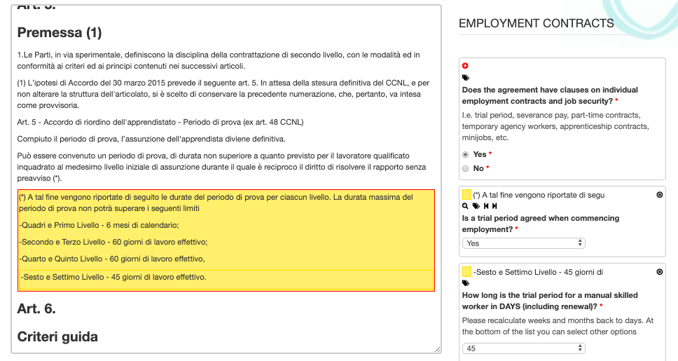
Collecting, annotating and coding agreements
‘COBRA’ ANNOTATION SYSTEM used by annotators :
https://cobra.wageindicator.org

Slide 7
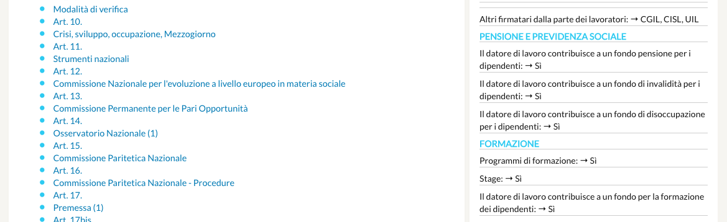
Collecting, annotating and coding agreements
WHAT CBAs LOOK LIKE ONLINE to users (i.e., citizens, trade unions, researchers) :
https://wageindicator.org/cbadatabase

Slide 8
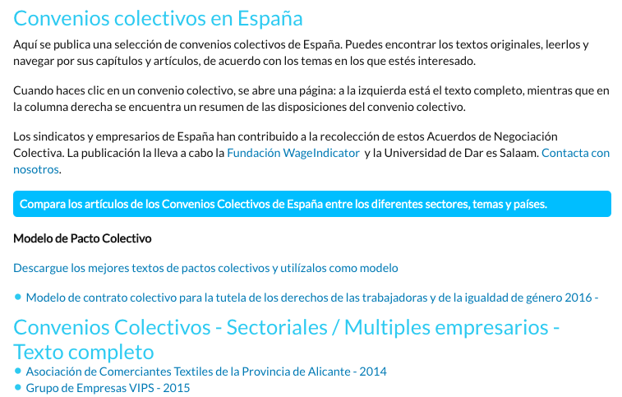
Collecting, annotating and coding agreements
THE COMPARISON TOOL:

Slide 9
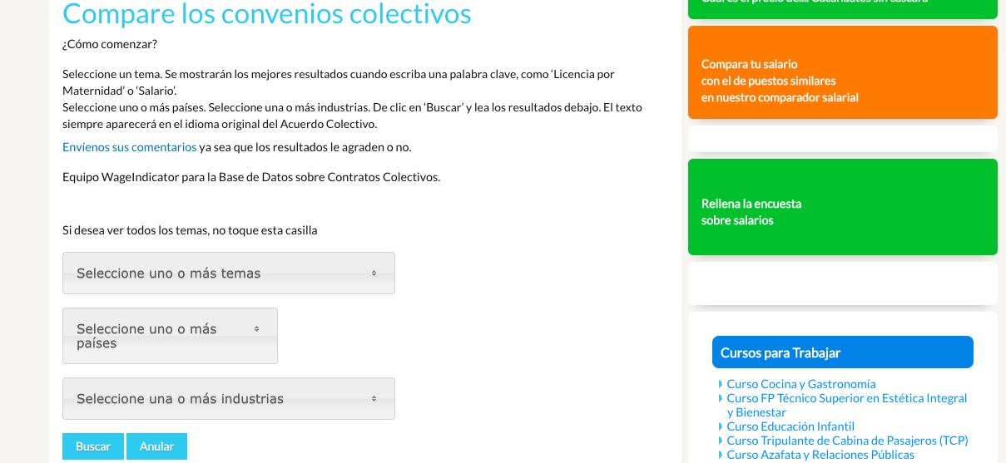
Collecting, annotating and coding agreements
THE COMPARISON TOOL:
https://tusalario.es/leys-laborales/base-de-datos-de-convenios-colectivos/compare-clauses

Slide 10
A comprehensive coding scheme* in continuous evolution
According to:
Findings coming from the CBAs analysis
Annotators and researchers’ inputs and insights
Industrial relations Projects (ongoing, in the pipeline as well as potential ones)
Highly relevant topics emerging in the public debate (remote work, Industry 4.0, green transition, wages)
*See the latest CBAs Database Codebook available here: Ceccon, D., Medas, G. (2022). Codebook WageIndicator Collective Agreements Database – Version 5 – February 2022. WageIndicator Foundation, Amsterdam.

Slide 11
Projects of the WIF CBAs Database…
Past projects
  Several Living Wage and Decent Wage projects (2012-2017): CBAs in Africa, Latin America and South-East Asia
  BARCOM (Contents of CBAs in the commerce sector in the EU)
  COLBAR (Contents of CBAs in all sectors in the EU)
Current projects
  BARWAGE (Coding pay scales & sampling)
  BARCOVID (Effects of COVID on bargaining & building a time series)
  Eurofound CBA Database (Wage floors & sampling)
  SSHOC (machine reading / NLP techniques)
  Decent work and living wages projects in garment sector in Indonesia and garment and flower sectors in Ethiopia
Future projects
  BARMETAL (Contents of CBAs in the metal sector & developing coding scheme for automatization, digitalization and decarbonization)

Slide 12
Our Approach, Strategy & Vision…
Each social dialogue project related to the CBAs database is not considered as a separate entity but rather a continuous of the past, present and future projects
Build a WageIndicator CBA Database with a representative sample of CBAs to become the reference for the analysis of CBAs in the EU
- We are already one of the largest international CBAs database available in terms of Countries covered and Number of CBAs
Extra EU CBAs (Africa, Asia, Latin America)
- The DNA of WIF is international in its deepest essence: we are currently involved in several extra EU projects and we will keep our focus on the other continents’ social dialogue dynamics - thanks to our solid connections with their social partners which have been built over the years

Slide 13
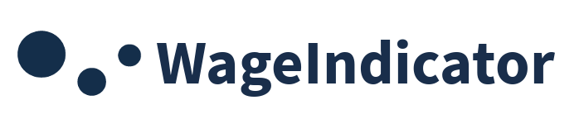
THANK YOU
Gabriele Medas
Manager Collective Agreements Database
WageIndicator Foundation
  gabrielemedas@wageindicator.org
Special thanks for the great contribution to the WIF CBAs Database:
Daniela Ceccon - Director Data at WageIndicator
Kea Tijdens - Director Scientific Research at WageIndicator
Janna Besamusca - University of Utrecht/Researcher at Wageindicator (coordinator BARWAGE)
European Commission. Directorate-General for Employment. (SOCPL-2021-IND-REL - Project ID 101052319)

