Slide 1
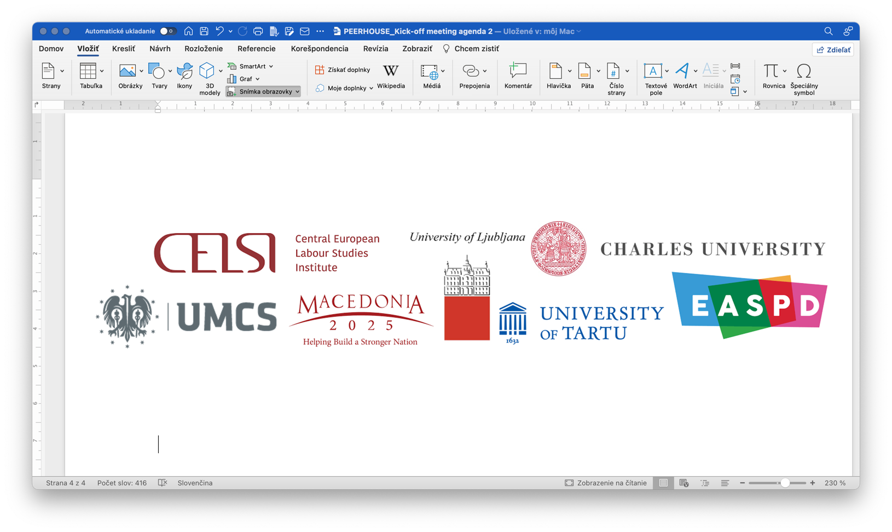


Personal and household services (PHS) in Central and Eastern European Countries: Improving working conditions and services through industrial relations
PERHOUSE
Monthly meeting November 2022, online
The project is funded by the European Union; Project No. 101052340

Slide 2
Meeting agenda (?)
State of play of the project - WP2
Literature review- discussion on the draft
Discussion on the draft analytical framework - postponed
Structure of the survey(s) – discussion - postponed
WP3 – role and responsibilities of EASPD and CUNI
Next steps and end of the meeting

Slide 3
Objectives and aims
General objective: To explore industrial relations to improve the working conditions and services in the PHS sector of CEE countries.
Reminder: the core is to investigate the IR, but before that, the complex description of the PHS sector needs to be provided.
Aims
Address the challenges of working conditions and services in the PHS sector of CEE countries.
Deepen the industrial relations (IR) analysis and the potential of social dialogue in the PHS of CEE countries.
Provide a comparative analysis of national experiences in IR and working relations in PHS and explore the link to EU-level social dialogue structures.
Promote awareness of the industrial relations practices related to the PHS sector.

Slide 4
Specific objectives
Interrelated objectives informing each other.
Address the challenges of working conditions
Conceptualisation
Scope, sub-sectors, size
Analysis of industrial relations and the potential of social dialogue
Identify the social actors representing workers and employers
Explore the discourse on PHS
Compare national experiences in IR and working relations and link to EU-level social dialogue structures.
Explore the demand and EU stakeholders’ views
IR links to EU SD and IR
Fill the gap in research.
Identify challenges
Identify the barriers of low representation + solutions
EU employment policy and IR as a response (?)
Promote awareness
EU and national collaboration
Discussion on EU regulations
Increase of acknowledgement

Slide 5
Research questions
Stay on the right track to find the answers to the research questions:
RQ1) What is the current state and structure of service provision of PHS in
CEE and what are the working conditions in the PHS sector?
RQ2) What is the role of social dialogue in regulating and improving the
work patterns in the personal and household services (PHS) sector of
domestic workers in Central and Eastern European countries (CEE)?
NM and other partners indicated that the IR in PHS are limited, and the SD is absent due to prevalent informal services, self-employment, and a relatively generous social security system. The limits and the reasons of SD will be described in the national reports as well.

Slide 6
WP2 – analytical framework, comparative data, data collection tools
2.1. Literature review
Review the previous studies on the industrial relations in the PHS sector in the 12 countries and identify who are the social actors representing workers and employers, including state)
2.2. Comparable data
Explore the scope, subsectors (care and non-care) and estimate the size of the PHS sector in the 12 countries based on the EU comparable and national data
2.3. Conceptual and analytical framework
Prepare all the tools for data collection: survey questionnaire on demand in 12 countries, survey questionnaire among stakeholders for 12 countries, interviews guide on stakeholders’ views (EU and national levels) and guide for the focus groups, the structure of the national case studies. All partners will be involved in this task and comment on the analytical tools.

Slide 7
WP2 – Deliverables and responsibilities
D2.1. Working paper on conceptualisation of the PHS sector in CEE - M6 (1/23)
The paper is based on the literature review and will encompass all the main findings and set the PHS sector's central concept and future analysis. The working paper aims to provide a comprehensive framework for the upcoming research activities of the consortium. The format is electronic, English language).
D2.2. Methodological tools (survey, interviews, focus groups, outlines) - M6 (1/23) – DD is January 23
This deliverable contains all data collection tools for the tasks in WP3 and WP4:
Online survey for social partners and stakeholders in 12 CEE;
Online survey to study the demand for PHS in 12 CEE;
Interview guide for EU-level stakeholders – will be prepared by CUNI
Three focus groups interview guides with domestic workers (child care, LTC, non-care services);
Structure of the national case studies
Responsible: CELSI (lead) in cooperation with all benefitiaries: UT, CU,UL,UMCS, MK2025, EASPD
.

Slide 8
Literature review
Methodology
Key words: Personal and household services, Europe, Central European Countries, care and non-care services, care economy, domestic work, ….
Second level key words: structure, employment, service provision, financing, working conditions, services quality, employment quality,
Third level key words: industrial relations. social partners, unionisations, representatives, social dialogue, social actors, collective agreements
Sources/databases – search strategy
Desk research based on the available academic and policy studies, media articles, regulations, project outputs, etc.
Statistical evidence on the PHS sector and domestic work in CEE countries (e.g. structure of service provision and financing, working conditions, employment trends and structures); Inspecting the available data at the European level and/or national data for its comparability;
Sources: scientific databases, ResearchGate, Academia, Journals, ….
Geographical coverage EU and CEE region (SK, PL, HU, HR, SI, BG, LT, LV, RO, CZ, EE, and North Macedonia);

Slide 9
We are looking for the CEE specificities
The added value of the project is to focus on CEE countries – to fill the knowledge gap on IR and PHS in the CEE countries
To find overview studies on the whole region or specific CEE countries
We are searching for the CEE region specificities regarding PHS provisions, structure, employment models, interrelation to the social security system, care drain, care gap, etc.
To have in mind:
  Challenge the assumptions on CEE regions as a region in constant transition and the often outdated perspective of the Western countries on the “Ost-block”
  Verify the assumption that the working conditions in (non)public services are better than in private/non-public services

Slide 10
Literature review
Themes researched:
Scope/ definitions of PHS
Structure of PHS
  Care and non-care
  Direct and indirect
  Formal and informal
Theories related to PHS
  Economic perspectives (commercialisation)
  Gender/feminists perspectives (social reproduction)
  Migration studies
  Anthropological studies
Potential of PHS
  Job creation
  Work life balance
  Women’s employment – gender equality
  Demand
  Supply
Themes researched:
Employment models
Working conditions - wages
Quality of employment
Quality of services
Social security system to be included
Governance/policies/regulations
EU level
CEE level
National level – as sources for the partners
Industrial relations/social dialogue
International/EU level
National level
Data and measurement
Statistical definitions
NACE classification
ISCO nomenclature
Estimations of the size (CEE?)

Slide 11
Scope/definitions of the PHS sector
At the kick-off meeting, we agreed that will not devote too much time to the scope of the sector, however, the scope and the subsectors are relevant the design the surveys, interviews and find the right stakeholders.
The European Commission (2012) defines PHS as ‘a broad range of activities that contribute to wellbeing at home of families and individuals: childcare, long-term care (LTC) for the elderly and persons with disabilities, cleaning, remedial classes, home repairs, gardening, ICT support, etc.’
The European Federation for Services to Individuals, an organisation representing federations and companies of personal services in Europe, clusters these activities based on two sub-sectors. It defines personal and household services (PHS) as:
“activities carried out mainly in users’ homes relating to personal assistance services (early childhood, child care, dependence, disability, invalidity, etc.) summarised under the term “care-related services” and to services of daily living (cleaning, ironing, gardening, small DIY, maintenance, remedial classes, etc.) united under the term “household support”.” (Decker and Lebrun 2018).
“Domestic work” describes all work performed in or for a household(s), following the ILO’s Domestic Workers Convention no.189/2011.
Notes:
To estimate the undeclared work in the PHS sector, we need to define the PHS sector properly. The study relies on the definition of the European Commission:......
For the statistical purposes, however, the statistical definition is crucial:
The narrow definition of PHS includes NACE subsectors Q88 – Social work activities without accommodation and household employment defined as T97 – Activities of households as employers of domestic personnel.
The broad definition of PHS includes, in addition to the above, the S95 – Repair of computers and personal and household goods and S96 – Other personal service activities. Although the inclusion of S95 is debated, this report aims at an encompassing approach to locate the PHS sectors and carefully selects care and non-care types of services delivered at home to assess the scope of PHS work in Europe.
Further differentiations that the report acknowledges include: care and non-care work, standard market-based services and long-term care of persons in need

Slide 12
Scope/definitions of the PHS sector
Eurofound - 2001 report on “employment in household services”:
“All those services provided by public or private organisations, or by the third sector, which substitutes paid work (in the form of a job or self-employment) for work which was formerly performed unwaged within the household. Therefore, all services provided inside and outside the home of the user are included, as long as they maintain and support members of a private household (Cancedda, 2001)
The definition of Eurofound partly responds to the questions of how unpaid work is interrelated to the PHS.
Vague definitions:
These different approaches converge in regrouping in a single encompassing category of ‘personal and household services’ (PHS) a series of services provided at the beneficiaries’ home, either care services or comfort services; these services are provided by a third actor and they participate to the well-being of persons (European Commission, 2015).
Notes:
To estimate the undeclared work in the PHS sector, we need to define the PHS sector properly. The study relies on the definition of the European Commission:......
For the statistical purposes, however, the statistical definition is crucial:
The narrow definition of PHS includes NACE subsectors Q88 – Social work activities without accommodation and household employment defined as T97 – Activities of households as employers of domestic personnel.
The broad definition of PHS includes, in addition to the above, the S95 – Repair of computers and personal and household goods and S96 – Other personal service activities. Although the inclusion of S95 is debated, this report aims at an encompassing approach to locate the PHS sectors and carefully selects care and non-care types of services delivered at home to assess the scope of PHS work in Europe.
Further differentiations that the report acknowledges include: care and non-care work, standard market-based services and long-term care of persons in need

Slide 13
Scope/definitions of the PHS sector
Definitions/scope based on listing the services (taxonomy/classifications)
ILO https://www.ilo.org/global/topics/domestic-workers/who/lang--en/index.htm
Domestic workers are those workers who perform work in or for a private household or households. They provide direct and indirect care services, and as such are key members of the care economy. Their work may include tasks such as cleaning the house, cooking, washing and ironing clothes, taking care of children, or elderly or sick members of a family, gardening, guarding the house, driving for the family, and even taking care of household pets. A domestic worker may work on full-time or part-time basis; may be employed by a single household or through or by a service provider; may be residing in the household of the employer (live-in worker) or may be living in his or her own residence (live-out). A domestic worker may be working in a country of which she/he is not a national, thus referred to as a migrant domestic worker.
Notes:
To estimate the undeclared work in the PHS sector, we need to define the PHS sector properly. The study relies on the definition of the European Commission:......
For the statistical purposes, however, the statistical definition is crucial:
The narrow definition of PHS includes NACE subsectors Q88 – Social work activities without accommodation and household employment defined as T97 – Activities of households as employers of domestic personnel.
The broad definition of PHS includes, in addition to the above, the S95 – Repair of computers and personal and household goods and S96 – Other personal service activities. Although the inclusion of S95 is debated, this report aims at an encompassing approach to locate the PHS sectors and carefully selects care and non-care types of services delivered at home to assess the scope of PHS work in Europe.
Further differentiations that the report acknowledges include: care and non-care work, standard market-based services and long-term care of persons in need

Slide 14
Structure/sub-sectors
Care and non-care
Non-care household services are usually defined as object-centred activities that support daily living, and which are mainly carried out in the home of a customer, sometimes also referred to as indirect care (OECD, 2021)
The term “non-care household services” might be construed as devaluing the work in the sector. To emphasize that non-care services are as valuable as care services, the ILO in its definition of domestic workers considers they provide both direct care (care for the elderly, persons with disabilities or children) and indirect care (cleaning, housekeeping, gardening), see ILO (2018)
However, exact definitions vary across countries as they are typically tied to specific policies and instruments in this sector. Often lumped together with care-related work under the umbrella Personal and Household Services (PHS), these activities aim to improve the well-being of households and/or support its maintenance. The main activities captured by the non-care household services label range from cleaning and ironing to maintenance and smaller repair work as well as gardening. Yet data sources and policy instruments do not always distinguish between care- and non-care types of service provision and providers may also deliver both types of services (Baga et al., 2020)
Notes:
To estimate the undeclared work in the PHS sector, we need to define the PHS sector properly. The study relies on the definition of the European Commission:......
For the statistical purposes, however, the statistical definition is crucial:
The narrow definition of PHS includes NACE subsectors Q88 – Social work activities without accommodation and household employment defined as T97 – Activities of households as employers of domestic personnel.
The broad definition of PHS includes, in addition to the above, the S95 – Repair of computers and personal and household goods and S96 – Other personal service activities. Although the inclusion of S95 is debated, this report aims at an encompassing approach to locate the PHS sectors and carefully selects care and non-care types of services delivered at home to assess the scope of PHS work in Europe.
Further differentiations that the report acknowledges include: care and non-care work, standard market-based services and long-term care of persons in need

Slide 15
Structure/sub-sectors
Care and non-care
Sometimes the non-care services are labelled as comfort services in terms of complementing the care services within the household realms (European Commission, 2015). The comfort services are understood as those which should ensure comfort for the dependent persons who are cared for.
Today we do not use the term comfort services, but recognise the tight connection of the care and other housedhold services such as preparing food while caring for a child, etc.
Distinguishing between care and “non-care” activities is difficult, as the same activity, e.g. preparing meals or cleaning the house, can be considered as part of the overall care provided to a dependent person or could be considered a convenience or comfort services if the beneficiary is not in a frail situation. The state of the recipient of personal service is therefore important and may contribute to defining the nature of the service (European Commission, 2001).
Formal/informal (informal = undeclared overlapping with unpaid done by relatives)
Informal might also equal unde-declared work, i.e. when the workers might be paid but not in the whole range of work – services they provide.
Informal, undeclared work involves workers (and their employers) who do not declare part of their earnings or do not declare their earnings at all. In the absence of taxation of labour income, those engaged in informal and undeclared work will have higher take-home pay than otherwise similar workers, but this comes at a price. Informal work is not covered by social protection arrangements in the area of health, unemployment and pensions.( OECD, 2021).
Notes:
To estimate the undeclared work in the PHS sector, we need to define the PHS sector properly. The study relies on the definition of the European Commission:......
For the statistical purposes, however, the statistical definition is crucial:
The narrow definition of PHS includes NACE subsectors Q88 – Social work activities without accommodation and household employment defined as T97 – Activities of households as employers of domestic personnel.
The broad definition of PHS includes, in addition to the above, the S95 – Repair of computers and personal and household goods and S96 – Other personal service activities. Although the inclusion of S95 is debated, this report aims at an encompassing approach to locate the PHS sectors and carefully selects care and non-care types of services delivered at home to assess the scope of PHS work in Europe.
Further differentiations that the report acknowledges include: care and non-care work, standard market-based services and long-term care of persons in need

Slide 16
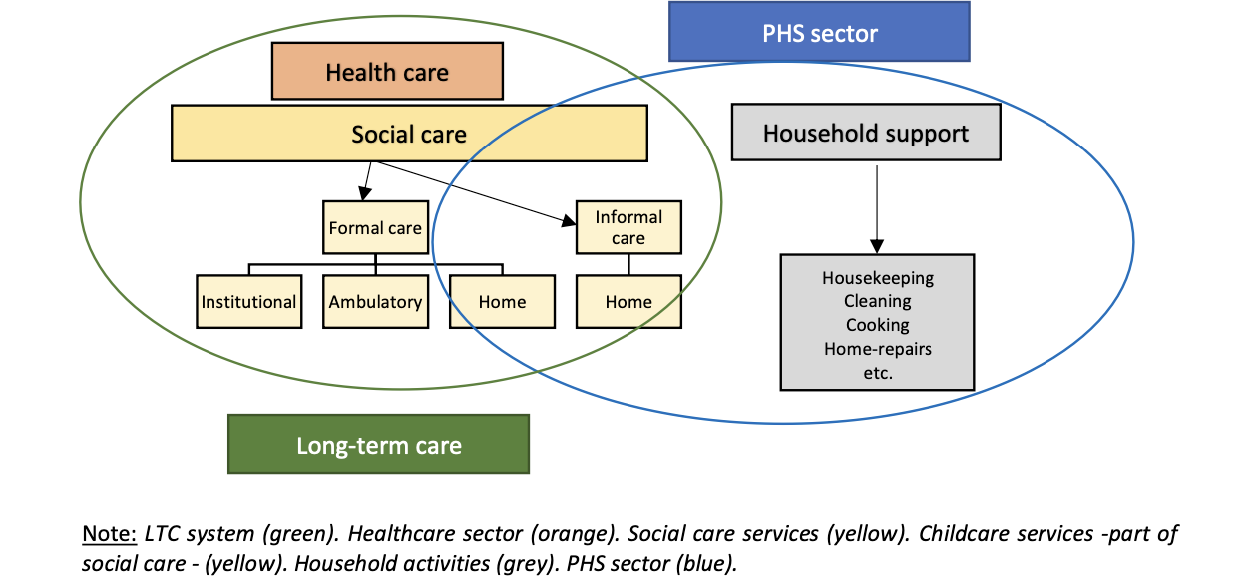
Structure/sub-sectors
Task: to develop overall scheme for the project, but partners might modify based on their country specificities
Mária Sedláková, 2020. "Job Quality and Industrial Relations in the Personal and Household Services (PHS-QUALITY), National report: Slovakia," Research Reports 34, Central European Labour Studies Institute (CELSI).
Notes:
To estimate the undeclared work in the PHS sector, we need to define the PHS sector properly. The study relies on the definition of the European Commission:......
For the statistical purposes, however, the statistical definition is crucial:
The narrow definition of PHS includes NACE subsectors Q88 – Social work activities without accommodation and household employment defined as T97 – Activities of households as employers of domestic personnel.
The broad definition of PHS includes, in addition to the above, the S95 – Repair of computers and personal and household goods and S96 – Other personal service activities. Although the inclusion of S95 is debated, this report aims at an encompassing approach to locate the PHS sectors and carefully selects care and non-care types of services delivered at home to assess the scope of PHS work in Europe.
Further differentiations that the report acknowledges include: care and non-care work, standard market-based services and long-term care of persons in need

Slide 17
Interaction and interdependence between the public sector and PHS
PHS sector – services provided in the households
Undeclared work
Informal care
Task: to develop an overall scheme for the project, but partners might modify based on their country specificities
Non-care
Care
Public and non public providers
Health care
Modified - Guzi, Holubová, Kahancová, Kahanec, Martišková, Radvanský, Bors, Schonenberg (2022) Tackling undeclared work in the personal and household services sector. ELA. At: https://www.ela.europa.eu/sites/default/files/2022-03/UDW_Study_report_on_PHS_2022.pdf
Childcare (kindergartens)
Social care
Institutions
Notes:
Here we wanted to depict the interaction and interdependence between PHS sector and public sector.
Our main argument is that the bigger is the public sector (more accessible services it provides in healthcare, childcare and social care) the lower is the demand in the PHS sector (esp. childcare) and thus lower is the incidence of the undeclared work in the sector.
These is an assumption – hypothesis that we would try to verify by available data, or at least try to explain the interdependence between the PHS sector and public sector (and UDW) by using qualitative information.
Suggestion: use this type of schemes to depict specific countries to show the different situation there – e.g in the case studies, or even based on our datasets

Slide 18
Data and measurement - following the scope (?)
The data available have its limitations and probably will not fully reflect perfectly the whole scope of the activities that we will include in the PHS scope – we need to make this transparent and admit the limitation when estimating the size .
NACE - the Statistical classification of economic activities
The narrow PHS definition includes NACE subsectors Q88 – Social work activities without accommodation and household employment defined as T97 – Activities of households as employers of domestic personnel.
The broad PHS definition includes, in addition to the above, the S95 – Repair of computers and personal and household goods and S96 – Other personal service activities.
Care activities in the PHS sector are defined within two categories in NACE: Q88 – Social work without accommodation mostly related to non-residential (long-term) care activities for dependent, disabled or elderly individuals and children (including nurseries); and partially (around a quarter) in T97 – Activities of households as employers of household personnel (e.g., cleaning, gardening, health-related personal care, child care etc.). (Guzi, 2022)
The household activities in T97 include direct household employment, while social care activities in Q88 cover both household employment and the provision of non-residential care by care institutions and organisations. Additionally, care activities in Q88 can be subdivided into supporting and long-term care activities. (Guzi, 2022)
Three NACE subsectors define the non-care activities in the PHS sector: S95 – Repair of computers and personal and household goods; S96 – Other personal service activities (e.g., hairdressers, nail bars) (Guzi, 2022)

Slide 19
Data and measurement - following the scope (?)
ISCO - the International standard classification of occupations
To give a more accurate representation of employment in the PHS sector, we can also rely on the International standard classification of occupations (ISCO) to assess the number of jobs in the sector and workers’ profiles (Decker, Lebrun, 2018).
This occupational approach is not entirely satisfactory either as there is no perfect correspondence between the various PHS activities with the list of occupations. Still, it reveals to be closer to reality than NACE statistics. In this case, it is no longer the type of employment (direct employment model vs. provider employment model) which will be decisive but rather the occupation, whether it is a care-related or a household support-related job. In this case, three groups will be particularly important (Decker, Lebrun, 2018).
Group 9111 of “domestic cleaners and helpers”. This group includes “domestic cleaners and helpers sweep, vacuum clean, wash and polish, take care of household linen, purchase household supplies, prepare food, serve meals and perform other domestic duties”.
Group 5311 of “Child Care Workers” is defined as providing “care and supervision for children in residential homes and in before-school, after-school, vacation and day-care centres”.
Group 5322 of “home-based personal care workers” which are defined as providing “routine personal care and assistance with activities of daily living to persons who require such care due to effects of ageing, illness, injury, or other physical or mental conditions, in private homes and other independent residential settings”.

Slide 20
Data and measurement - following the scope (?)
ISCO - the International standard classification
PHS occupations in the ISCO statistical nomenclature
53. Personal care workers
531. Child Care Workers and Teachers’ Aides
5311. Child Care Workers
5312. Teacher’s Aides
532. Personal Care Workers in Health Services
5321. Health Care Assistants
5322. Home-based Personal Care Workers
5329. Personal Care Workers in Health Services Not Elsewhere Classified
91. Cleaners and Helpers
911. Domestic, Hotel, and Office Cleaners and Helpers
9111. Domestic Cleaners and Helpers
9112. Cleaners and Helpers in Offices, Hotels and Other Establishments
912. Vehicle, Window, Laundry and Other Hand Cleaning Workers
9121. Hand Launderers and Pressers
9122 Vehicle Cleaners
9123 Window Cleaners
9129 Others Cleaning Workers.
The use of "4-digit" data raises issues of sample size and collection and Eurostat data related to the ISCO classification are not available for all Member States and we have to rely on the broader category
Missing data substituted, e.g:
European Federation of Cleaning Industries (EFCI) - data representing the sub-category 9112 of “Cleaners and Helpers in Offices, Hotels and Other Establishments
Partner from EE indicated microdata for EE - NACE for all companies and ISCO for all employees.
SI partner questioned some categories, as the services need to be provided in the household as the defining characteristics of the PHS) – to be verified if all the categories comply with this criterion.
.
(Decker, Lebrun, (2018)PHS monitor http://www.efsi-europe.eu/fileadmin/MEDIA/publications/2018/PHS_Industry_monitor_April_2018.pdf

Slide 21
Issues for discussion
CEE as donors and receiving countries
Transnationalisation of care and care relocation
Care drain, care gap, migrant labour
Working conditions of carers from CEE in other countries
Representation of CEE carers working abroad and TCN carers in CEE
The same for non-care PHS (?)
Sources:
Ezzedine, P., Krause, K. (2022). Profitable Bodies and Care Mobilitiesin Central and Eastern Europe
https://www.relocatingcare.org/
https://www.care4care.co.uk/

Slide 22
Issues for discussion
WP3 – role and responsibilities of EASPD and CUNI
According to the project description:
EU level interviews will be realised by the expert from CU in coordination with EASPD. The EU level interviews will capture the EU level stakeholders’ views on the PHS sector in the CEE countries. CUNI researchers will conduct interviews. Stakeholders will be selected based on their relevance for the sector, the selection will be coordinated with the EASPD and associated partners (EFSI, UNI ETUI, EFFAT and EFFE, etc.). The number of interviews: 10.
D3.1. EU Stakeholder views study, CU/EASPD: The study will be based on the analysis of the 10 interviews with the EU- level social partners and stakeholders relevant to the PHS sector. Data from the online survey among stakeholders will also be included. Format electronic, English language.
CUNI will prepare the draft of the interviews based on the relevant lit. on interrelations of the EU level and PHS in CEE. CUNI asked the partners for suggestions related to relevant documents linked to thier country PHS agenda and EU. The draft interview guide to be feedbacked by other partners by 15 of FEB 23.

Slide 23
Issues agreed and follow up:
The draft lit. the review is to be sent to partners for comments by the end of 2022 latest
The next monthly meeting will be in the first week of 2023
The WP2 Deliverables are to be finalised by the end of January 2023

