Slide 1
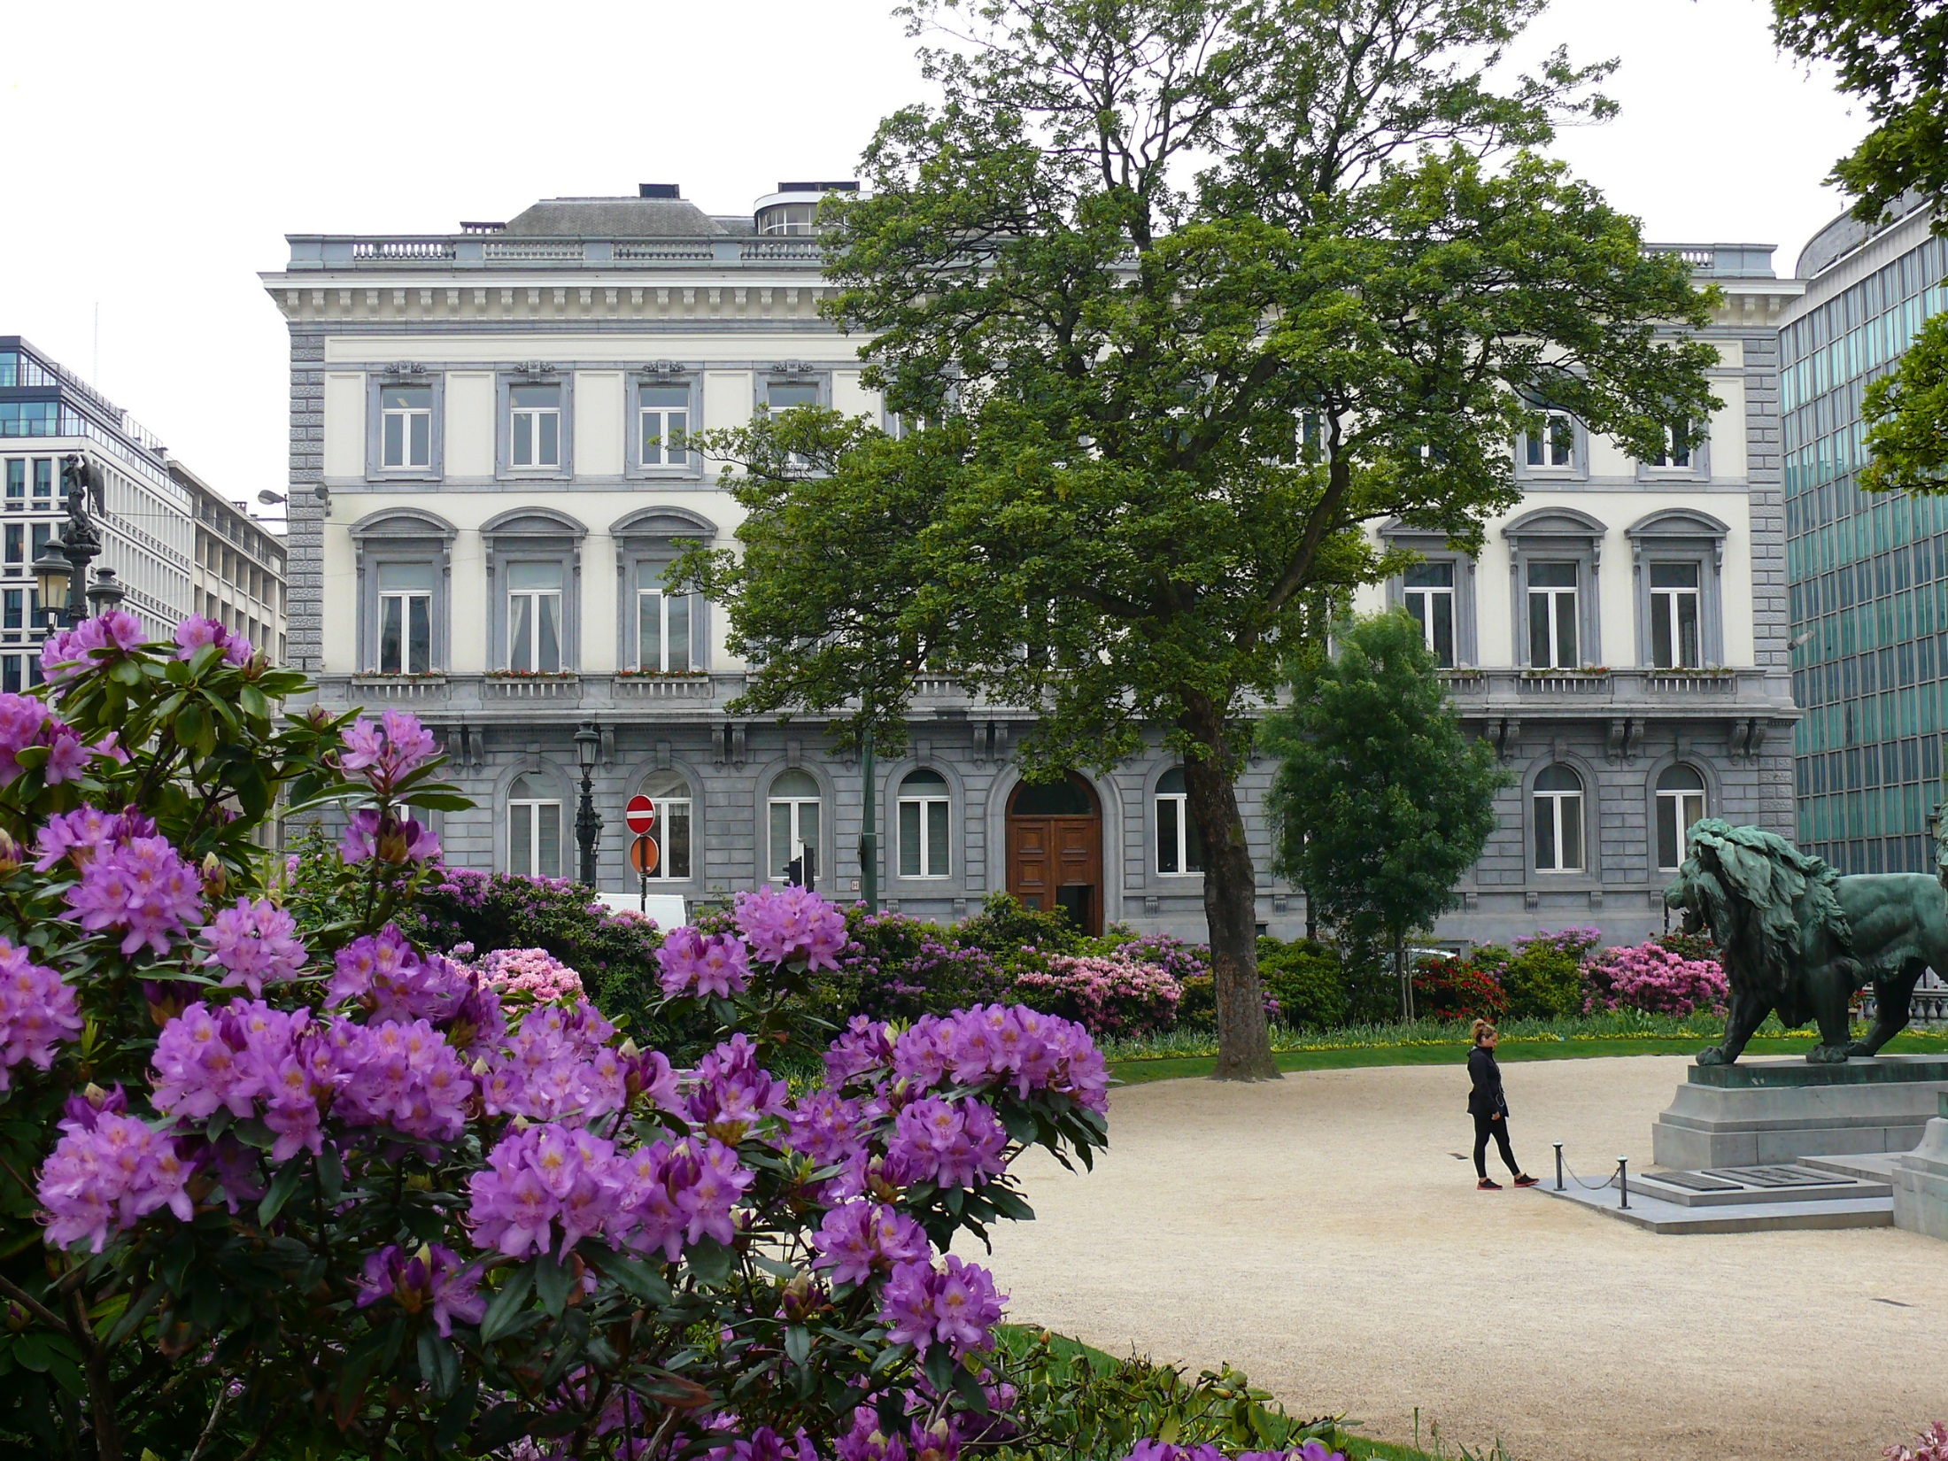
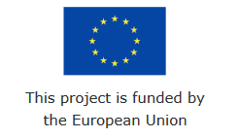
Negotiating return to work in the age of demographic change through industrial relations (REWIR)
(with support from the European Commission Grant Agreement VS/2019/0075)
Leonie Westhoff
31st January 2020
Rome, Italy
@CEPS_thinktank

Slide 2
EU level data collection (1)
ten interviews conducted, two more planned (12 out of 15)
two European institutions
three trade unions
two employers’ organizations
five patient organizations
Ongoing desk research to complement interviews
Relevant European directives and other policy documents
Position papers written by stakeholders
Academic research

Slide 3
EU level data collection (2)
Some preliminary results can be identified
EU level social partners do not identify the issue of RTW after chronic disease as high on their agenda
Policy work within the European institutions focuses more on prevention, though there is some movement
Patient organizations are very active on the issue and are trying to put it on the agenda and involve more stakeholders, including social partners
The potential for EU action – with the input of social partners – lies mostly in awareness-raising, sharing of best practices and developing guidelines
More specific action should be taken at national level given cultural specificities and different legislative frameworks

Slide 4
Data collection for Belgium (1)
four interviews conducted, one more scheduled (5 out of 5-6)
One academic expert
One government representative (cabinet)
One patient organization representative
One disability insurance representative
One employment agency representative
Ongoing desk research to complement interviews
National legislation
Social partner agreements (e.g. National Labour Council)
Publications by social partners
Policy position papers by other stakeholders
Academic research

Slide 5
Data collection for Belgium (2)
two stakeholder discussions (14/01 and 28/01)
Three trade union representatives
two employer representatives, one private provider of HR services, one HR manager
In Belgium, it was very difficult to reach company-level representatives, particularly regarding the trade unions
Participants were asked to share their experiences at the company level as far as possible
Some participants were directly involved at the company level and shared relevant details

Slide 6
Data collection for Belgium (3)
Preliminary findings
In Belgium, discussion of RTW after chronic disease is centered around the significant reform of the system in 2016
At national level, trade unions and employers agree that the system is flawed, though they do not necessarily agree on solutions; however, common positions are frequently agreed on through national social dialogue
At company level, the RTW process is handled primarily between the employer and the employee; trade union representatives tend to be involved only when there is a conflict
As the formal procedure for RTW is seen critically, many employers circumvent it and make use of informal procedures, particularly in small companies
There are sectoral differences in the extent of problems with RTW and the involvement of social partners

Slide 7
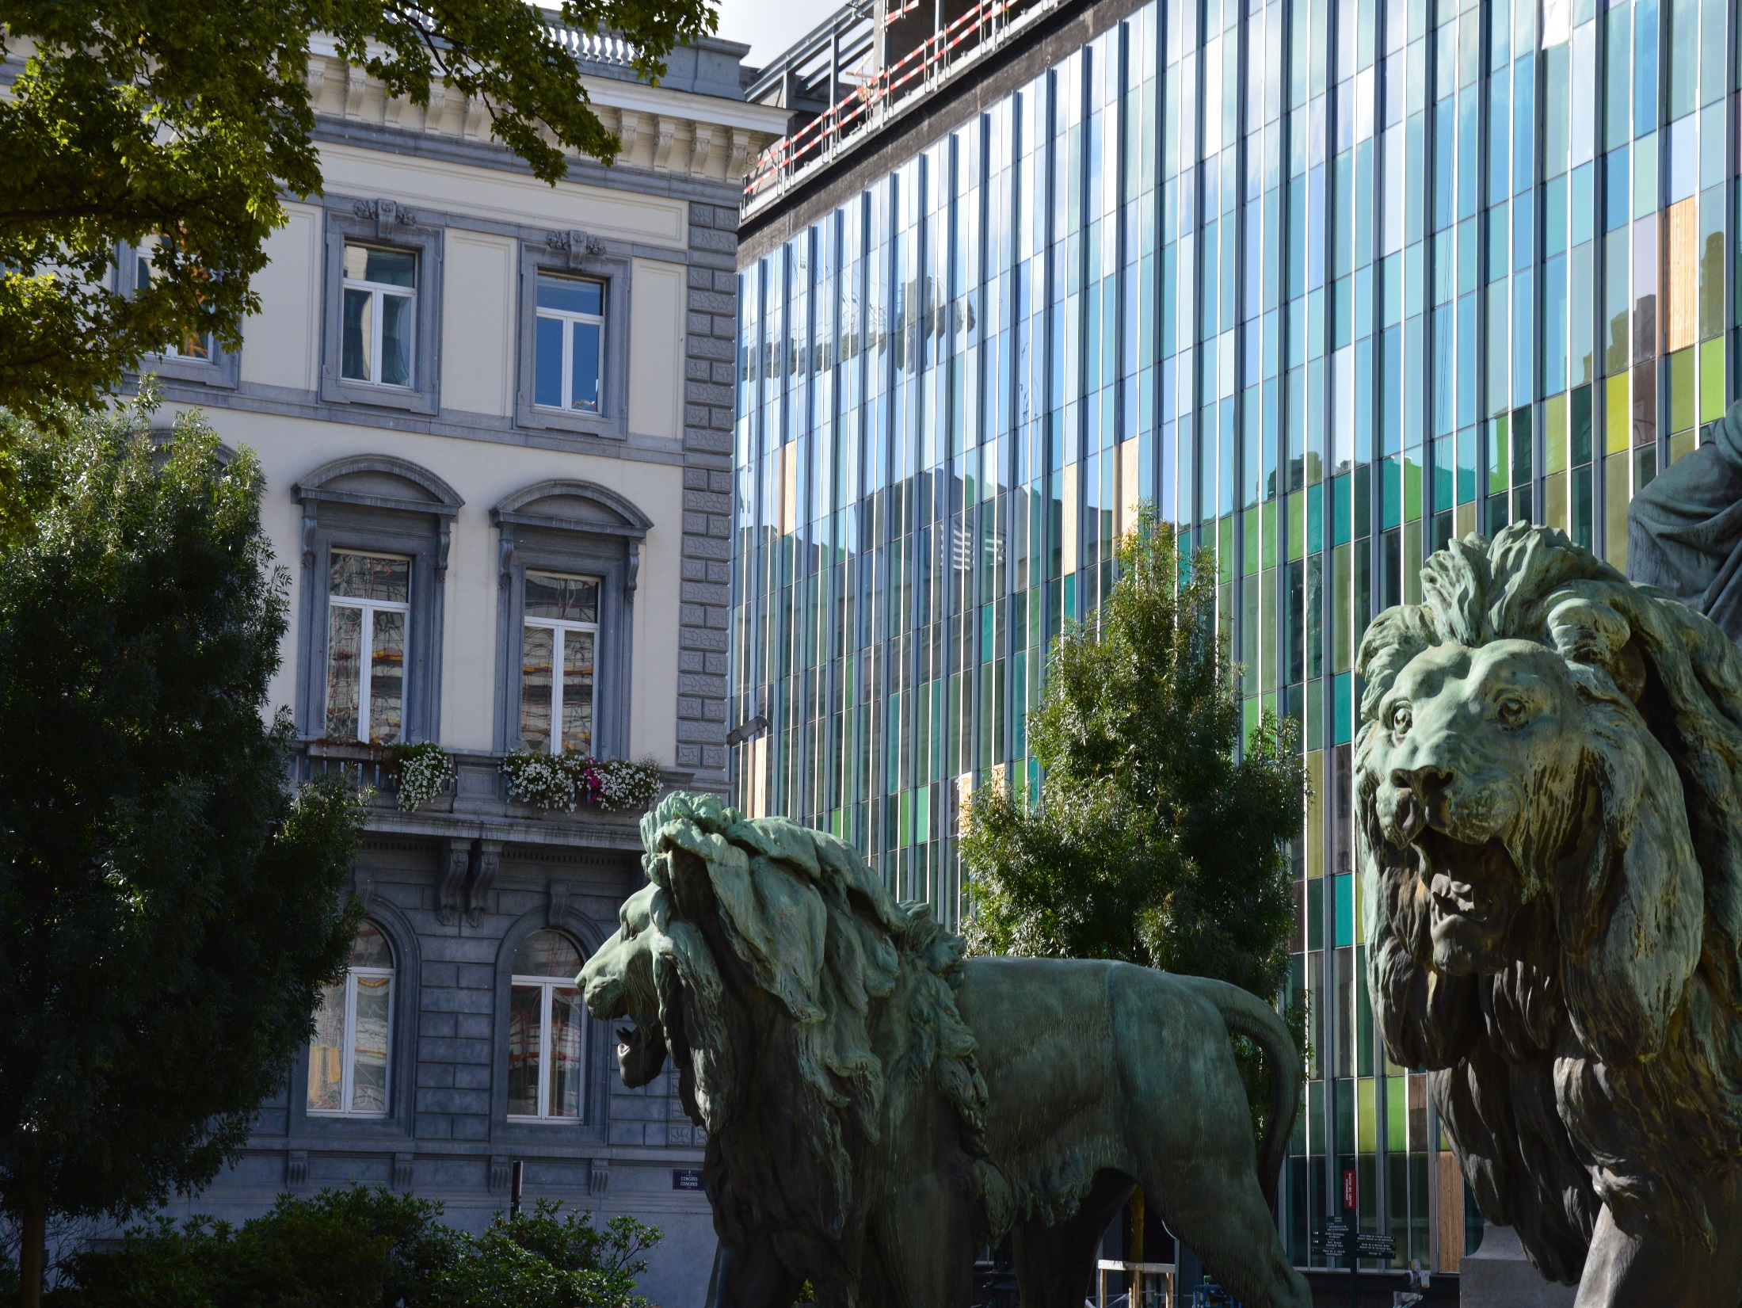
@CEPS_ThinkTank
info@ceps.eu
Thank you!
1 Place du Congres, 1000 Brussels
Tel: (+32 2)229 39 11

