Slide 1
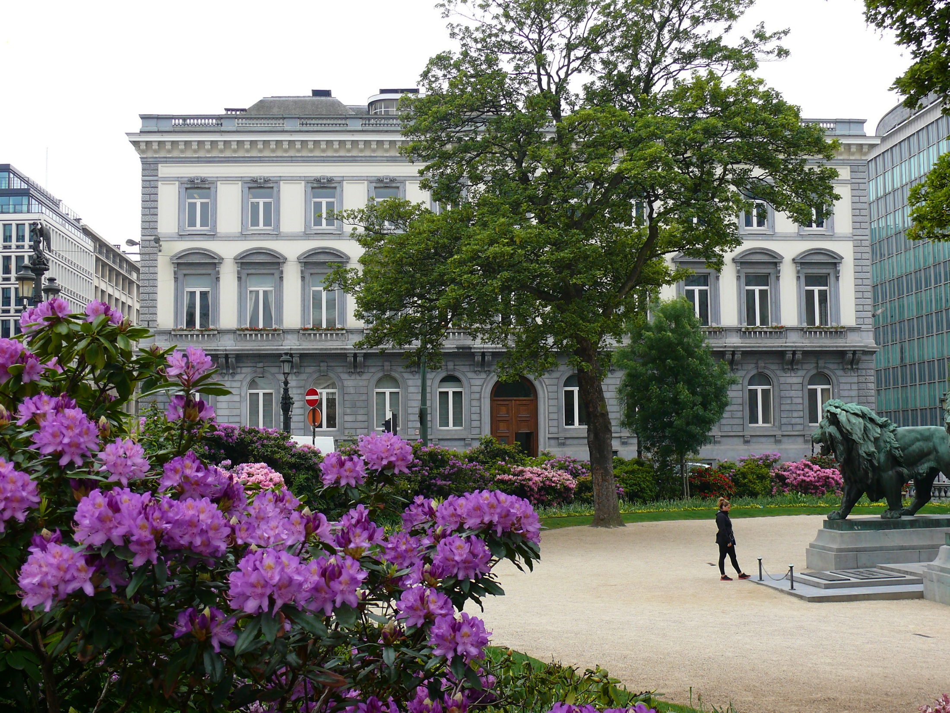
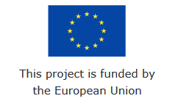
Negotiating return to work in the age of demographic change through industrial relations (REWIR)
(with support from the European Commission Grant Agreement VS/2019/0075)
Manon Jacquot
31st January 2020
Rome, Italy
@CEPS_thinktank

Slide 2
Project management and next steps

Slide 3
Next steps – administrative (1)
Reporting:
Technical and financial interim reports for REWIR
The interim reporting is prepared and being submitted to the EC together with the mid-term financial reporting, request for pre-financing and first deliverable of the project (analytical and conceptual framework)
Internal Deadline 28 February 2020
EC has 60 days to approve: 30 April 2020
CEPS will pay 40% of the total amount:

Slide 4
Next steps – administrative (2)
Meeting with the project officer
Emphasis on communication and dissemination activities
Feeding the project website regularly is important
Next (and last) project meeting date to be decided
(Early) July in Sibiu? Doodle
Final conference in Brussels
Deciding on the date ASAP – EC is interested in participating, but they need to know the details in advance

Slide 5
Next steps – research activities (1)
WP2: Stakeholders’ views
Deliverables: June 2020
D2.1:Working paper on EU-level social partners’ views and involvement in return to work policies, evaluating the potential of EU-level industrial relations for designing return to work (M16) (CEPS)
D2.2: Working paper presenting benchmark case studies on France, Germany and the UK, their return to work policies and best practices, lessons for other countries and EU-level policy making (M16) (Amir)

Slide 6
Next steps – research activities (2)
WP3: Company level perspective
Deliverables: due June 2020
D3.1:6 national reports, addressing the role of company-level industrial relations in facilitating return to work and identifying best practices, based on the group discussions and surveys (M16) (All partners)
D3.2: 6 national policy briefs summarising country findings using national and company-level evidence (English and main national language of country) (M16) (All partners) template is available

Slide 7
Next steps – research activities (3)
WP4: comparative research
Drafting comparative report and policy brief (CEPS with contributions from all partners)
Deliverable: Comparative report – October 2020
Comparative policy brief – October 2020
Policy recommendations (CEPS, with inputs from all partners)
Report presenting policy recommendations on of current and future roles of industrial relations as a prominent channel to encourage longer labour market involvement in the context of demographic change – October 2020

Slide 8
Next steps – research activities (4)
WP5: dissemination and communication
Website:
Continue populating the website content (minutes of meeting and publications)
Webinar: all partners (until February 2021)
Series of videos with topics to be discussed in Sibiu
Final conference – February 2021 preferably end of January
Decide on a date, agenda etc. early enough to start advertising in advance
Publications
Publish research on project website
Submit to academic journals – internal discussion on interests

Slide 9
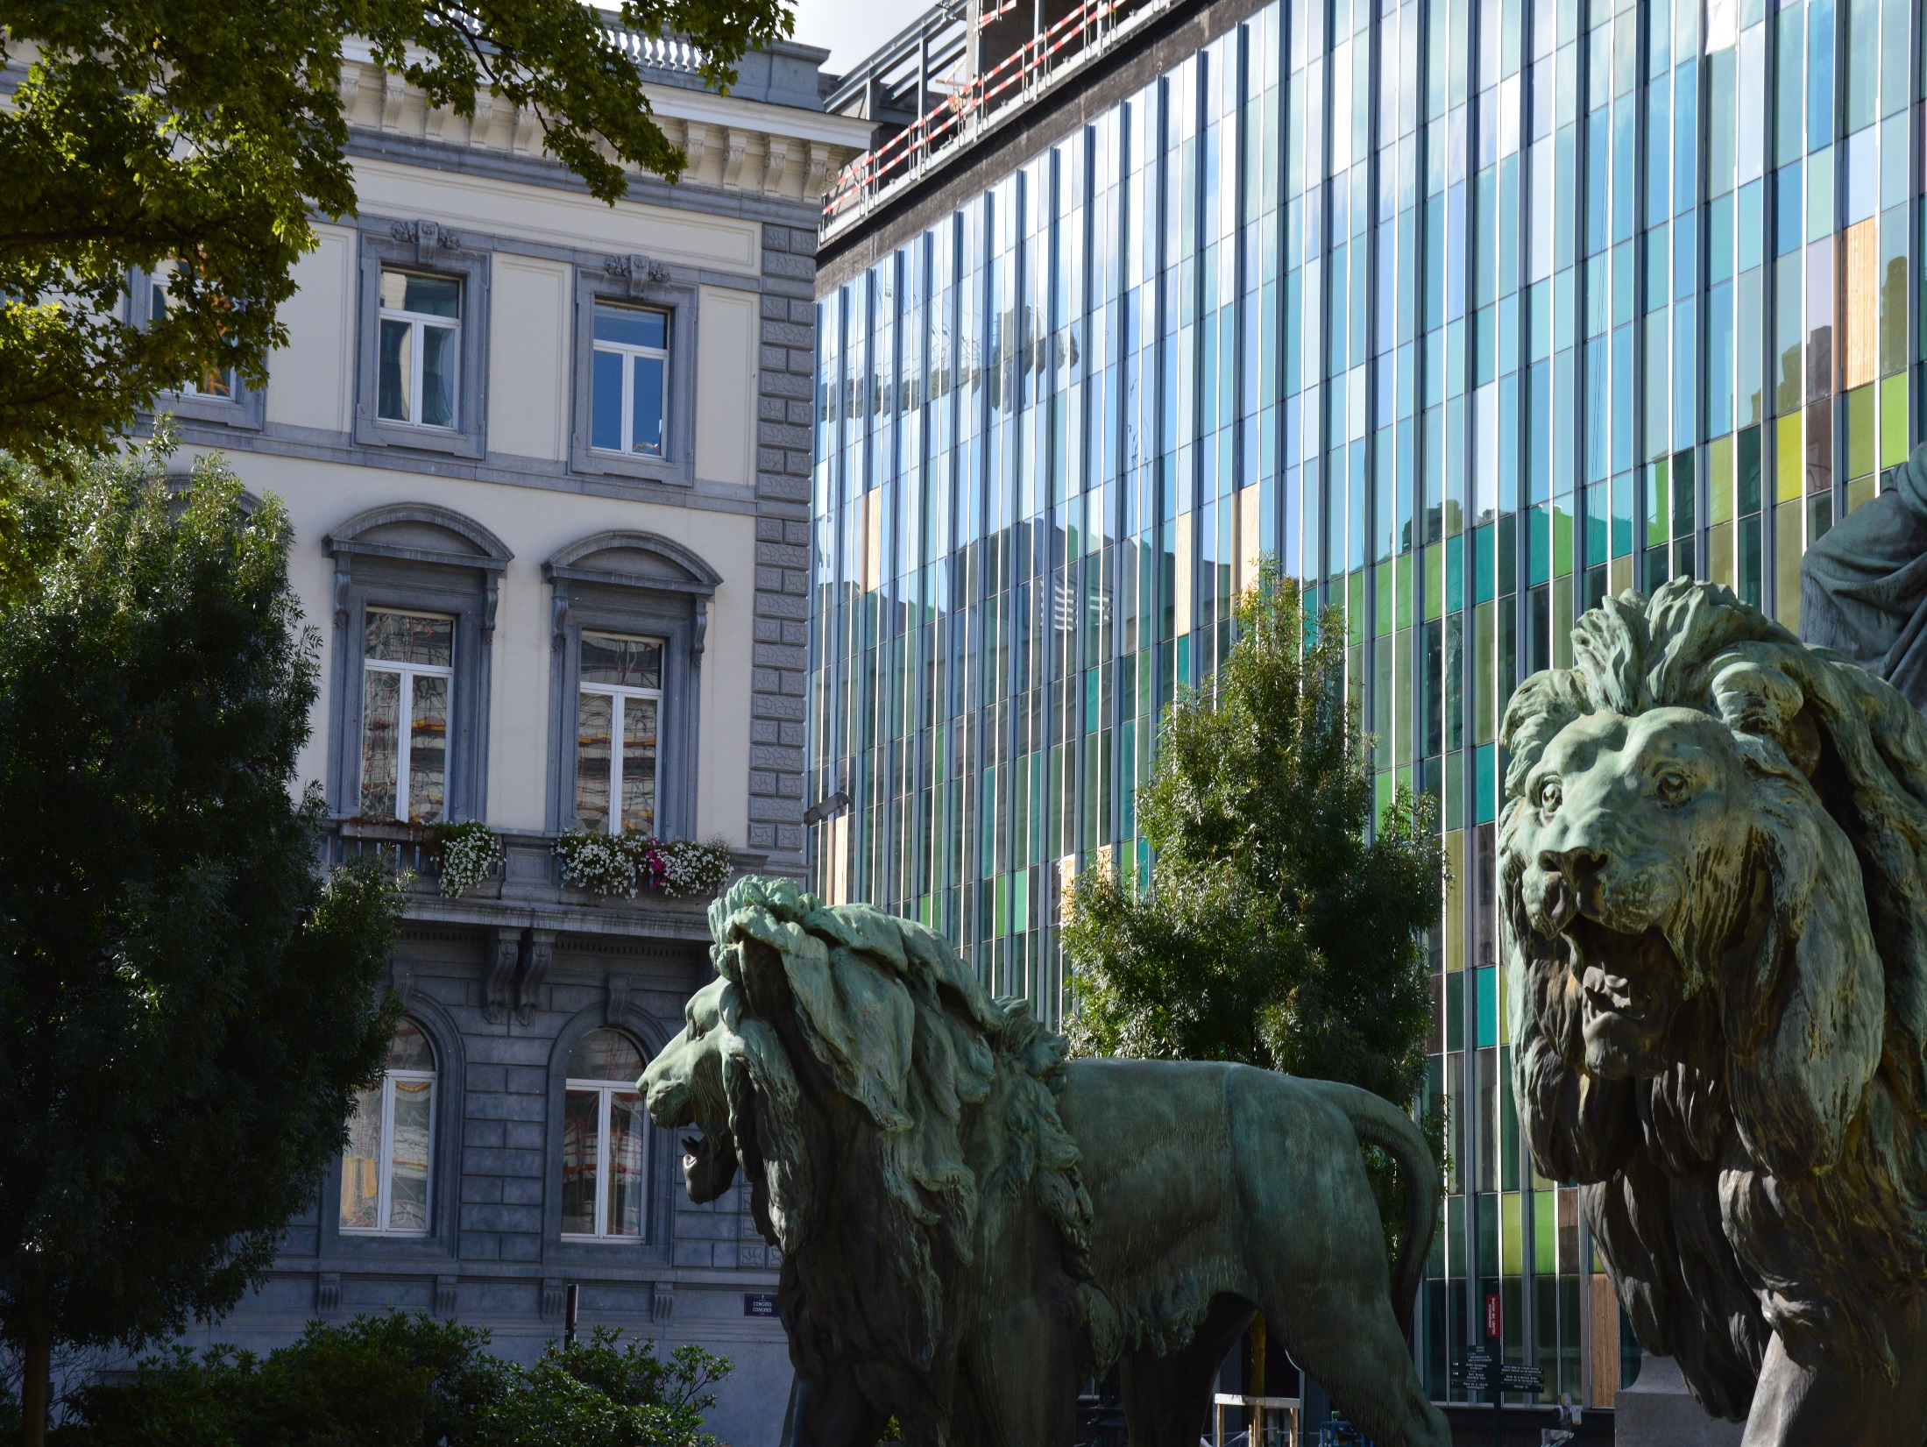
@CEPS_ThinkTank
info@ceps.eu
Thank you!
1 Place du Congres, 1000 Brussels
Tel: (+32 2)229 39 11

