Slide 1
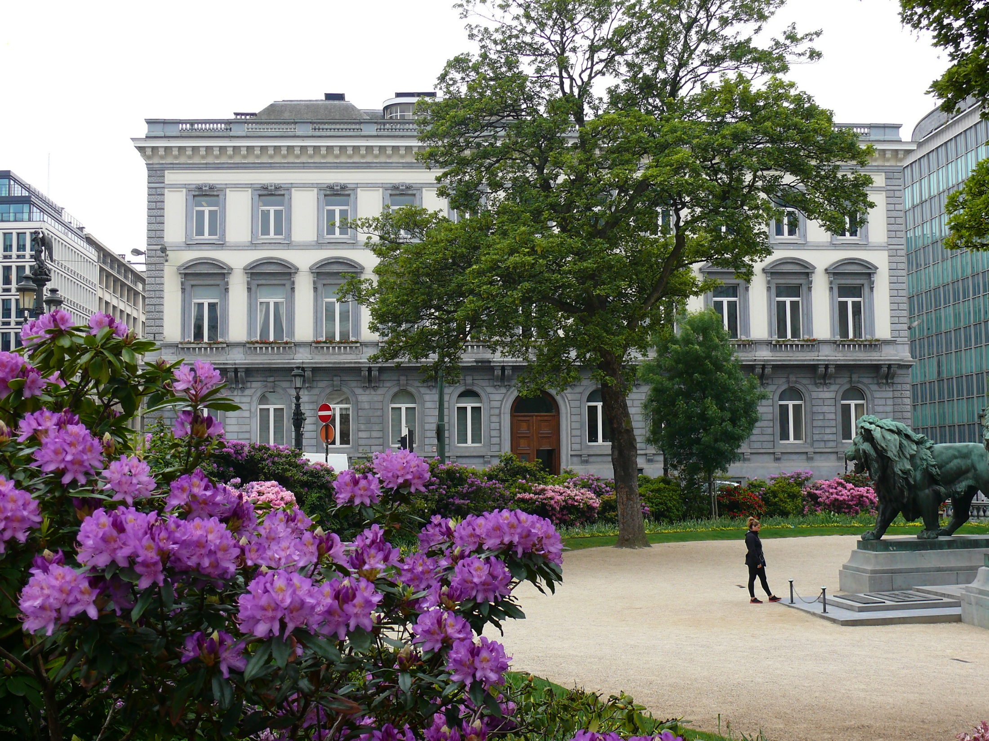
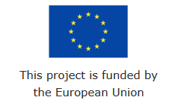
Negotiating return to work in the age of demographic change through industrial relations (REWIR)
(with support from the European Commission Grant Agreement VS/2019/0075)
31st January 2020
Rome, Italy
@CEPS_thinktank

Slide 2
June 2020
D2.1 Working paper on EU-level social partners and involvement in return to work policies
(CEPS, CELSI, inputs from partners where relevant)
D2.2 Working paper presenting benchmark case studies
(Ziv)
D3.1 Six national reports on company-level industrial relations for return to work
(All partners)
D3.2 Six national policy briefs – in English and national language
(All partners)

Slide 3
EU-level and comparative EU28
RQs 1, 2 and 3
EU-level interviews, EU-wide survey
D2.1
National and company level
RQs 2, 3, 4 and 5
Worker survey, company survey,
SGDs, roundtables
National level interviews
(+ EU-wide survey, where relevant)
D3.1
D3.2
RQ 6 (and all others) in D4.1 and 4.2 → Reference to the concepts and link to the objectives

Slide 4
Points for discussion:
Structure of the reports
Inputs for each deliverable
National/company level
Timeline

Slide 5
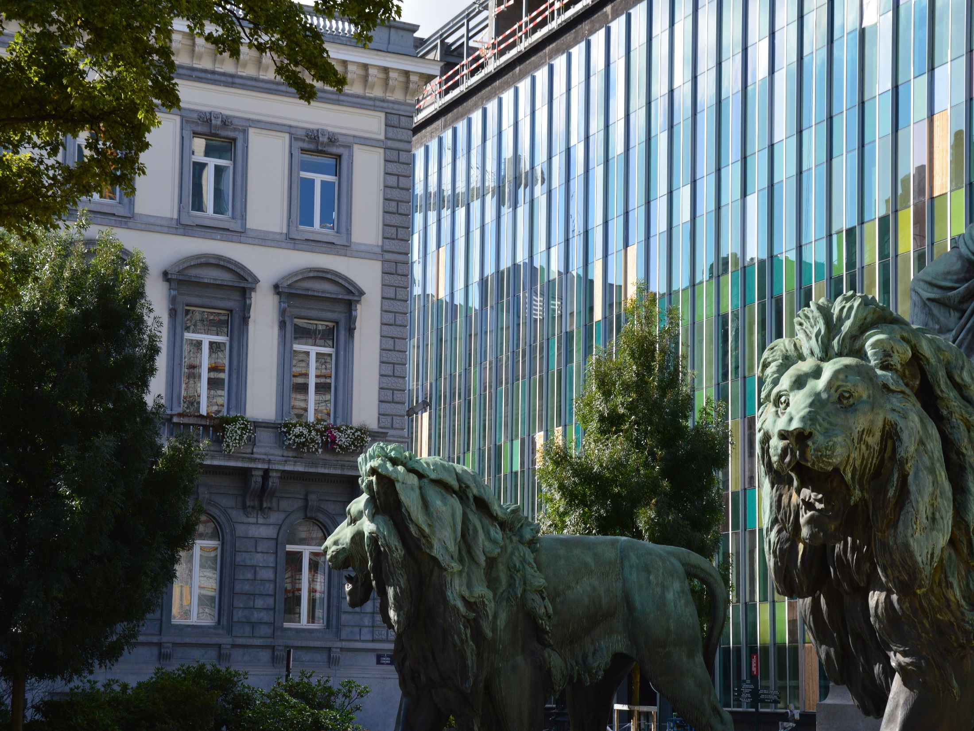
@CEPS_ThinkTank
info@ceps.eu
Thank you!
1 Place du Congres, 1000 Brussels
Tel: (+32 2)229 39 11

