Slide 1
Interviews and stakeholder group discussions Romania

Slide 2
Focus groups
Focus groups with employers – 14.01.2020
Focus groups with trade union representatives – 15.01.2020

Slide 3
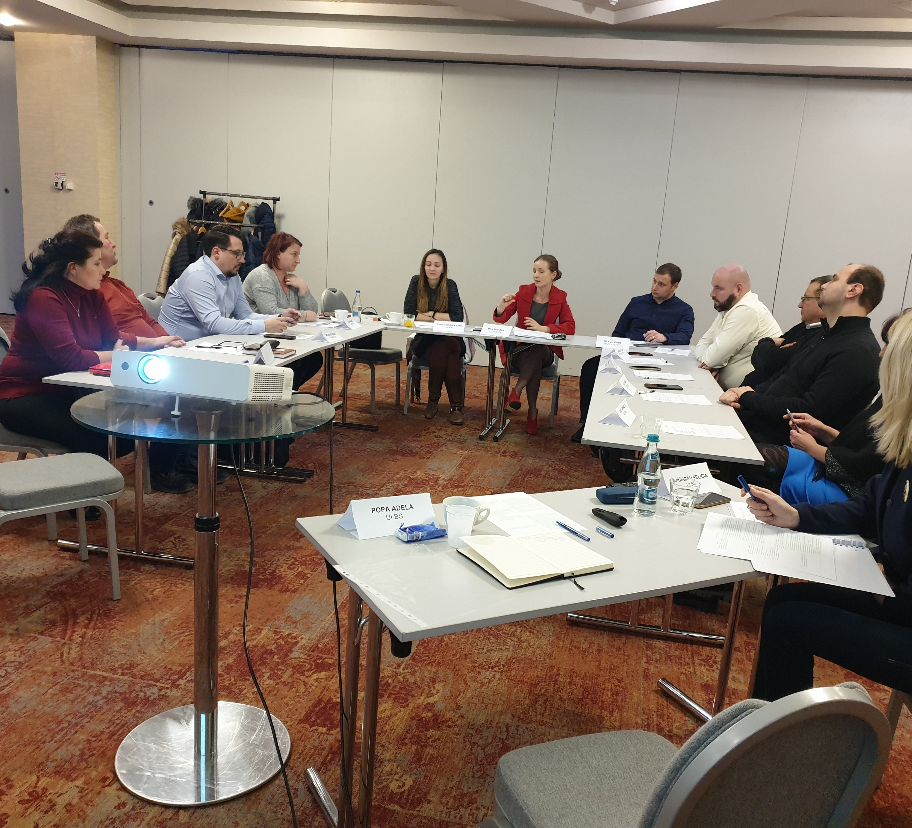
Focus group with employers
13 participants (11 employers and 2 ULBS staff)
Duration: 2h 39 minutes.
Participants from organisations in Sibiu area
9 private and 2 public
Organisations in the automotive, construction, energy, electricity devices, culture and public facilities fields
Organisations of various sizes.

Slide 4
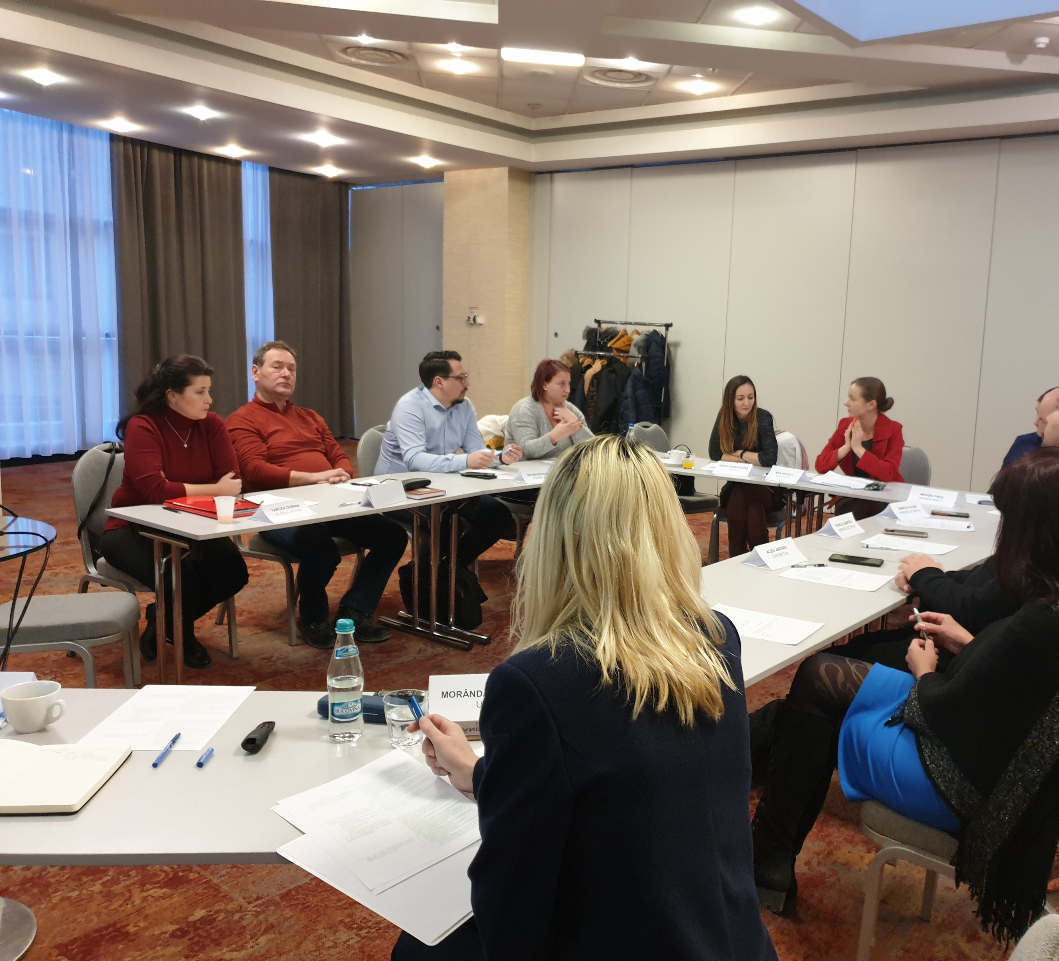
Focus groups with employers
Results available in the Dropbox folder:
File:
Group discussion 1 - summary

Slide 5
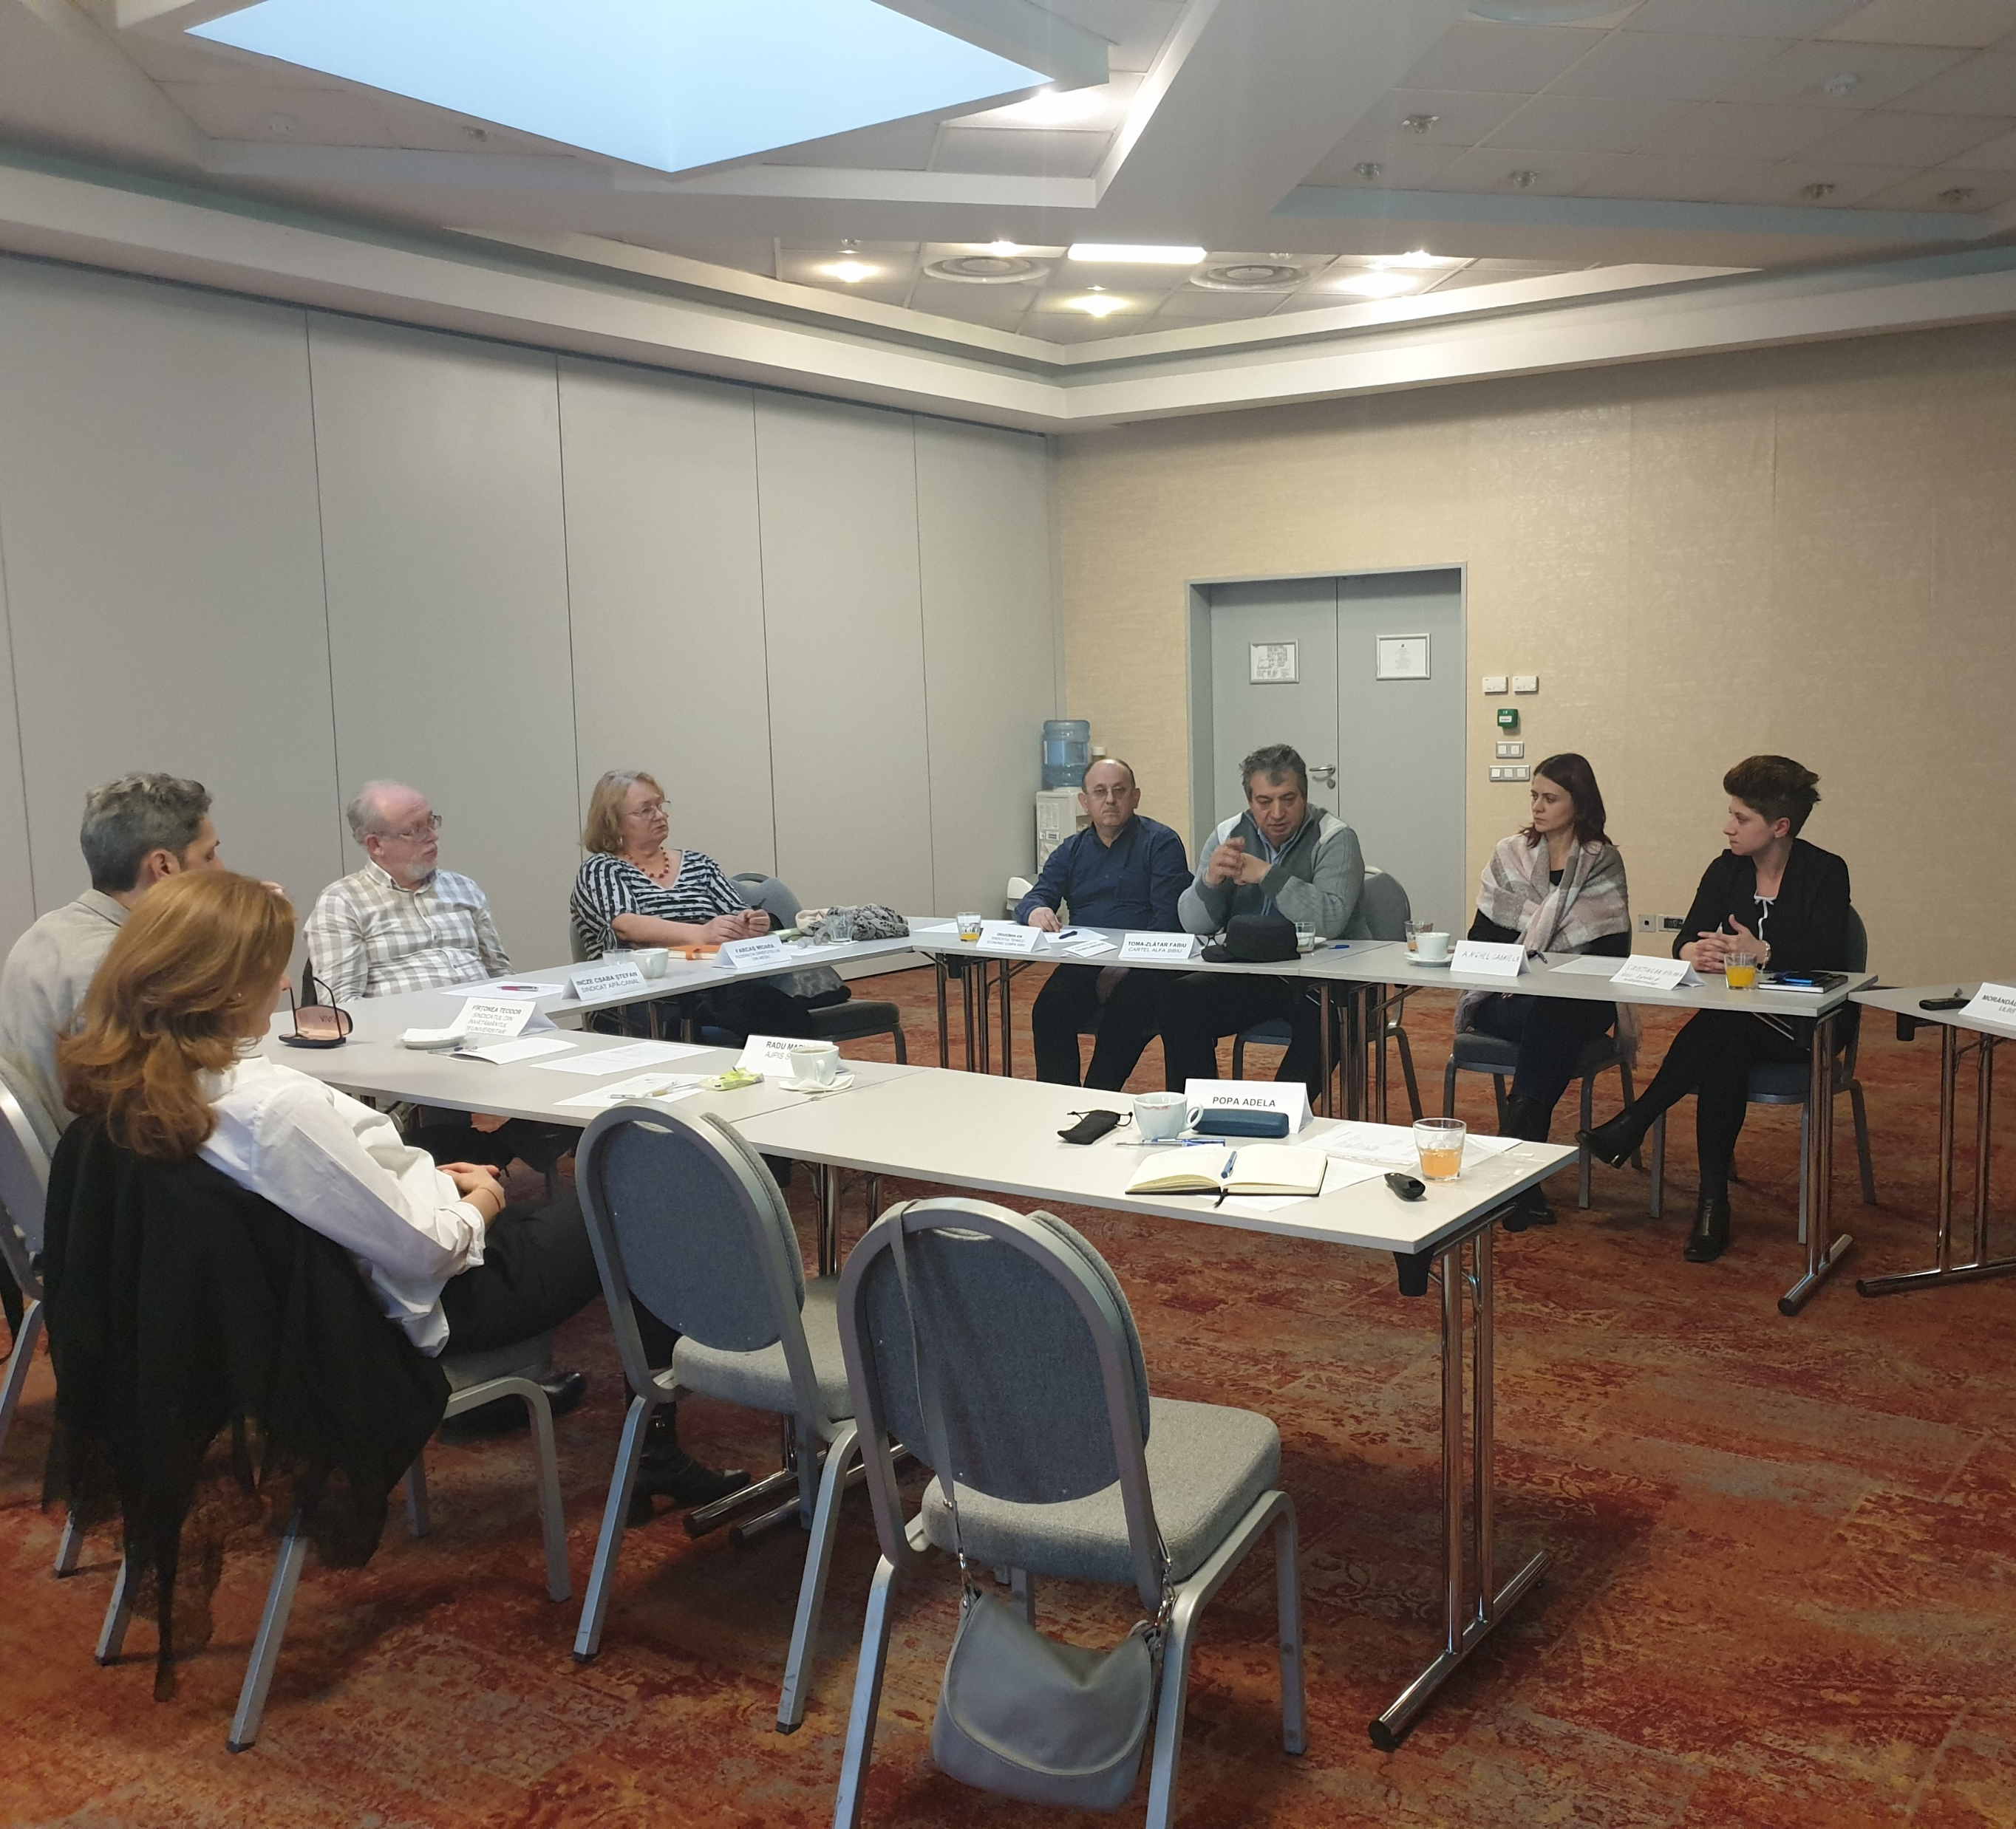
Focus group with trade unions
10 participants (5 TU representatives, 2 employers, 1 from Ministry of Labour and 2 ULBS staff)
Duration: 2h 38 minutes.
Participants from trade unions in education, environment, construction, public utilities, machinery
1 participant from Ministry of Labour – the County Agency for Social Inspection (people with disabilities)

Slide 6
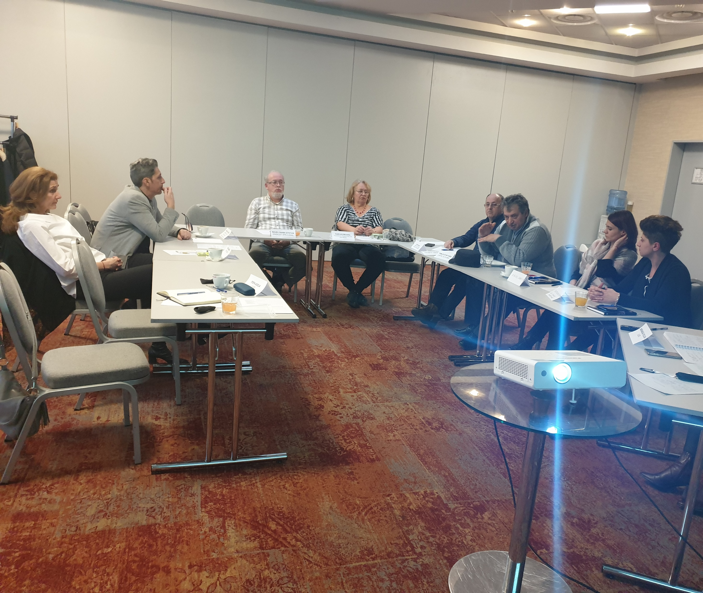
Focus groups with trade unions
Results – work in progress
File:
Group discussion 2 - summary

Slide 7
Interviews
Results – work in progress
Low response rate (especially from the high level policy makers)
Interviews done | Interviews confirmed but not yet done | Invitations waiting for response
1 – health professional (OH) in the public health state institution (Ministry of Health) 1 – health professional, social security physician, member in the College of Physicians 1 – social inspector for disability services, Agency subordinated to the Ministry of Labour 1- counsellor in the Labour force agency (private) 1 – representative of Service for Assessment of People with Disabilities (county level) Done so far: 5 | 1 – Director of the Department for Occupation and Work, Ministry of Labour 1 – Counsellor in the Labour Force Agency (public, county level) 1 – Coordinator of big NGO which makes lobby for work reintegration Total no. of expected interviews: 8-11 | 1 – Ministry of Health 1 – Ministry of Labour, Department for Social Dialog 1 – National employment institution agency

