Slide 1
More labour market transparency for the benefit of all. Employers, employees and workers worldwide. Sharing and comparing information on Wages, Labour Law and Career.
Millions of users, now in 140 countries, make us truly global.
6 offices, 100 team members of different age, color, educational background. A balance between global analysis and local perfection.
By Paulien Osse Director WageIndicator Foundation –

Slide 2
What do we create together?
140 websites in 48 languages, many databases and tools
Surveys - online and face to face data collection
Salary by Occupation in Salary Checks
Living wages calculations
Desk research:
Minimum Wages on gazetted level
Labour law - including links to the law
Collective Agreements - full text
Companies, factories, farms on level of compliance
Context - for workers, employers, social partners, governments and academics (datasets)

Slide 3
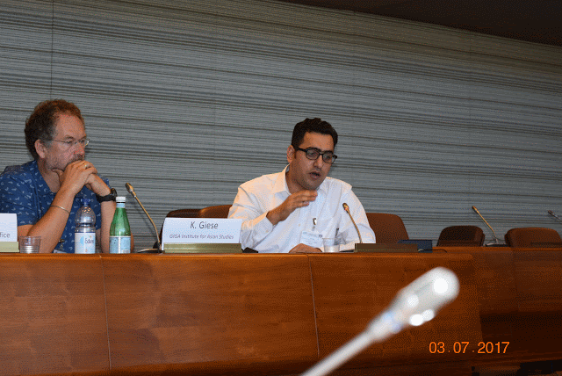
How do we do it as WageIndicators?
In our team meetings we go for smart, cheap, fast and for everybody in all countries. Professors, trade unionists, journalists, IT, data managers, photographers, etc. have their professional opinion. But the principles count.
Team members come from all over the world
They are academics, journalist, trade unionist, etc
In 140 countries: We work very hard, and emphasise intellectual joy. Our core team comes from all over the world. HQ in Amsterdam | If the team doesn't like it, there is no WageIndicator.

Slide 4
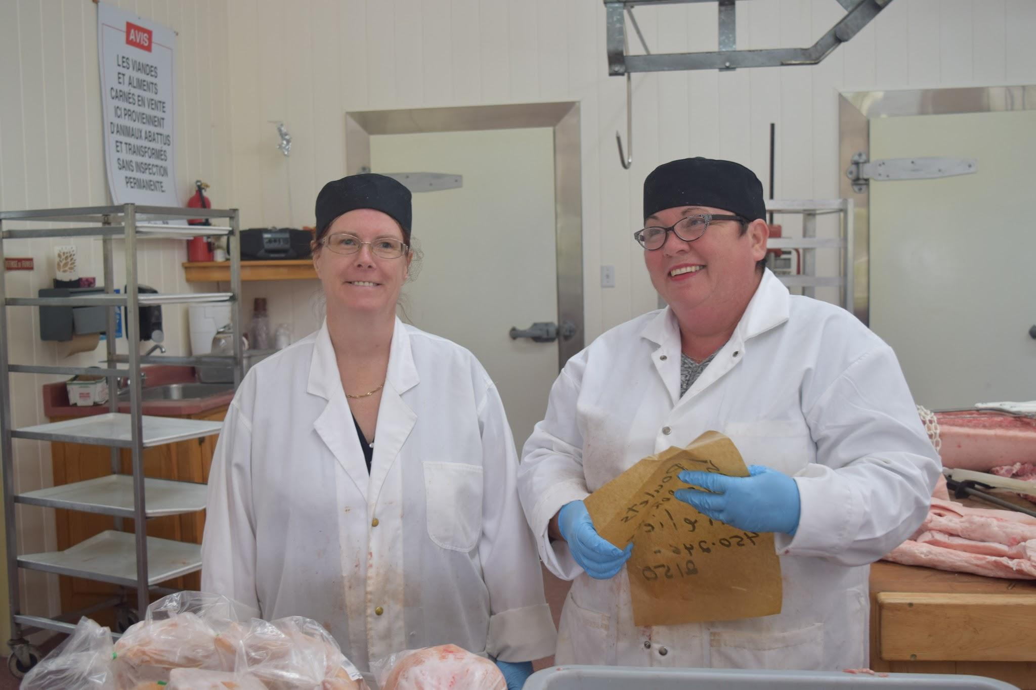
Principle 1: Respect each person in each country
For example: you like to check your salary as worker in a butchery | You like to check your labour rights. Are you entitled to the minimum wage?

Slide 5
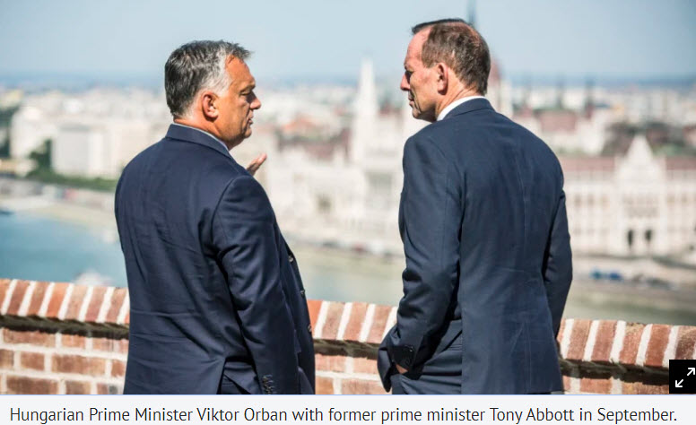
Principle 2: Governments need data for decisions, so do People
Your need reliable data to take important decisions | You need simple, cheap tools to decide for yourself, your kid, your family, your employees, your health!

Slide 6
What do we create together?

Slide 7
Labour Law
We present Labour Law pages for over 100 countries, as detailed as possible in national languages. Advantage: workers and employers can check the law, follow the links to their labour code, and compare with other countries.
TESTIMONIAL
Trade Union leader: thanks to these labour Law pages in the Mywage website, I understand the labour law in my country.

Slide 8
The Decent Work topics we address - 1
Minimum wages
Employer pays employees a minimum wage
Employer pays wages on a regular basis
Employment contract
Written employment contract, fixed-term contracts less than #36 months
employment contract provides probation period
employer hires no contract workers for permanent tasks
workers can terminate employment without pressure
Working time
working hours are less than #54 hours per week, employer does not force to work more than #54 hrs p/w
a weekly rest day, paid day-off on national public holiday
premium pay for working on rest day/holiday
annual paid leave of at least #12 working days
Maternity
13 weeks of maternity leave, paid leave, nursing breaks, paternity leave, paid leave
pregnant workers exempted from night work, workers on maternity leave or pregnant are not dismissed, free medical care,

Slide 9
The Decent Work topics we address - 2
Health and safety
fire extinguisher, control of ventilation and temperature, free protective equipment or measures
on-site medical facilities, training on health and safety issues
paid sick leave
Social security
occupational injury benefits, old age pension rights, survivors/dependents benefits
Fair treatment
women and men are paid equal for equal work
no cases of sexual harassment reported last year
no discrimination due to religion reported
no labour of children under #15 years
no adolescents under #18 in hazardous work
Right to organise
covered by a collective agreement about wages
employer allows workers to join a trade union, to hold a strike
no discrimination of trade union members

Slide 10
Return to work surveys in WageIndicator websites - a survey needs a home -1
Slovakia
https://mojplat.sk/pravo/praceneschopnost/spat-do-prace-po-chronickej-chorobe
United Kingdom
https://wageindicator.co.uk/advice/work-and-sickness/return-to-work-after-sickleave
Ireland
https://mywage.org/ireland/labour-law/work-and-sickness/return-to-work-after-sickleave
Italy
https://iltuosalario.it/le-leggi-italiane-sul-lavoro/malattia/rientro-al-lavoro-dopo-un-congedo-di-malattia
Belgium
https://votresalaire.be/droits/travail-et-maladie/retour-a-lemploi-apres-une-maladie
https://loonwijzer.be/arbeidsrecht/ziekte-en-werk/weer-aan-het-werk-na-ziekte
Netherlands
https://loonwijzer.nl/arbeidsvoorwaarden/ziekte-en-wia/weer-aan-het-werk-na-ziekte
Romenia
https://salarulmeu.ro/drepturile-tale/munca-si-boli/reveniti-la-munca-dupa-concediu-medical
France
https://votresalaire.fr/droits/travail-et-maladie/retour-a-lemploi-apres-une-maladie
Estonia
https://mysalary.ee/toooigus/haiguspuhkus/toole-tagasi-poordumine-parast-rasket-haigust

Slide 11
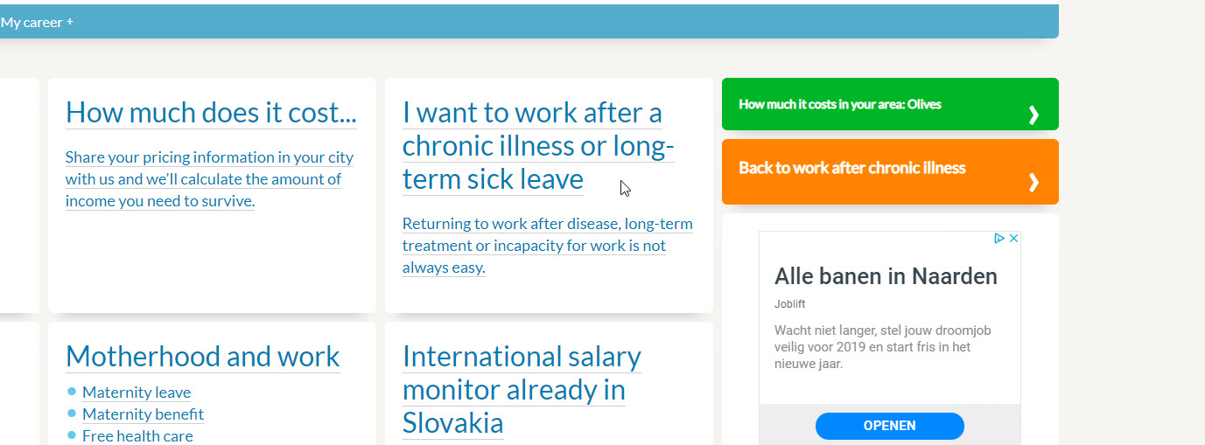
Return to work surveys in WageIndicator websites - a survey needs a teaser in the website - 2

Slide 12
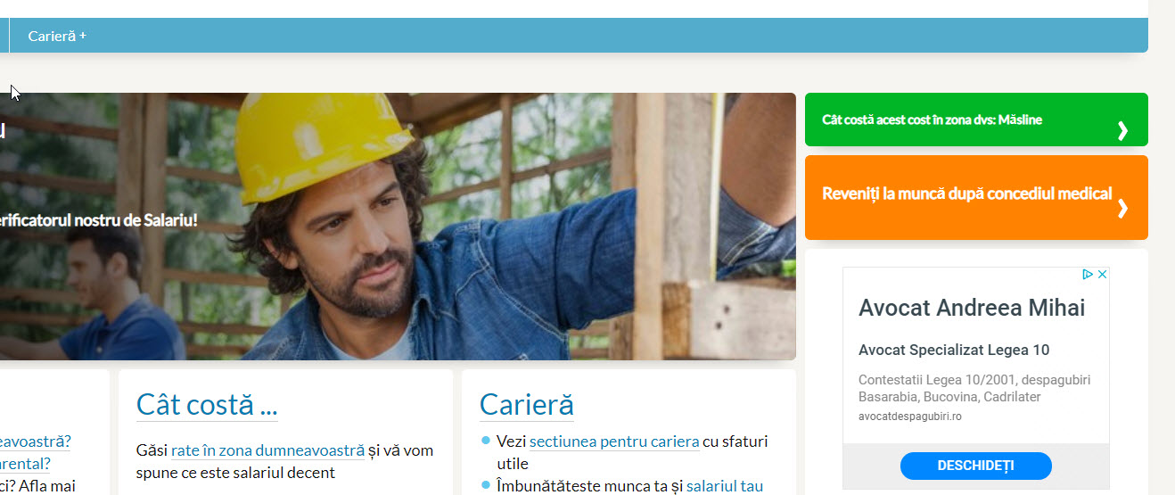
Return to work surveys in WageIndicator websites - a survey needs a banner - 3

Slide 13
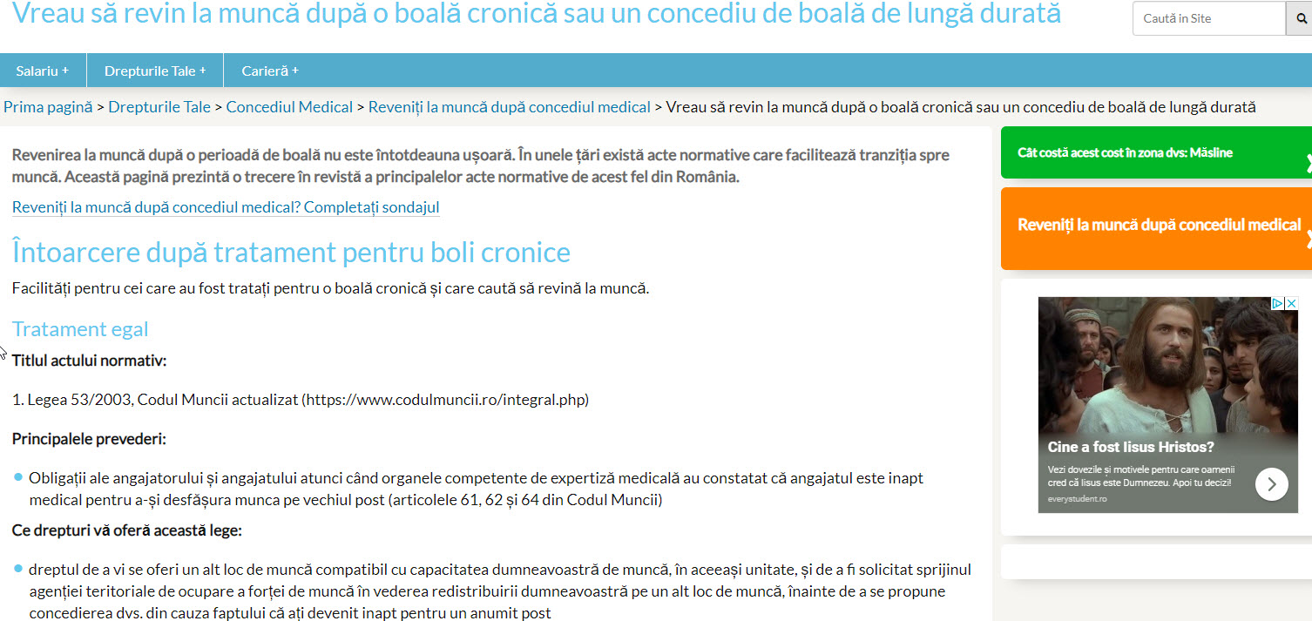
Return to work surveys in WageIndicator websites - a survey needs context - 4

Slide 14
Return to work surveys in WageIndicator websites - a survey needs follow up in Facebook/Twitter - 5
Any Facebook / Twitter account - please use it.
As shown by CELSI - Slovak workers survey Return to Work collected more than enough respondents
BUT Facebook / Twitter might be not enough

Slide 15
Return to work surveys in WageIndicator websites - a survey needs follow up in special groups by email - 6
Where Loonwijzer ( more than half a million users per month) had enough respondents (50 by using the sites home page for 3 weeks, used Clesi Facebook for Slovak.
An other way:
ask special groups of patients to share the survey link from WageIndicator in their Facebook group, or via email. The Irish will do this for the Arthritis group.

Slide 16
Return to work surveys in WageIndicator websites - and nobody wants to complete the survey, then what? - 7
Given that you tried all options to make sure that 50 relevant people in your country answer the survey:
option one - do it as described above 4 to 5 steps - smart/ reasonable cheap - and don't give up!
option two - buy banners at facebook and google with a link to the survey, make sure the survey will be completed, by adding a facebook tag in the end of the survey. (this is last resort)

Slide 17
Return to work surveys in WageIndicator websites - Results so far - 8
latest info by Adam on Friday morning

Slide 18
By end of 2020 in 150 countries

Slide 19
Paulien Osse
Director
WageIndicator Foundation
p/a University of Amsterdam/AIAS-HSI
Nieuwe Achtergracht 166
1018WV Amsterdam
The Netherlands
+31 6 539 77 695
paulienosse@wageindicator.org
www.wageindicator.org

