Slide 1
EESDA survey
Preliminary analysis
Monika MartiŠková (CELSI)

Slide 2
About the survey
Openned since October 2018
Completed responses 81 (111)
Topics:
  Involvement into the EU level social dialogue structures
  Topics social partners adress in the EU
  social dialogue structures
  Outputs
  Opinion on the EU level SD

Slide 4
Partners and responses rates
Partner | Country | Number of responses | Partner | Country | Number of responses
CEPS | Belgium | 4 | UG | Sweden | 5
CEPS | Netherlands | 2 | UG | Finland | 2
CEPS | France | 2 | UG | Denmark | 4
CEPS | Luxemburg | 2 | UG | Germany | 5
CEPS | Ireland | 1 | UG | Austria | 2
CELSI | Czechia | 6 | CCP | Spain | 0
CELSI | Slovakia | 7 | CCP | Portugal | 4
CELSI | Poland | 3 | CCP | Italy | 0
CELSI | Hungary | 4 | CCP | Greece | 0
CELSI | Croatia | 4 | CCP | Cyprus | 0
CELSI | Slovenia | 3 | UT | Estonia | 8
CELSI | Romania | 2 | UT | Lithuania | 5
CELSI | Bulgaria | 5 | UT | Latvia | 8
 |  |  | UT | Malta | 8

Slide 5
  Organizations involvement into the EU level social dialogue structures
Does your organization participate in EU-level social dialogue structures?
 | Responses
Yes | 74,42% | 64
No | 25,58% | 22

Slide 6
Reason for non-participation
(more than one answer possible)

Slide 7
Where SP participate?
Notes:
The Social Dialogue Committee (SDC) is the main European forum for bipar­tite social dialogue at the cross-industry level. It normally convenes 3 times per year. The SDC consists of maximum 64 representatives of social partners, equally divided between the employers’ organizations and trade unions and including the EU Secretariats of the cross-industry social partners, as well as representatives from the national member organisations on each side. The parties negotiate and adopt joint texts, plans and follow up on their joint initiatives.

Slide 8
Who represents the organization?

Slide 11
Reason for change in representation

Slide 14
SP making their own proposals
N=71

Slide 15
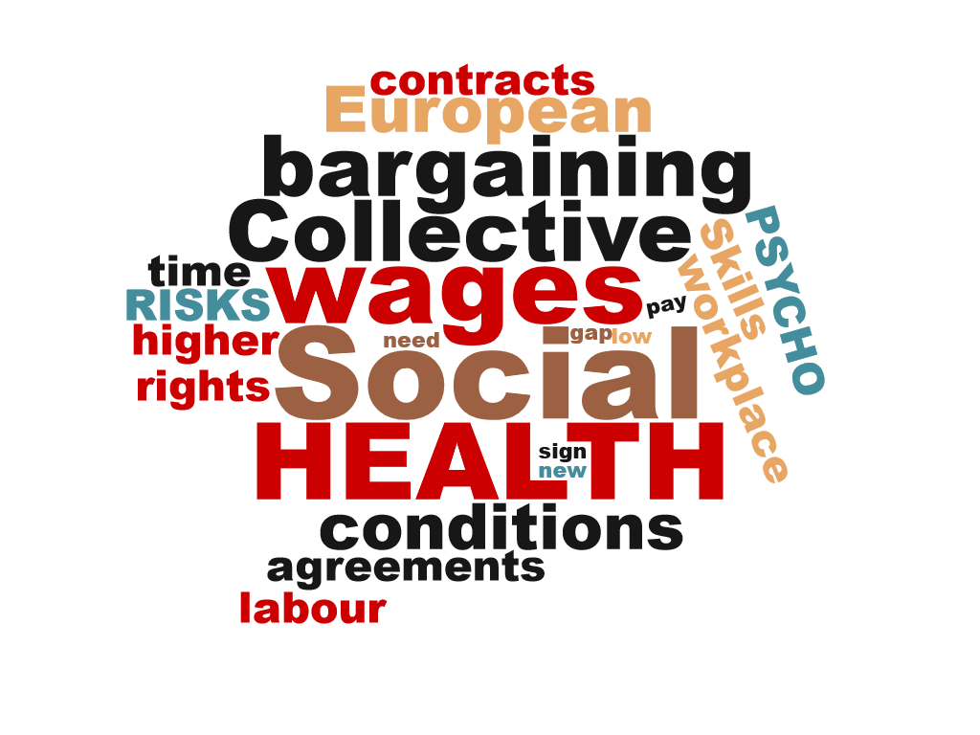
Topics suggested

Slide 16
Forum where the topic was suggested

Slide 17
What was the final output of your proposal?

Slide 18
Do you have a specific experience where a specific output of EU-level social dialogue contributed to a real-life change in your members’ business or working lives? It can be both positive or negative.
 | Responses
Yes | 53,85% | 28
No | 46,15% | 24
 | Answered | 52
 | Skipped | 45

Slide 19
Opinion on social dialogue

Slide 22
Respondents and their participation at the EU level social dialogue
75% of our respondents participates on the EU level SD structures
The most often reason for non-participation is: lack of financial resources, insufficient capacities (e.g. personal), and the language barrier
SP mostly participates on the meetings of sectoral organizations and ESSD meetings and European social dialogue committee
In general employees represents organizations at the EU level SD meetings, in both employers and TU organizations
BUT if specific meeting is considered representation changes, e.g. in ECOSOC meeting it is more often elected representatives, while on ESSD it is an employee
The delegations are mostly stable, there is no one clear reason for changes in representation

Slide 23
Topics addressed at the EU level
When the most frequent topics of ESSDCs are considered, they have been mostly assessed as „discussed appropriately“, or „could be addressed more often“
More than half of SP propose their own topics, using mostly meetings of EU-level sectoral organization (24%), or ECOSOC meetings (19%) or European social dialogue meetings (19%)
Most of the suggested topics are either only discussed with no proposal, or are transposed to agenda and lead to non-binding outcome
When it comes to assessment of the most frequent topics and their ideal outcome, either council directive or soft-tools of joint opinions are considered the most suitable. The highest preference for council directive is in the health and safety issue.
In general, organizations are satisfied with the current structure of outputs
There is no clear result on the answer if SD output contributed to real-life change, which corresponds also with another question about the tangible effects, when majority replied „sometimes“

Slide 24
Opinion on EU level social dialogue
Discussion initiation is possible, only fraction of respondents replied it is impossible
Increasing importance of the Eu level SD: Majority of the respondents see the EU level as it should become more important for EU-level policy making (36%) and another 25% replied it will become more important
Implementation is an issue: Respondents would like to see improvements in the depth of social dialogue, and in more negotiations instead of only information exchange and consultations, in the way EU agenda is transposed to social dialogue agenda in the own country and in the implementation follow-up procedure

