Slide 1
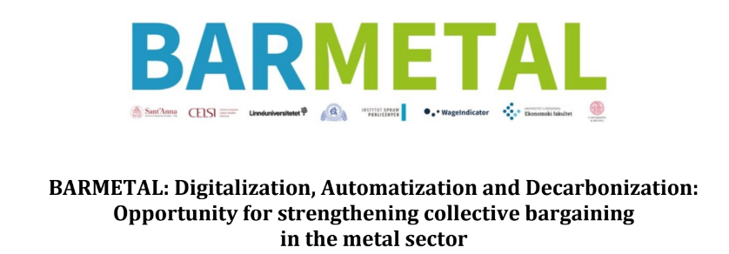
Facing D-A-D challenges at the EU-level and key learning points for the metal sector across Europe
Monika Martišková, Barbara Surdykowska, Angelo Moro, Maria Enrica Virgillito

Slide 2
Context
Over the last three decades, a trend common to most European countries has led to the progressive softening of social dialogue institutions and the liberalisation of collective bargaining, through the weakening of the national/sectoral level and the strengthening of the local/firm level.
Challenges posed by D-A-D are considerably diversified and strongly depend on the different collective bargaining and social dialogue institutions and opportunities in each country
Context of labour market situation and institutions matters (SMW, retraining policies etc)

Slide 3
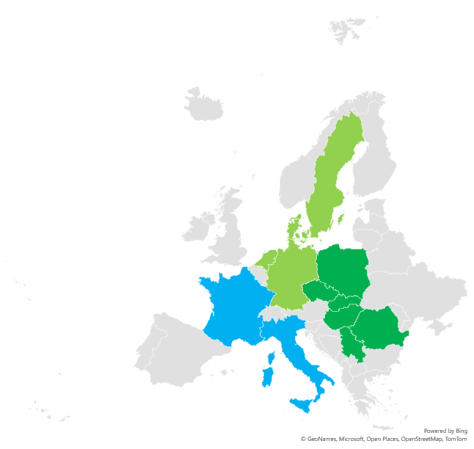
Social dialogue and DAD challenge in the EU countries
DAD rarely the subject of in-depth social dialogue at company level, even less so of collective bargaining
Regarded by management as an exclusive prerogative, not requiring consultation with workers‘ representatives (in many cases this view is shared by trade unions e.g. NL, RO, or PL)
In Germany future-oriented agreements play an important role and are increasingly concluded not only at sectoral but increasingly at company level
Denmark, Sweden and the Netherlands part of consultation and workers participation processes
France and Italy – heterogenous results of company level bargaining
In CEE – there is a call for coordinated approaches to adress DAD challenges (especially in training policies), but not via SD, limited participation of employers

Slide 4
EU level social dialogue in metal industry – the state of the art
European Sectoral Social Dialogue Committee (ESSDC) for metal sector discusses situations in the sectors of the manufacture of fabricated metal products, computer, electronic and optical products, electrical equipment, machinery, motor vehicles, and other transport equipment
Non-binding outcomes only: Topics of the joint texts typically evolve around skills and development, vocational education and training and highlight the importance of participation of social partners (while preserving the authonomy of social partners)
Social partners IndustriAll and CEEMET communicate with the European Commission, and engage in policy-making so ESSDC remains important platform for discussing the challenges related to the labour market and its transformation.
Exchanging information and best and bad practices from affiliates of social partners. BUT opposition to any kind of EU regulation in this area because of the diversity of national collective bargaining systems (and education systems)
Informal interactions with other stakeholders are even more important, e.g. with DG Employment is appreciated, and not only through the formal consultations, but also at informal meetings, joint events that are organised in order to pass the messages to the policymakers. Other actors active in social dialogue around D-A-D also confirm the importance of informal tights

Slide 5
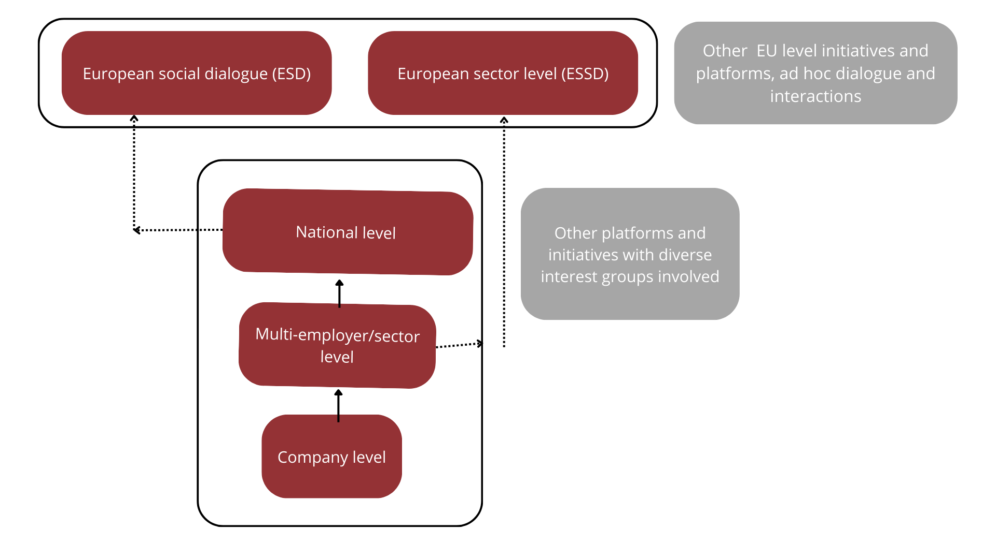
Role of social dialogue in EU level policies
What we observe is the growing importance of informal tights
Wider coordination between national affiliates and EU level organisations is not present – low level of articulation between national and EU level (lack of participation of national affiliates)
Parallel to what we observe at the national level in many countries, that company level is the most important decision making unit -> low level of coordination and articulation of interests at sector/national level
Undermining the scale effect of coordination and increasingly observed spontaneous coordination among employers, which undermines the public policies in education and reskilling

Slide 6
Challenges
Strengthen the role of the Sectoral Social Dialogue Committee (SSDC) on D-A-D issues, in particular by favouring the gradual achievement of a consensus among social partners that would lead to a real collective bargaining process
Improving the coordination with the national levels through the greater involvement in the European social dialogue of the more reluctant social partners, especially from CEE countries
Raising social partners’ and stakeholders' awareness of the need for an integrated and coordinated approach to training and re-skilling at regional and national level, but supported by the EU level

Slide 7
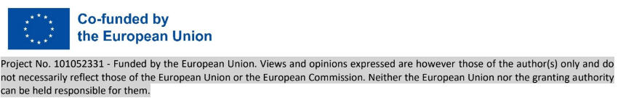
Thank you for your attention!

