Slide 1


Implications of deep decarbonization of high emission industries on labour market and employees (DEEPLAB)
CELSI Frontiers seminar 6.12.2024
With a focus on Slovakia
Názov projektu: Implications of deep decarbonisation of high emission industries on labour market and employees in Slovakia (DEEPLAB)
Project number: 09I03-03-V04-00768
Monika Martišková, PhD.
Jakub Barszcz, MSc.

Slide 2
Project Objectives
Two layers of the project:
to understand the consequences of the decarbonization on labour market under different scenarios of technologies implementation and discuss policies that can be derived from the modelled scenarios.
methodologically, we aim to map the interaction between qualitative and quantitative methods (the impact of the stakeholders' involvement in the quantitative modelling)
Projects aims
Mapping the scale and scope of decarbonization across the Slovak industries
Collecting inputs on considered deep decarbonization pathways with industry actors and labour policy representatives
Model the decarbonisation of selected sectors by 2030, 2040 and 2050 using at least three different scenarios assessed through an adapted multi-regional structural model IMPACTECH
Share the results with the scientific community
Share the results with stakeholders and provide salient evidence and through co-creative workshops provide recommendations for policy-making.

Slide 3
01
02
A brief introduction
Methodology
03
04
Innovativeness
Discussion
The what and why of decarbonisation.
We describe our methodology.
What does our study bring to the table?
Questions, comments, concerns?

Slide 4
01
(A brief) Introduction to (deep) decarbonisation

Slide 5
Deep decarbonisation:
Rapid reduction of greenhouse gas (GHG) emissions by 2050 or before.

Slide 6
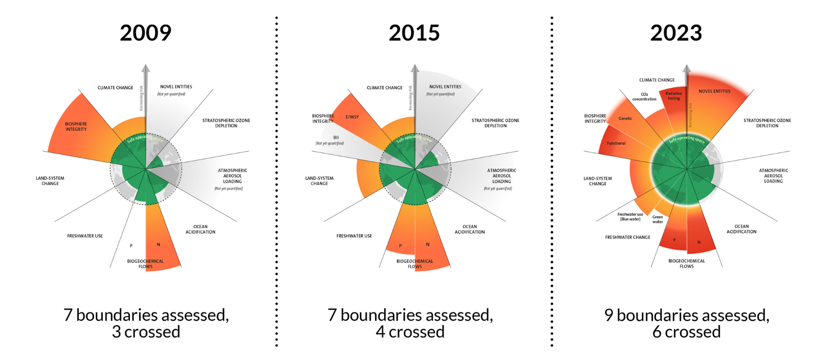
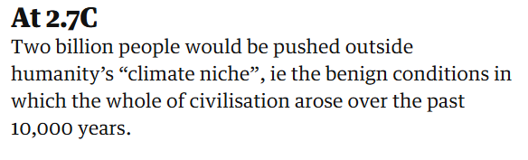
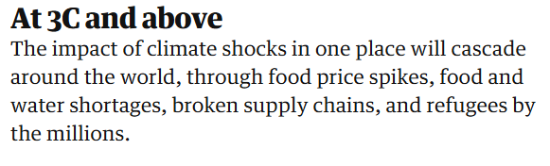
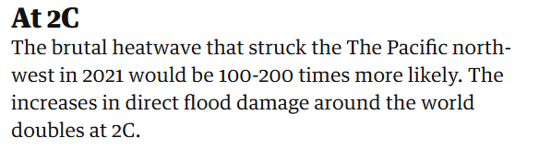
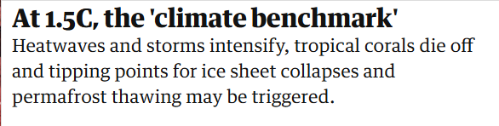
The Global View: Why Decarbonisation?
Anthropogenic climate change and environmental deterioration - a serious problem.
Sources: Stockholm Resilience Centre and the Guardian
Notes:
Anthropogenic climate change, enviro deterioration, and global warming refer to human activity which negatively impacts nature - climate, environment, and more - through actions such as, f.e., burning fossil fuels or material extractivism.
Sources for images: https://www.theguardian.com/environment/article/2024/may/11/brutal-heatwaves-submerged-cities-what-3c-world-would-look-like and https://www.stockholmresilience.org/research/planetary-boundaries.html
By the millions is an optimistic estimate, in my account.

Slide 7
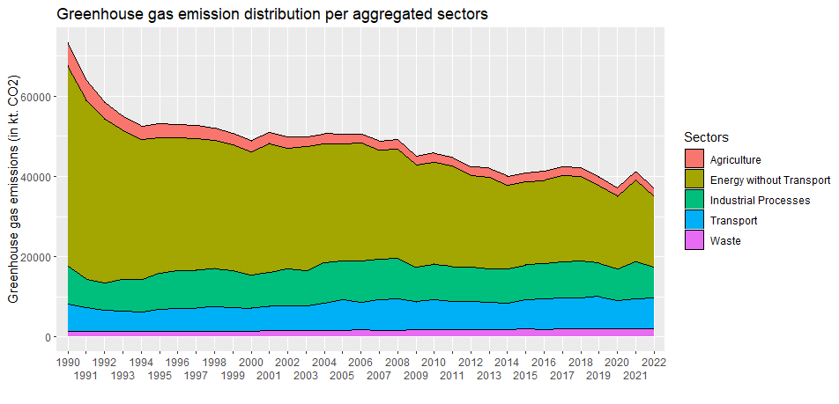
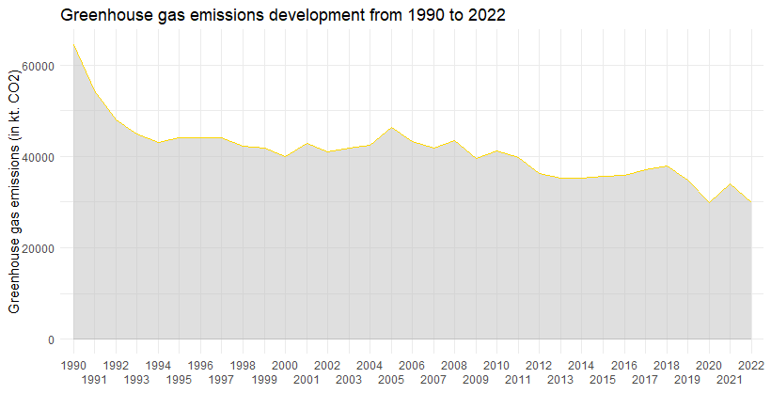
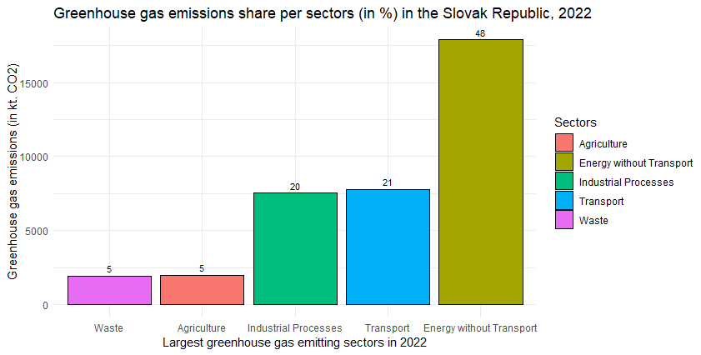
The View from Slovakia: GHG Emission Development (1)
Source: Slovak National Inventory Report 2024

Slide 8
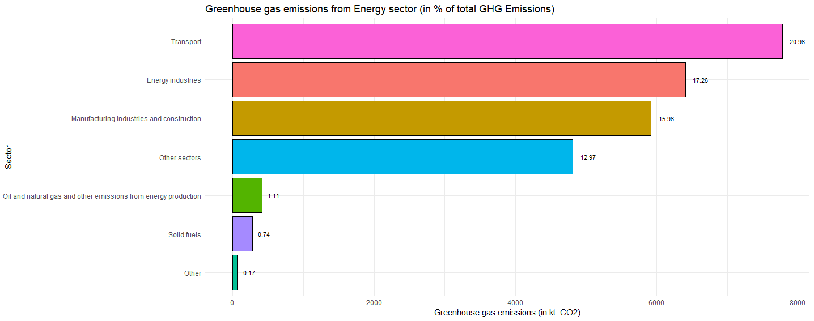
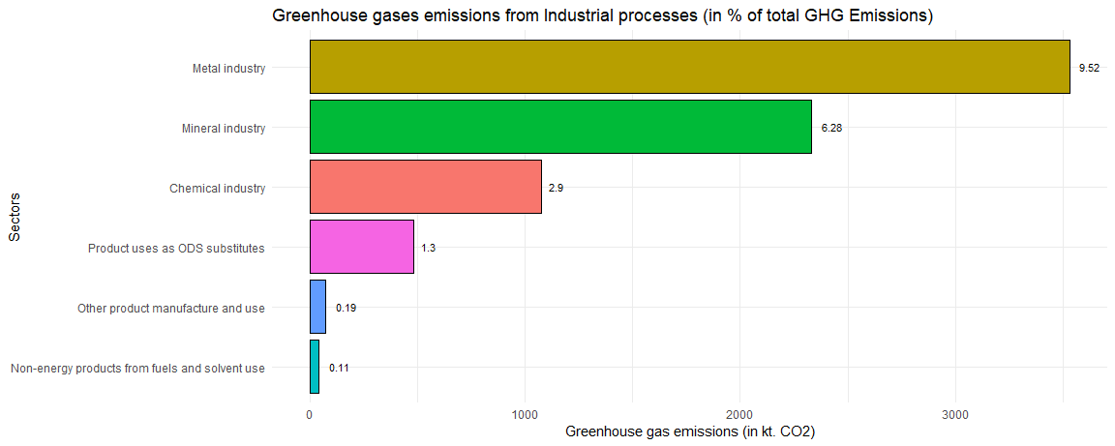
The View from Slovakia: Disaggregated Sector View (2)
Source: Slovak National Inventory Report 2024

Slide 9
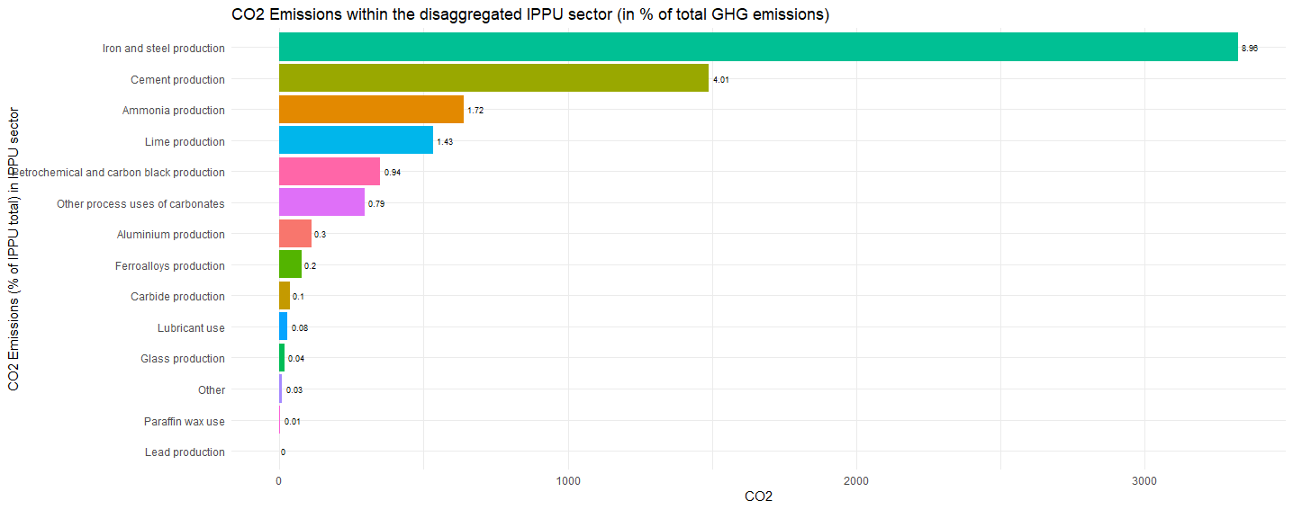
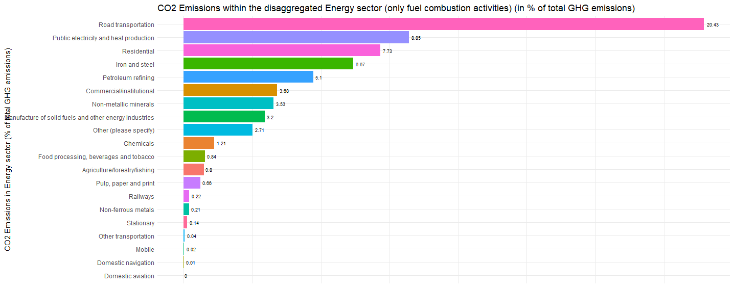
The View from Slovakia: (Even More) Disaggregated Sector View (3)
Source: Slovak National Inventory Report 2024

Slide 10
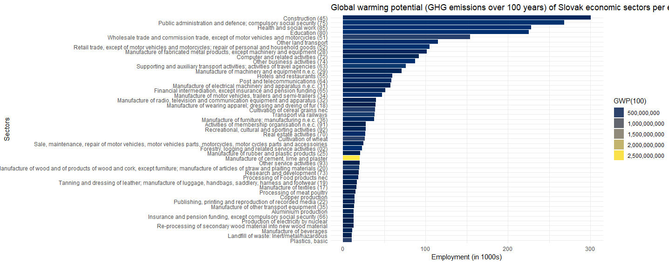
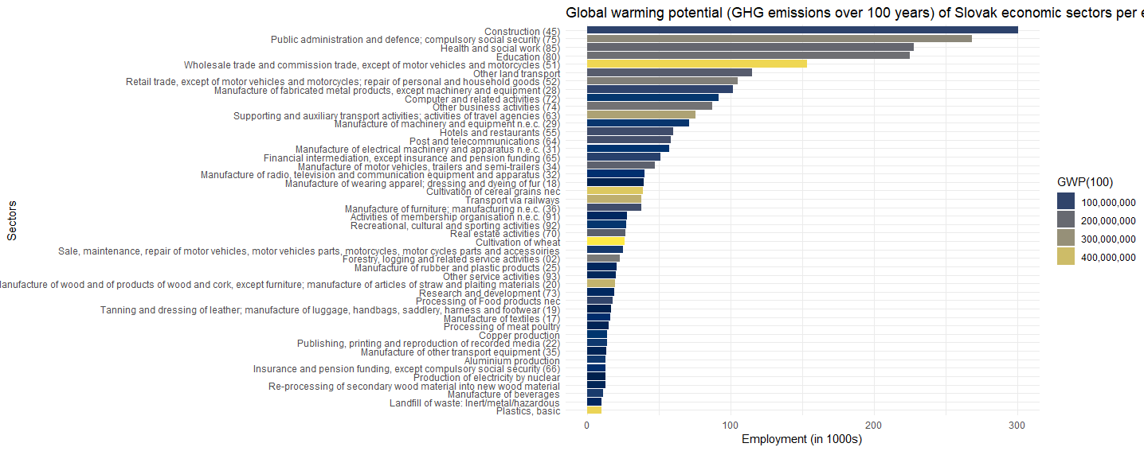
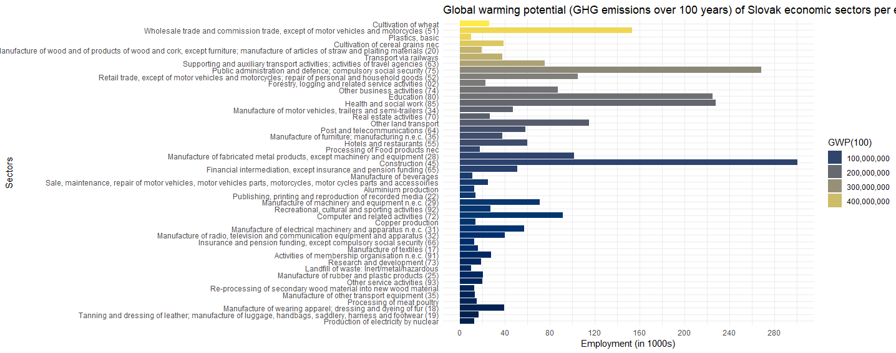
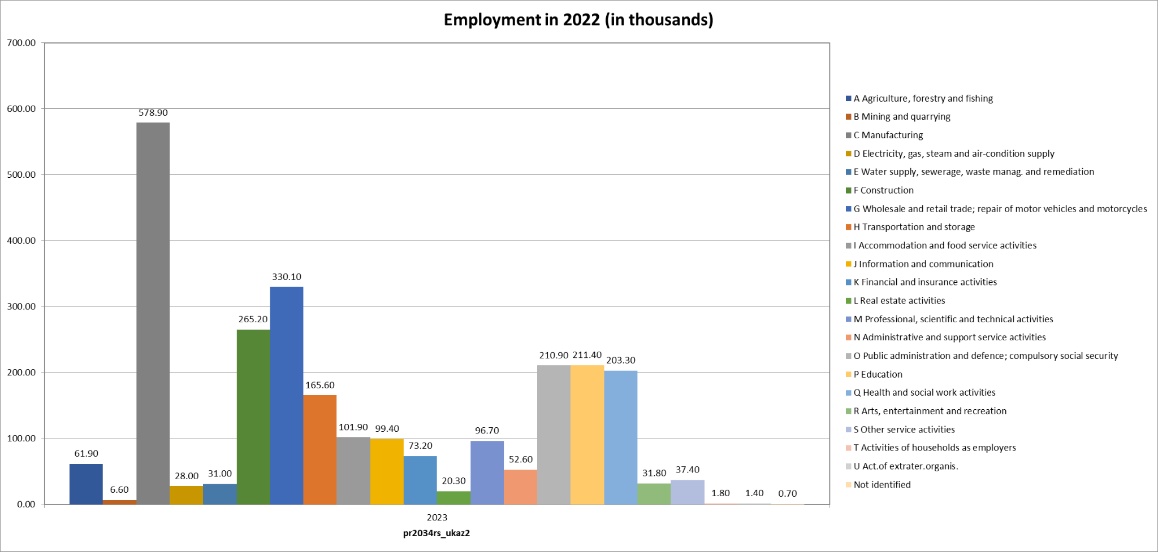
The View from Slovakia: Contrast with Employment (4)
Source: Statistical Office of Slovakia, EXIOBASE

Slide 11
UNDERSTANDING THE PROBLEM
Energy and Transport
IPPU
Construction
Road transport, public heating, residential, iron and steel, etc.
Steel and iron, ammonia, lime, and similar processes.
Cement production.

Slide 12
Possible decarbonisation technologies

Slide 13
Mostly same as before…
Steel and Iron | Road Transport | Construction | Chemicals (Plastics)
Direct reduction of iron (using nat. gas) Direct reduction of iron (using hydrogen) Carbon Capture, Utilisation and Sequestration Technologies | Battery electric vehicles Hydrogen vehicles Fuel cell powered vehicles | Carbon Capture, Utilisation and Sequestration Technologies Electric kiln + CCS Separation | Electric steam cracking technology Carbon Capture, Utilisation and Sequestration Recycled feedstock - chemical/mechanical, or biomass feedstock
Technology Readiness Level (from the IEA):
DRI (5-6) H-DR (6) CCUS (7) | EV (9) Hydrogen (6) Fuel Cell (9-10) | Electrification (5-6) CCUS (6) | Feedstock (4-7) ESC (5) CCUS (6)
Notes:
For feedstock changes, varieties are: recycled: chemical or mechanical, biomass, carbon capture and utilisation).
For alternative vehicles: (battery, fuel cell, hydrogen, etc)

Slide 14
Alternative pathways - Decarbonisation Scenarios
Full electrification?
Carbon capture, utilisation, and sequestration?
Business as usual?
Recycling?
Other?
Notes:
For feedstock changes, varieties are: recycled: chemical or mechanical, biomass, carbon capture and utilisation).
For alternative vehicles: (battery, fuel cell, hydrogen, etc)

Slide 15
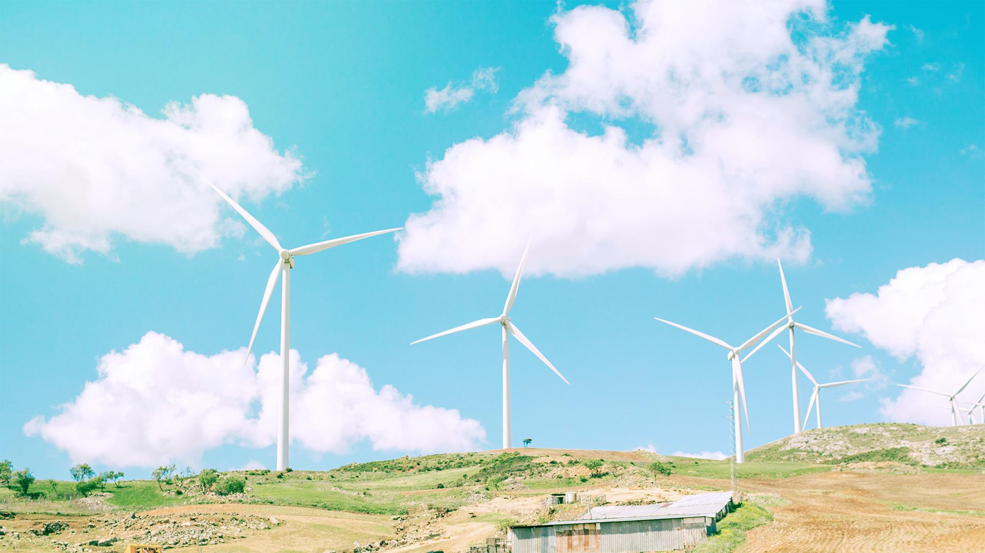
02
Methodology

Slide 16
Quantitative Section: Input-Output Analysis (1)
Developed by Wassily Leontief in the 1930s.
One of the most widely applied methods in economics.
The Basics
Advantages
Limitations
Geographic region(s) captured in econ data.
Flows of products across industries.
Extended to environment, employment, etc.
Interconnection of production and consumption with socio-economic indicators.
Covers complete impacts of changes through the supply chains - direct, indirect, induced effects.
Unconstrained prod. capacity.
Fixed input structure.
Fixed relationship between quantity and price.
Notes:
While we solve the problem of unconstrained production capacity by integrating external scenarios for which we assume the feasibility of their demands on the relevant inputs (from other sectors as well as labour and capital), the fixed structure of inputs in key industries is to some extent solved by dividing them into individual production technologies.
The fixed relationship between quantity and price then plays only a limited role given the indicators under consideration (labour demand in number of persons and the ratio of labour demand vs. capital demand) - as such, the model works overall with base year prices, i.e. 2015.

Slide 17
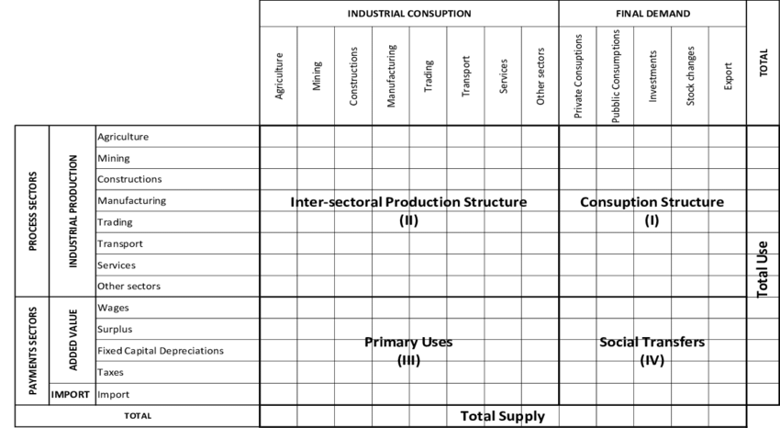
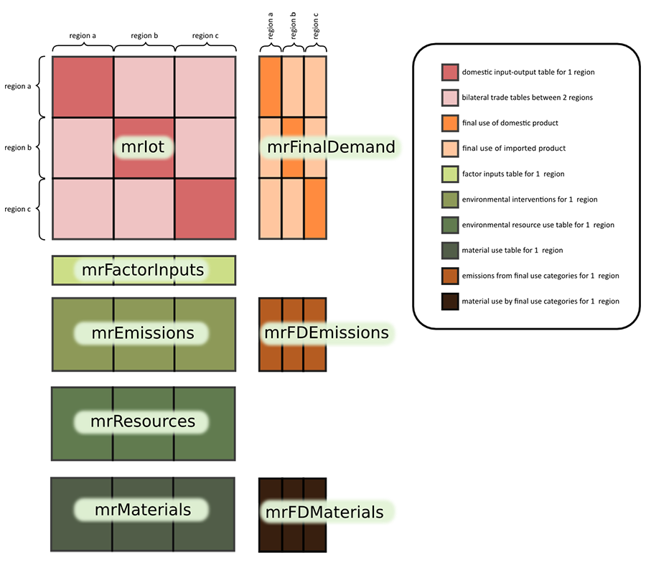
Notes:
Source: Basic structure: https://www.researchgate.net/publication/342823701_InputOutput_models_for_freight_transport_demand_a_macro_approach_to_traffic_analysis_for_a_freight_corridor?_tp=eyJjb250ZXh0Ijp7ImZpcnN0UGFnZSI6Il9kaXJlY3QiLCJwYWdlIjoiX2RpcmVjdCJ9fQ
MRIO: Exiobase website.

Slide 18
Quantitative Section: Input-Output Analysis (2)
Exiobase v. 3.8.2
A time-series of environmentally extended MRIO tables from 1995. Latest data should be available at the very least up to 2018 (but also until later dates).
IMPACTECH model
Models the economic impacts of a low-carbon energy transition. Can evaluate impact of technological changes over a given time horizon (f.e. in terms of employment, GHG, etc.)

Slide 19
Basic IMPACTECH Requirements (3)
SCENARIOS
OP-EX
Workforce projections
Diverse technological mixes and their use within production.
Operating expenditures and their projections for modelled technologies.
Projections of workforce share by skill levels.

Slide 20
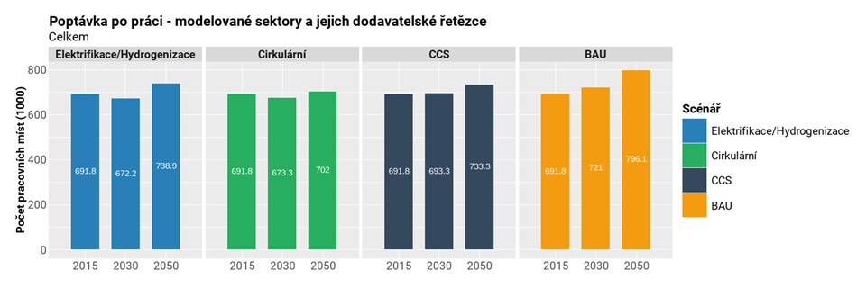
Results: Example from the Czech case (in 2022)
CUSTOMIZE IT!
VENUS
If you want to modify this graph, click on it, follow the link, change the data and replace it
JUPITER
MARS
Source: CELSI & Martin Černý, PhD. (2022)

Slide 21
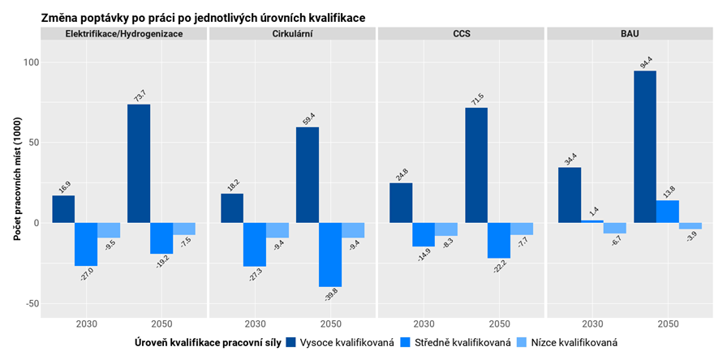
Results: Example from the Czech case (in 2022)
Source: CELSI & Martin Černý, PhD. (2022)
Notes:
For further info: https://www.socialguarantee.org/
Guaranteed income refers to minimum income threshold, real living income refers to living wage, basically. US - set of services necessary to meet basic human needs, free (or provided at a predefined level) at point of provision.

Slide 22
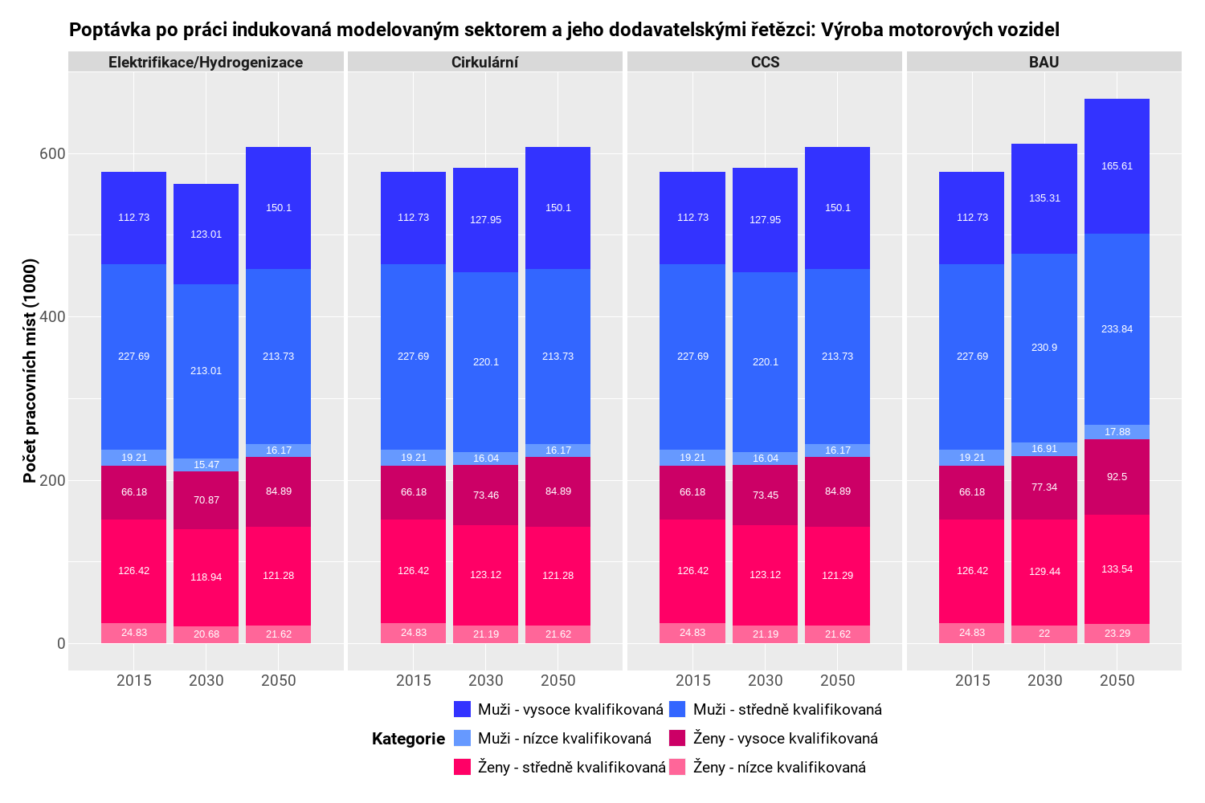
Results: Example from the Czech case (in 2022)
Source: CELSI & Martin Černý, PhD. (2022)
Notes:
For further info: https://www.socialguarantee.org/
Guaranteed income refers to minimum income threshold, real living income refers to living wage, basically. US - set of services necessary to meet basic human needs, free (or provided at a predefined level) at point of provision.

Slide 23
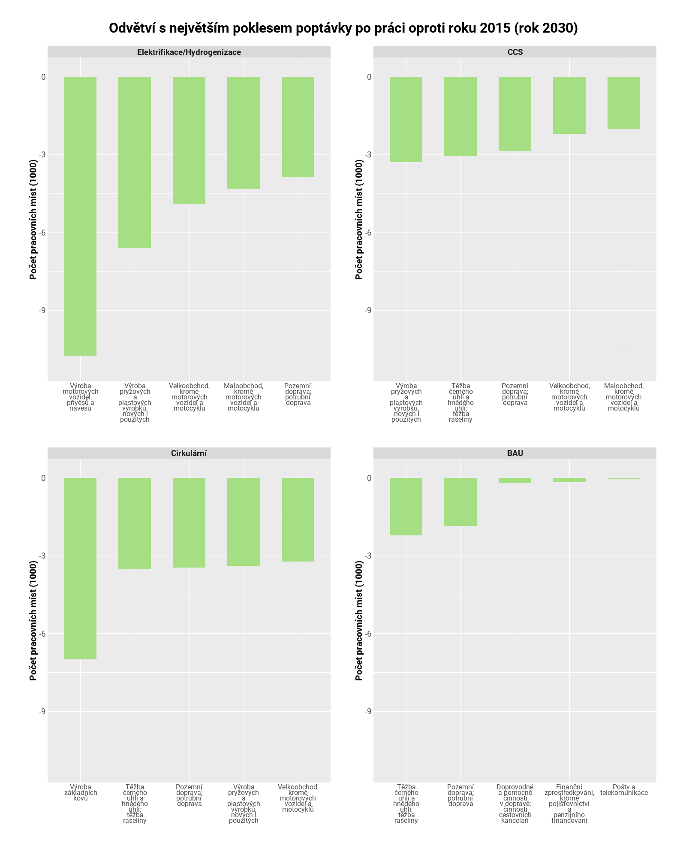
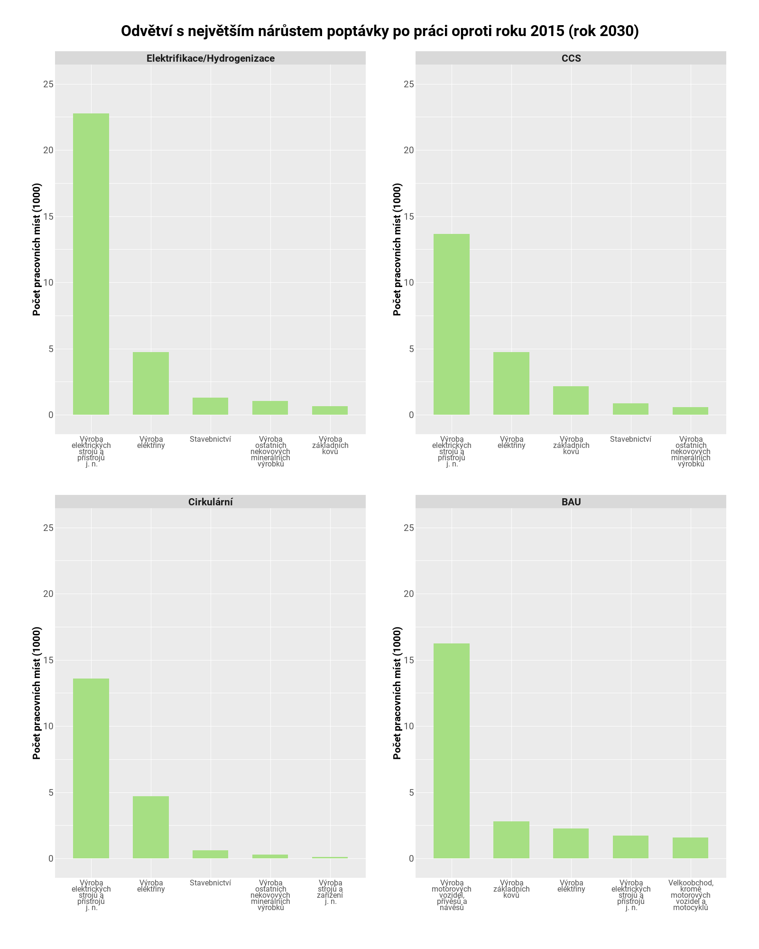
Notes:
For further info: https://www.socialguarantee.org/
Guaranteed income refers to minimum income threshold, real living income refers to living wage, basically. US - set of services necessary to meet basic human needs, free (or provided at a predefined level) at point of provision.

Slide 24
Qualitative Section:
Stakeholders involvement
Deep Decarbonization Pathways Framework

Slide 25
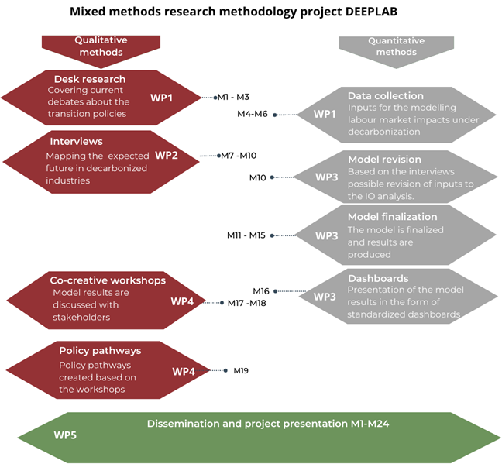

Slide 26

03 Innovativeness

Slide 27
Innovativeness: Explorative research
Explorative mix methods
Participatory in policy making
Combining quantitative and qualitative methods based on Deep
‘Participants develop explicitly normative scenarios together, testing their feasibility and implications.’
Notes:
In other words, criteria are developed for a sustainable, and desirable, future, which are then used as a guide for the design and implementation of measures that may facilitate progress towards that future.
Advantages:

Slide 28
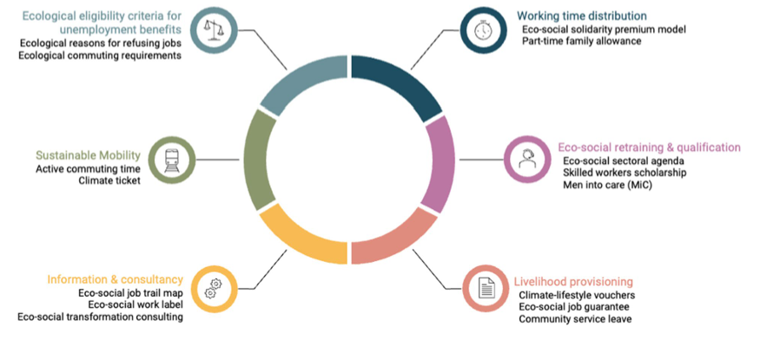
Innovativeness: Eco-social policies for deep decarbonisation
Source: Neier et al. (2024), Navigating labor-market transitions: an eco-social policy toolbox for public employment services
Notes:
Neier et al. (2024) as source for eco-social PES measures and as source for the figure, Bohnenberger (2020): Greening work: labor market policies for the environment, for other ideas highlighted below (on unions specifically).. Add: strengthening role for unions and climate insurance, time-banking, ecological transformation income. In some stronger forms - ecol. Transformation income in the form of UBI, UBS, or UBVs. Active and strong participation of unions (and hence, stronger role for unions in SVK context) - e.g. IG Metall example in Germany, or conversion scenarios such as that of UK Commercial and Services Union - planned conversion scenario for flight attendants to become train attendants. Also non-formalised knowledge of plant workers - not useful for production process, but incredibly useful for transformation. Here - argument for further cooperatives even (to be discussed).
For UBS - ‘green new deal’s component of a social guarantee.’ https://www.socialguarantee.org/

Slide 29
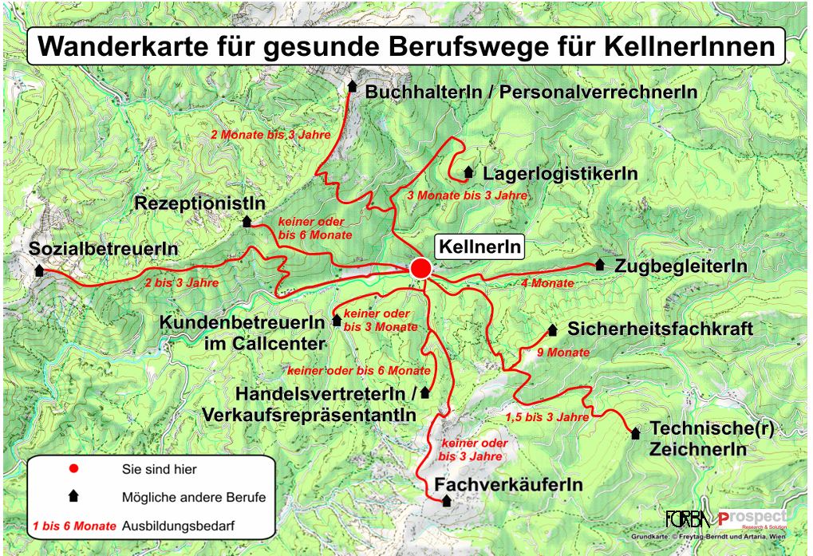
Notes:
The map includes:
- Reflection on your job, skills, etc.
- Description of possible pathways,
- Links to relevant resources/names of relevant resources,
Etc.
Source: Flecker et al (2012) Prototyp einer „Wanderkarte“ für gesunde Berufswege Materialien zur Unterstützung von Berufswechseln aus Berufen mit begrenzter Tätigkeitsdauer

Slide 30
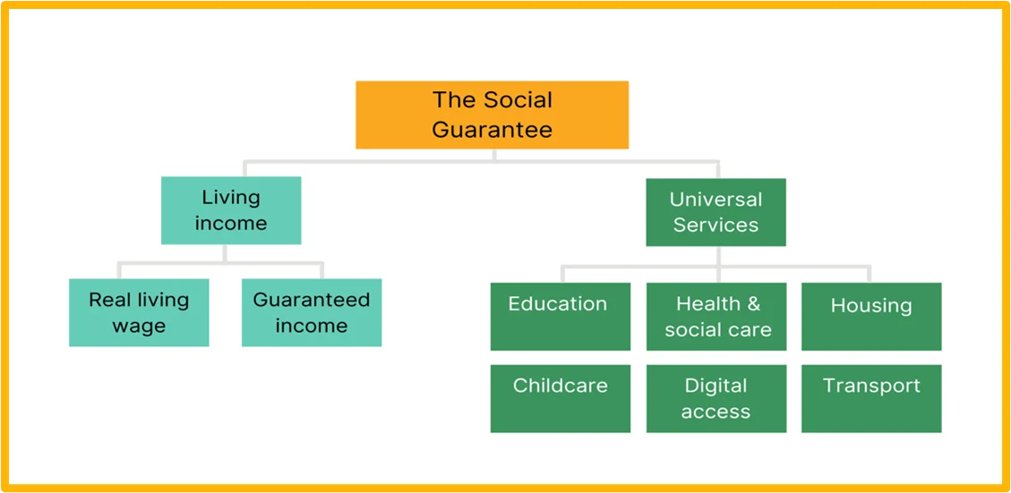
Inovativeness: Eco-social policies for deep decarbonisation
Source: Coote (2021), Towards sustainable wellbeing: The social guarantee and universal services
Notes:
UBS is grounded in the vision of a ‘safe and just space for humanity’. It seeks to realise the vision by cutting greenhouse gas (GHG) emissions and safeguarding ecological limits, by promoting greater equality and by establishing secure social foundations for all.

Slide 31
04 Discussion
Comments about the mixed methods approach?
How to make the project impactful in Slovakia?
How to present the results in academia and how to policy makers?
Any other questions or comments are welcomed.
Thank you for your attention!
Monika Martišková & Jakub Barszcz
Notes:
For further info: https://www.socialguarantee.org/
Guaranteed income refers to minimum income threshold, real living income refers to living wage, basically. US - set of services necessary to meet basic human needs, free (or provided at a predefined level) at point of provision.

