Slide 1



Impacts of deep decarbonisation in a small, open economy
With a focus on employment and the labour-market
Project: Implications of deep decarbonisation of high emission industries on labour market and employees in Slovakia (DEEPLAB)
Project number: 09I03-03-V04-00768
Monika Martišková, PhD
Jakub Barszcz, MSc
Presentation CELSI Frontiers Seminar, Bratislava, 20.6.2025

Slide 2
Table of contents
01
03
02
04
Methodology & Method
Preliminary results
How we go about getting results.
How we go about getting results.
What do we model?
Conclusion and Q&A
Model assumptions and utilized scenarios.
Short summary of the presentation.

Slide 3
Project goals – a quick reminder
Objective #1
Expand knowledge, identify future demand for different skill levels of employees in selected industries subject to decarbonization, offer a detailed view of the future labour market development in Slovak industry under different scenarios.
Topic - economic and labour market implications of decarbonisation measures, in particular mapping the implications for the workforce in decarbonising sectors and their supply chains in Slovakia.
Objective #2
Contribute to debate on economic transformation and its implications for the workforce.

Slide 4
Setting the stage
What are the consequences of decarbonisation on the labour market under different scenarios of technology implementation?
What is the impact of stakeholders' involvement in the quantitative modelling and what policies can be derived from the
modelled scenarios?
Understudied
Specific context
Options/impacts of decarbonisation understudied.
CEE: heavy industry, trade unions, foreign TNCs.
‘How’ matters
Collaborative
‘How’ interacts with necessary transformative process.
Close collaboration with stakeholders in co-creative workshops.

Slide 5



Project timeline
Data collection and desk research to inform the model.
Presentation of model results as standardised dashboards.
M1 – M6
M16
M7 – M15
M17 – M19
Interviews, model revision and finalisation.
Co-creative workshops and policy pathways.

Slide 6
Methodology &
Method

Slide 7
A mixed-method approach
DEEPLAB
Desk Research
External inputs
Collaboration
Data gathering to inform tech choice and scenarios.
Interviews & modelling combined and intertwined.
Co-creative workshops and policy pathway creation.
25%
50%
75%

Slide 8
How do we go about it?
Scenario analysis
New technology introduction
We model specific combinations of low-carbon technologies in pre-defined scenarios of future deep decarbonisation efforts in Slovakia.
Input data for new technologies gathered from desk research and active stakeholder involvement in data gathering. Scenario assumptions consulted with stakeholders.
Employment impacts
We model both the impacts of initial investments, as well as the resulting O&M employment.

Slide 9
Methodological approach
Modeling low-carbon technologies
In key hard-to-abate sectors within the Slovak economy.
In 4 distinct scenarios
For now, these are:
Renewables, CCS, Circular, WEM.
For 2030, 2040, and 2050
3 milestones from now until 2050.

Slide 10
Covered sectors
Sector | Example of modeled tech
Automotive | Battery Electric Vehicle
Steel & Iron | DR-H and EAF
Chemicals (Basic plastics, fertilizers) | Electrification, water electrolysis
Cement | Electrification of kiln, CCS
Aluminum | Electrification, inert anodes, recycling
Paper | Electrification, alternative feedstock
Energy | Wind, solar, nuclear, geothermal

Slide 11
Why these sectors?
15%
53%
Employment
Emissions
Covered sectors account for significant employment in key.
Industries responsible for significant amounts of Slovak production emissions.

Slide 12
Identifikované odvetvia podľa emisií CO2

Slide 13
Identifikované odvetvia podľa zamestnanosti

Slide 14
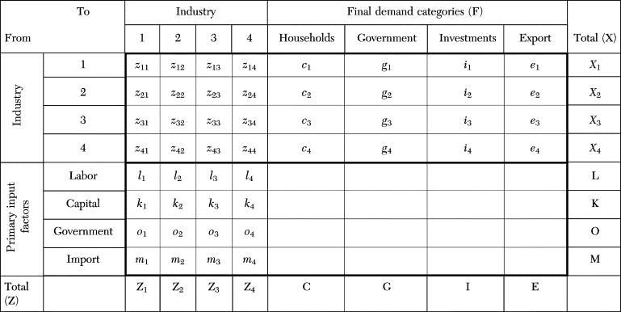
Input-Output Modelling #1
Quantitative part of our methodology.
Consists of sets of interconnected tables, constructed based on national account data (supply and use tables).
Notes:
Geographic region(s) captured in econ data.
Flows of products across industries.
Extended to environment, employment, etc.

Slide 15
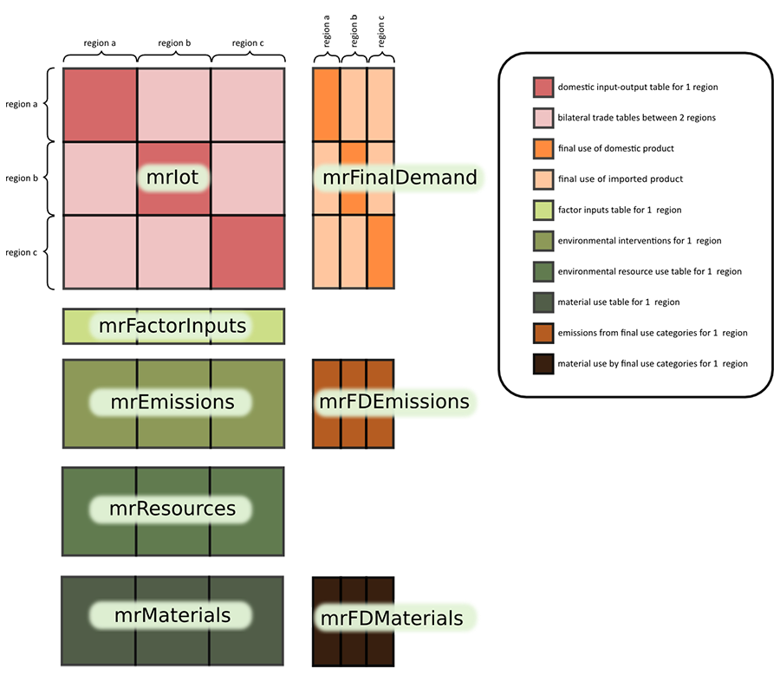

Slide 16
Input-Output Modelling #2
4* main followed indicators
GHG emissions
Employment per skill-level/gender
Consumption of fixed capital
Compensation of employees

Slide 17
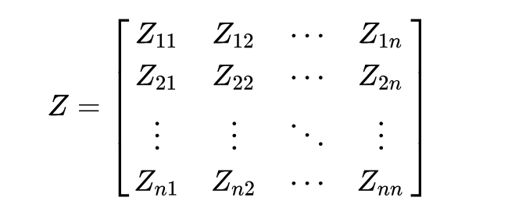
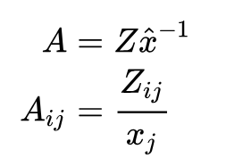
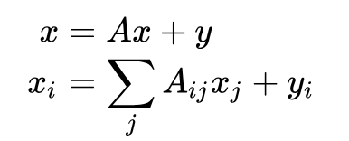
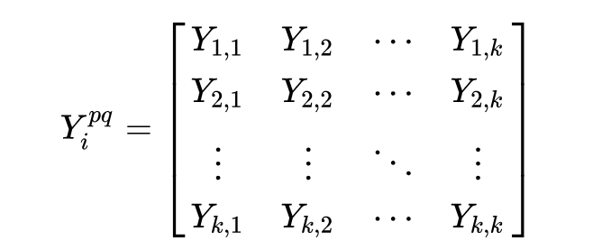

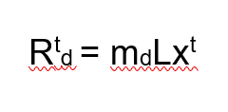

Input-Output Modelling #3
‘This is all rather standard’ – relationships within the model
Z – Inter-industry flows matrix
A – Direct requirements matrix
L – Total requirements matrix
Y – Matrix of final demand
x – Vector of total/gross output
E – Extensions matrix
M – Intensity matrix

Slide 18
Process in more detail
We build on previous work by Cerny et al. (2021;2022):
01
02
03
04
05
Focus on Slovakia in particular.
Gather specific inputs for novel technologies from external sources.
Employment-skill level interaction with labour market developments (digitalisation and automatisation).
Gradually changing scenario-based outputs and shares of new technologies in production.
Intensity matrix for footprint calculation of relevant indicators.

Slide 19
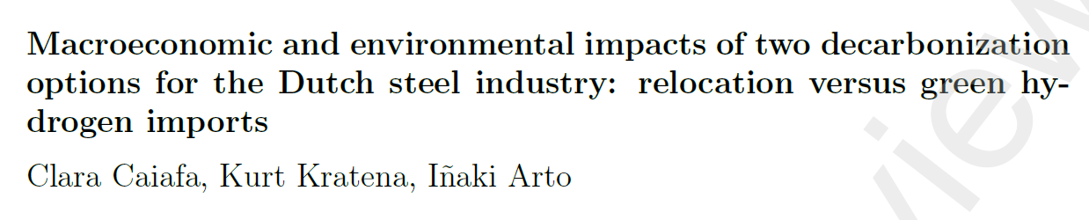
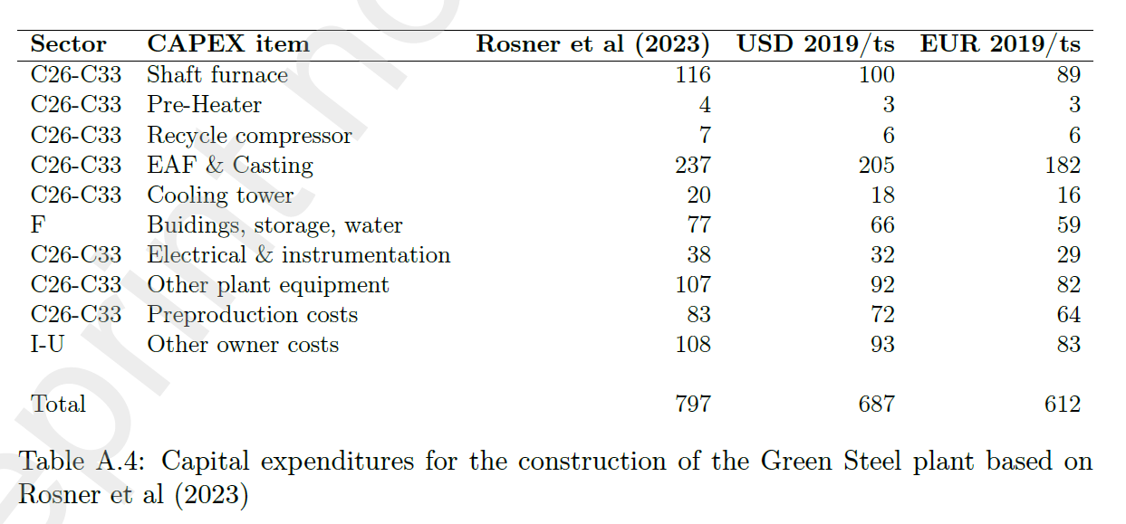
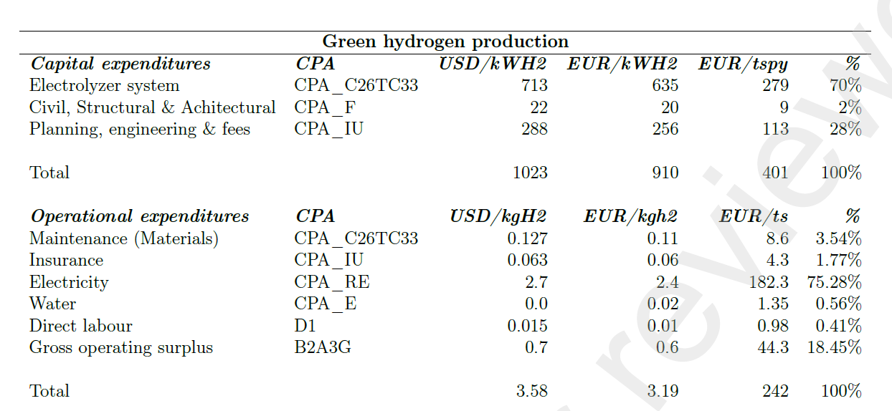
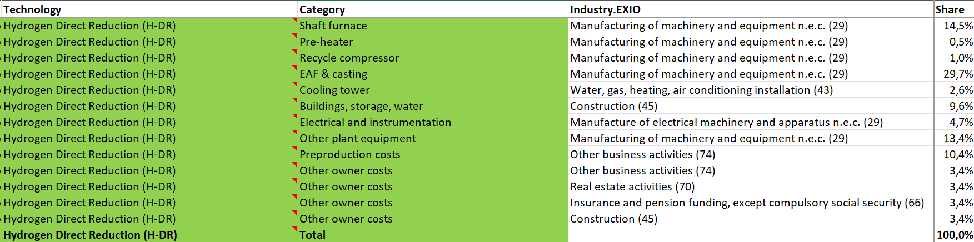
Required inputs

Slide 20
Scenarios: a deeper look
100 percent renewables
The ‘big green state’* scenario. Assumes rapid and significant investment into new technologies and renewable electricity production.
Carbon Capture and Storage
The ‘medium effort’ scenario. Assumption of sufficient viability of carbon capture, storage, and utilization until 2050 to augment electrification.
Maximum circularity
Scenario assuming maximum extent of circular economy development in regard to key sectors (steel and iron, fertilisers, cement, plastics).
NECP
Scenario with existing measures, EU reference scenario
*See Gabor and Braun (2025). ‘Green Macrofinancial regimes’

Slide 21
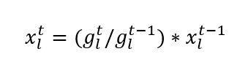
Scenario: key sources
Scenario name | Key source
100 percent renewables | Stanford 100% WWS, IEA/IT 2050/BCG Klimapfade
CCS/Circular | IEA/IT 2050/BCG Klimapfade, Dokupilova & Repikova (2025).
NECP | NECP, EU reference scenario 2020

Slide 22
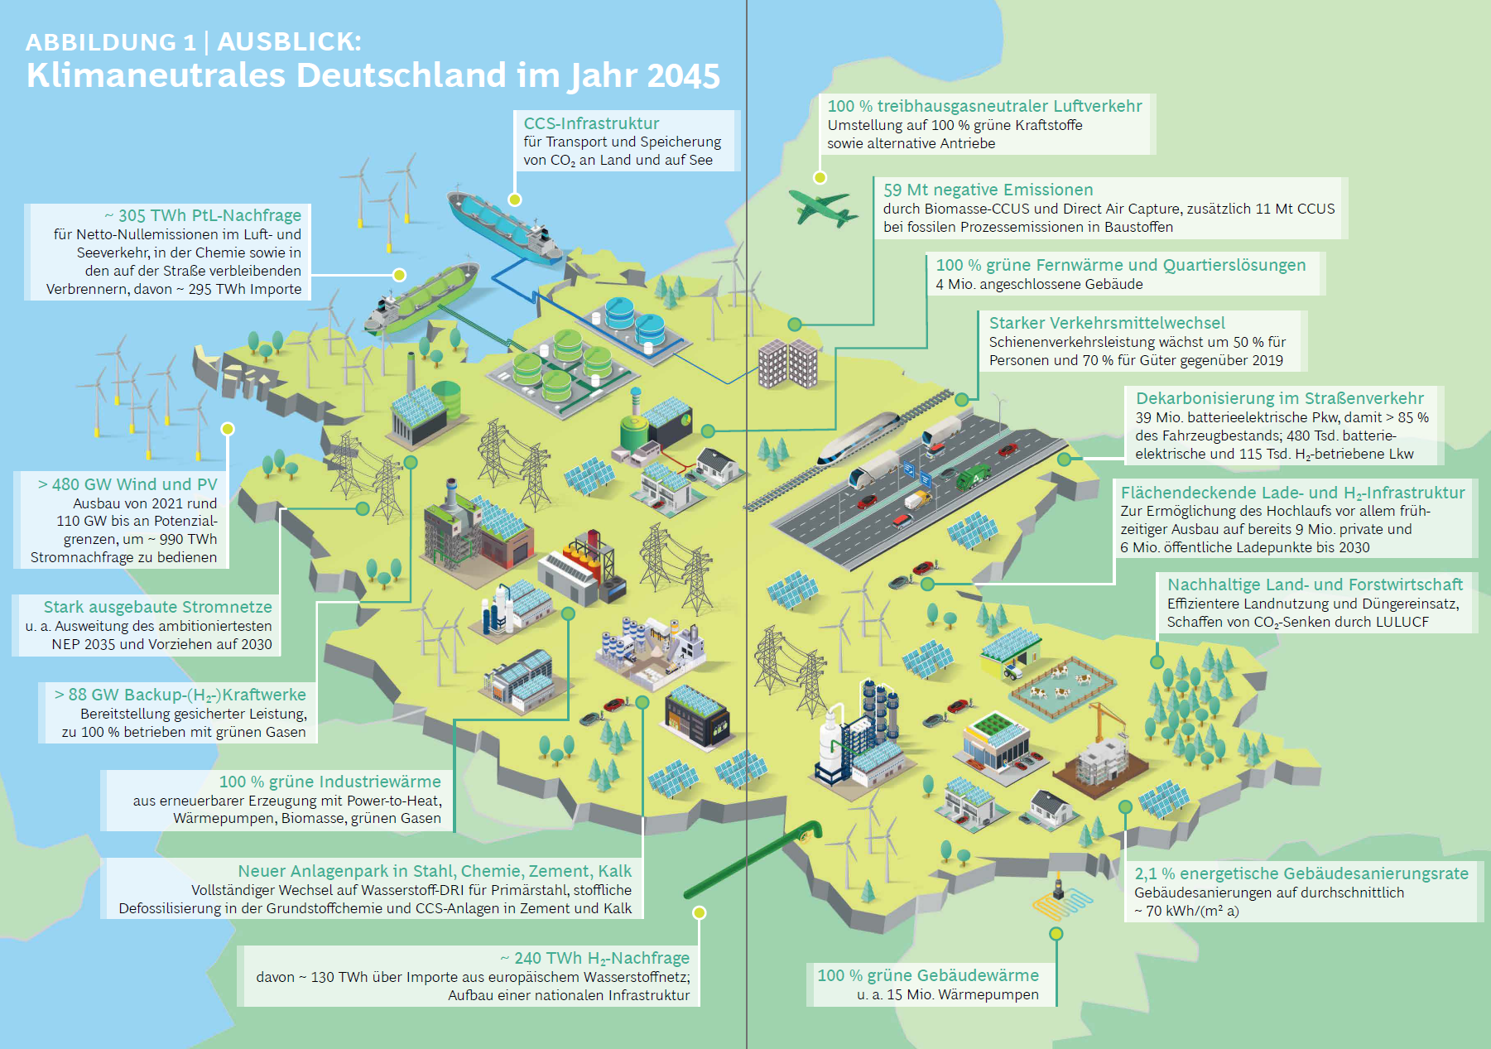
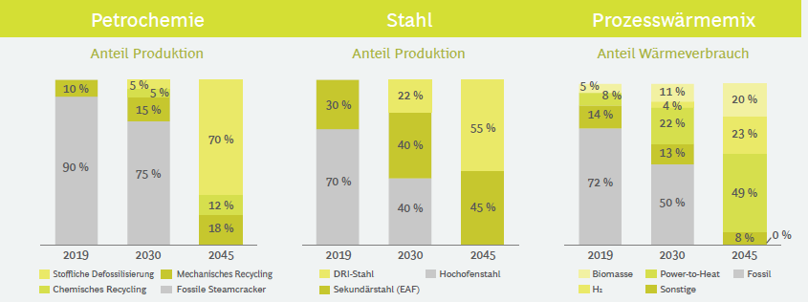

Slide 23
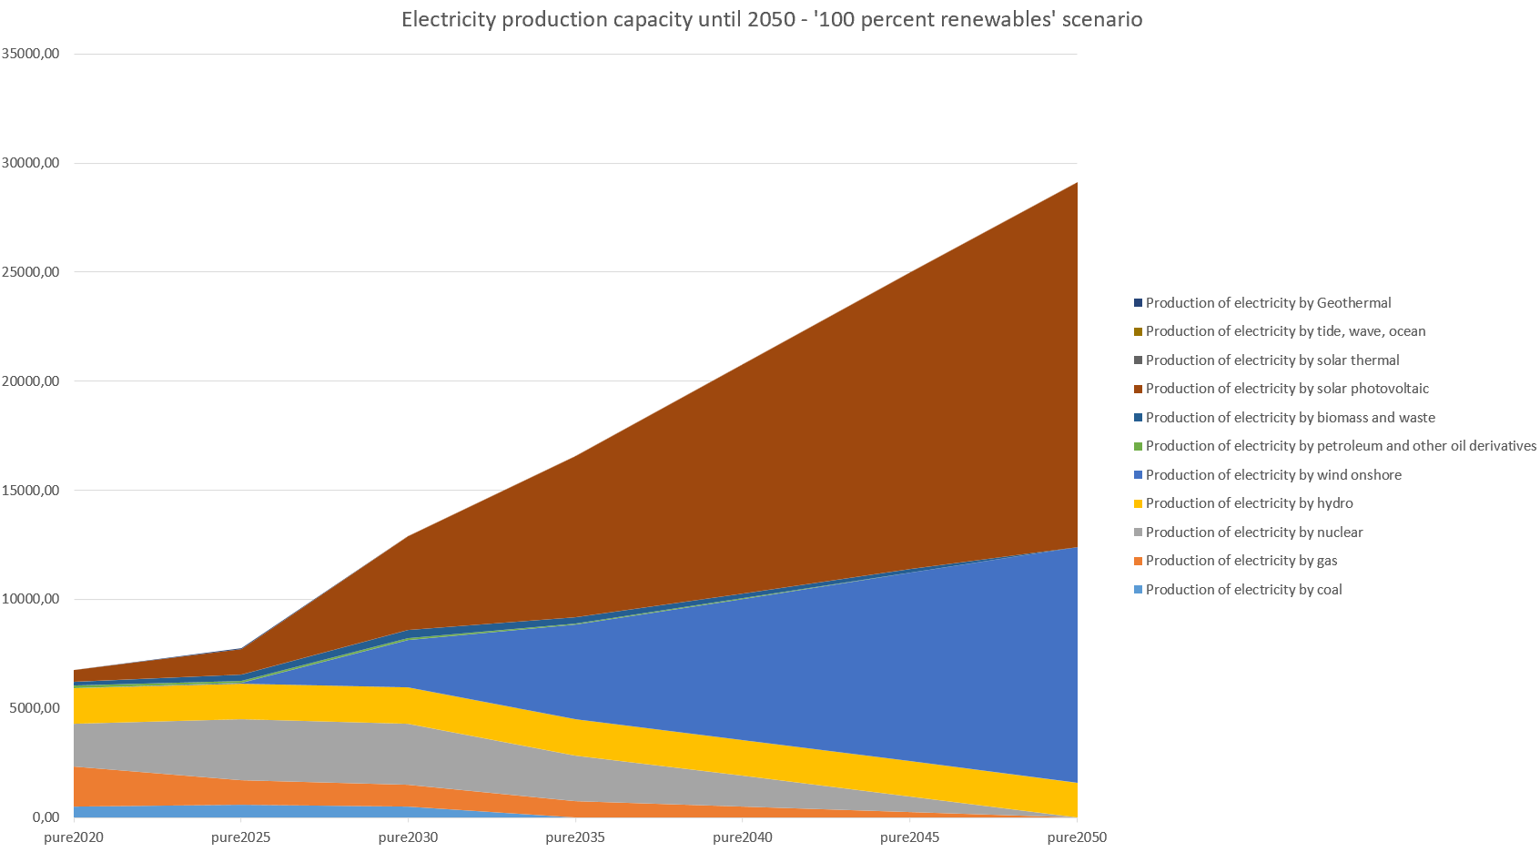
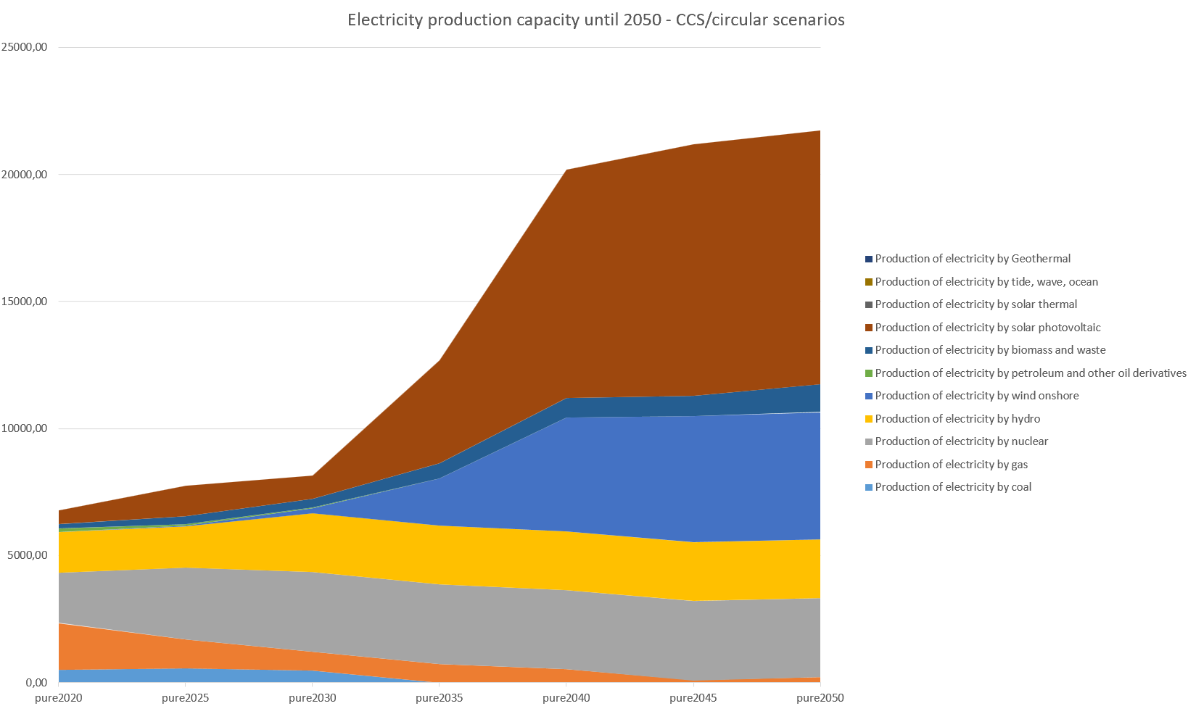
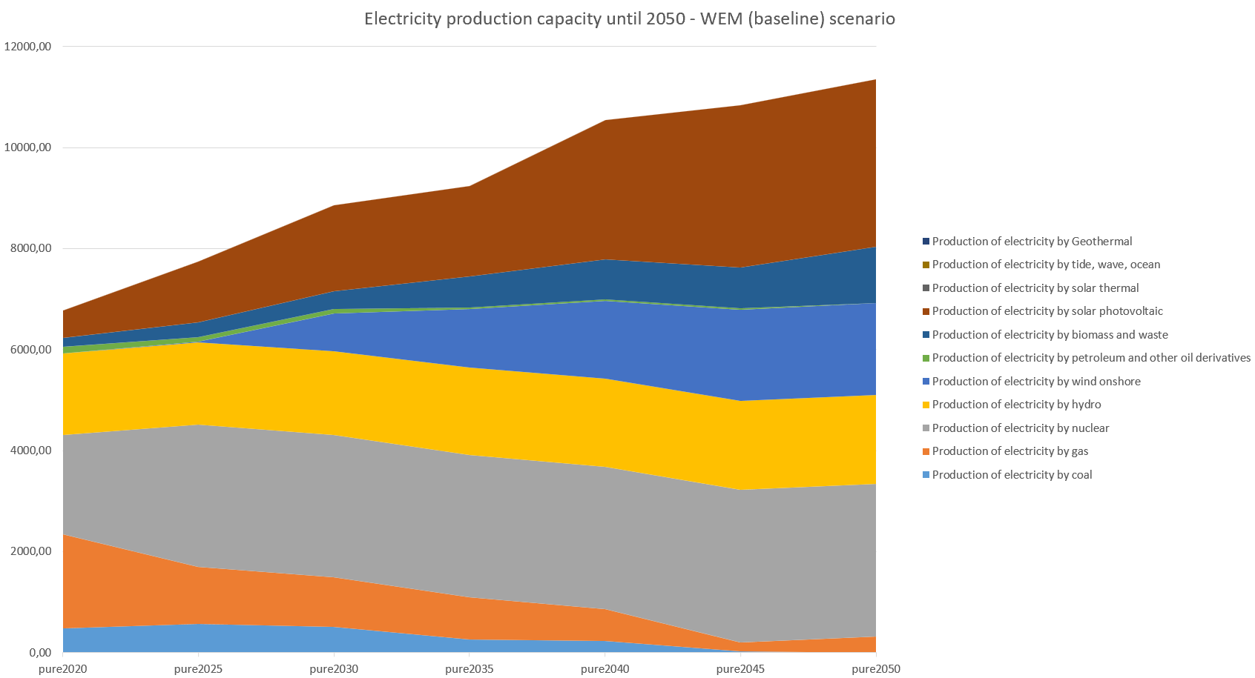

Slide 28
Interviews
Sector | Interview | Findings
Steel production | Yes | Focus on electrification and CCS technologies
Cement production | Yes | CCS and reprocessing CCS deployed only beyond 2040
Automotive | Yes | CCS scenario most probable
Plastics production | Contacted
Circular economy | Yes | Circularity, waste management and employment Key role of municipalities
Paper mill | Contacted
Solar and wind | Contacted (study available)
Experts | SAV – yes UHP, EUBA - planned | We use data from pathfinder of SAV
N-fertilizer/chemical industry | contacted

Slide 29
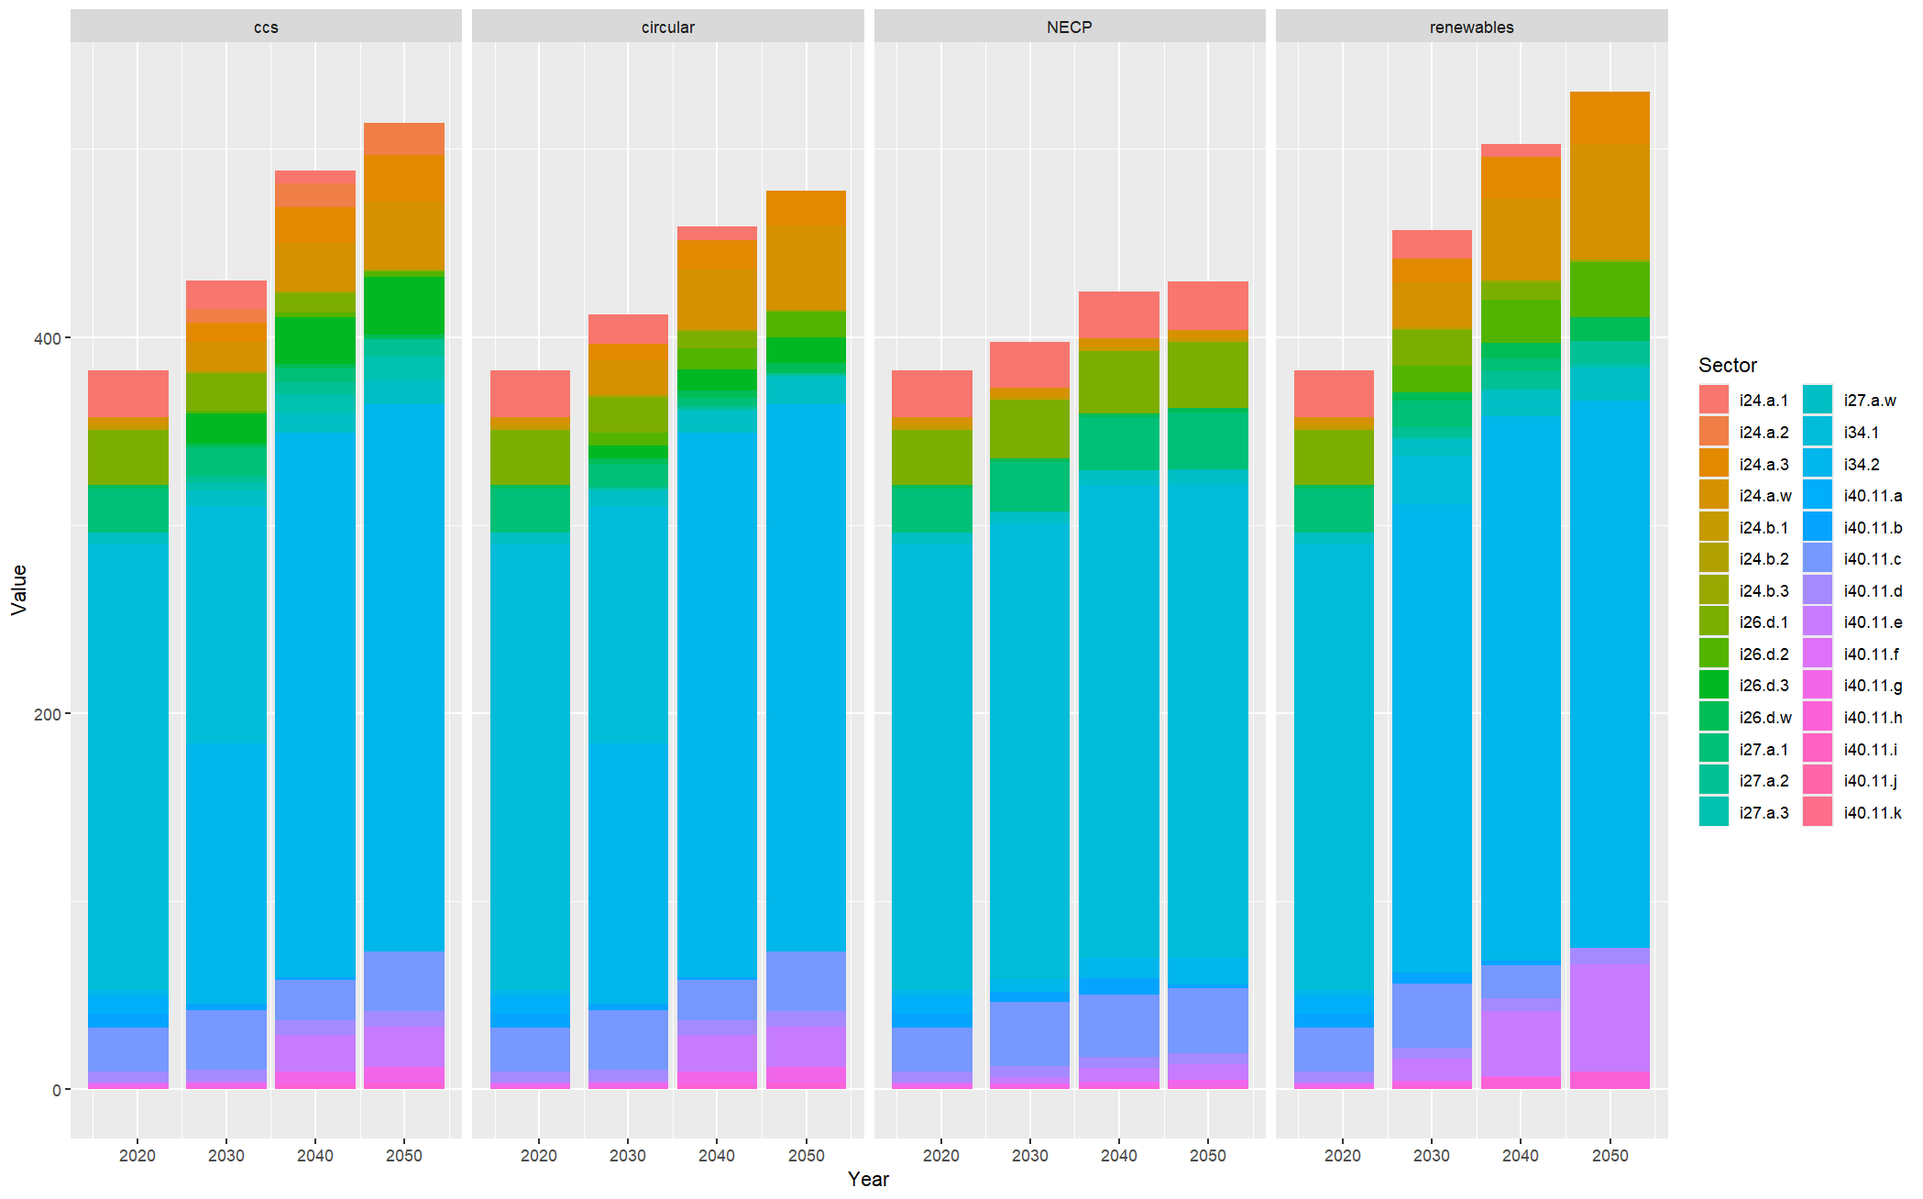
Preliminary results

Slide 30
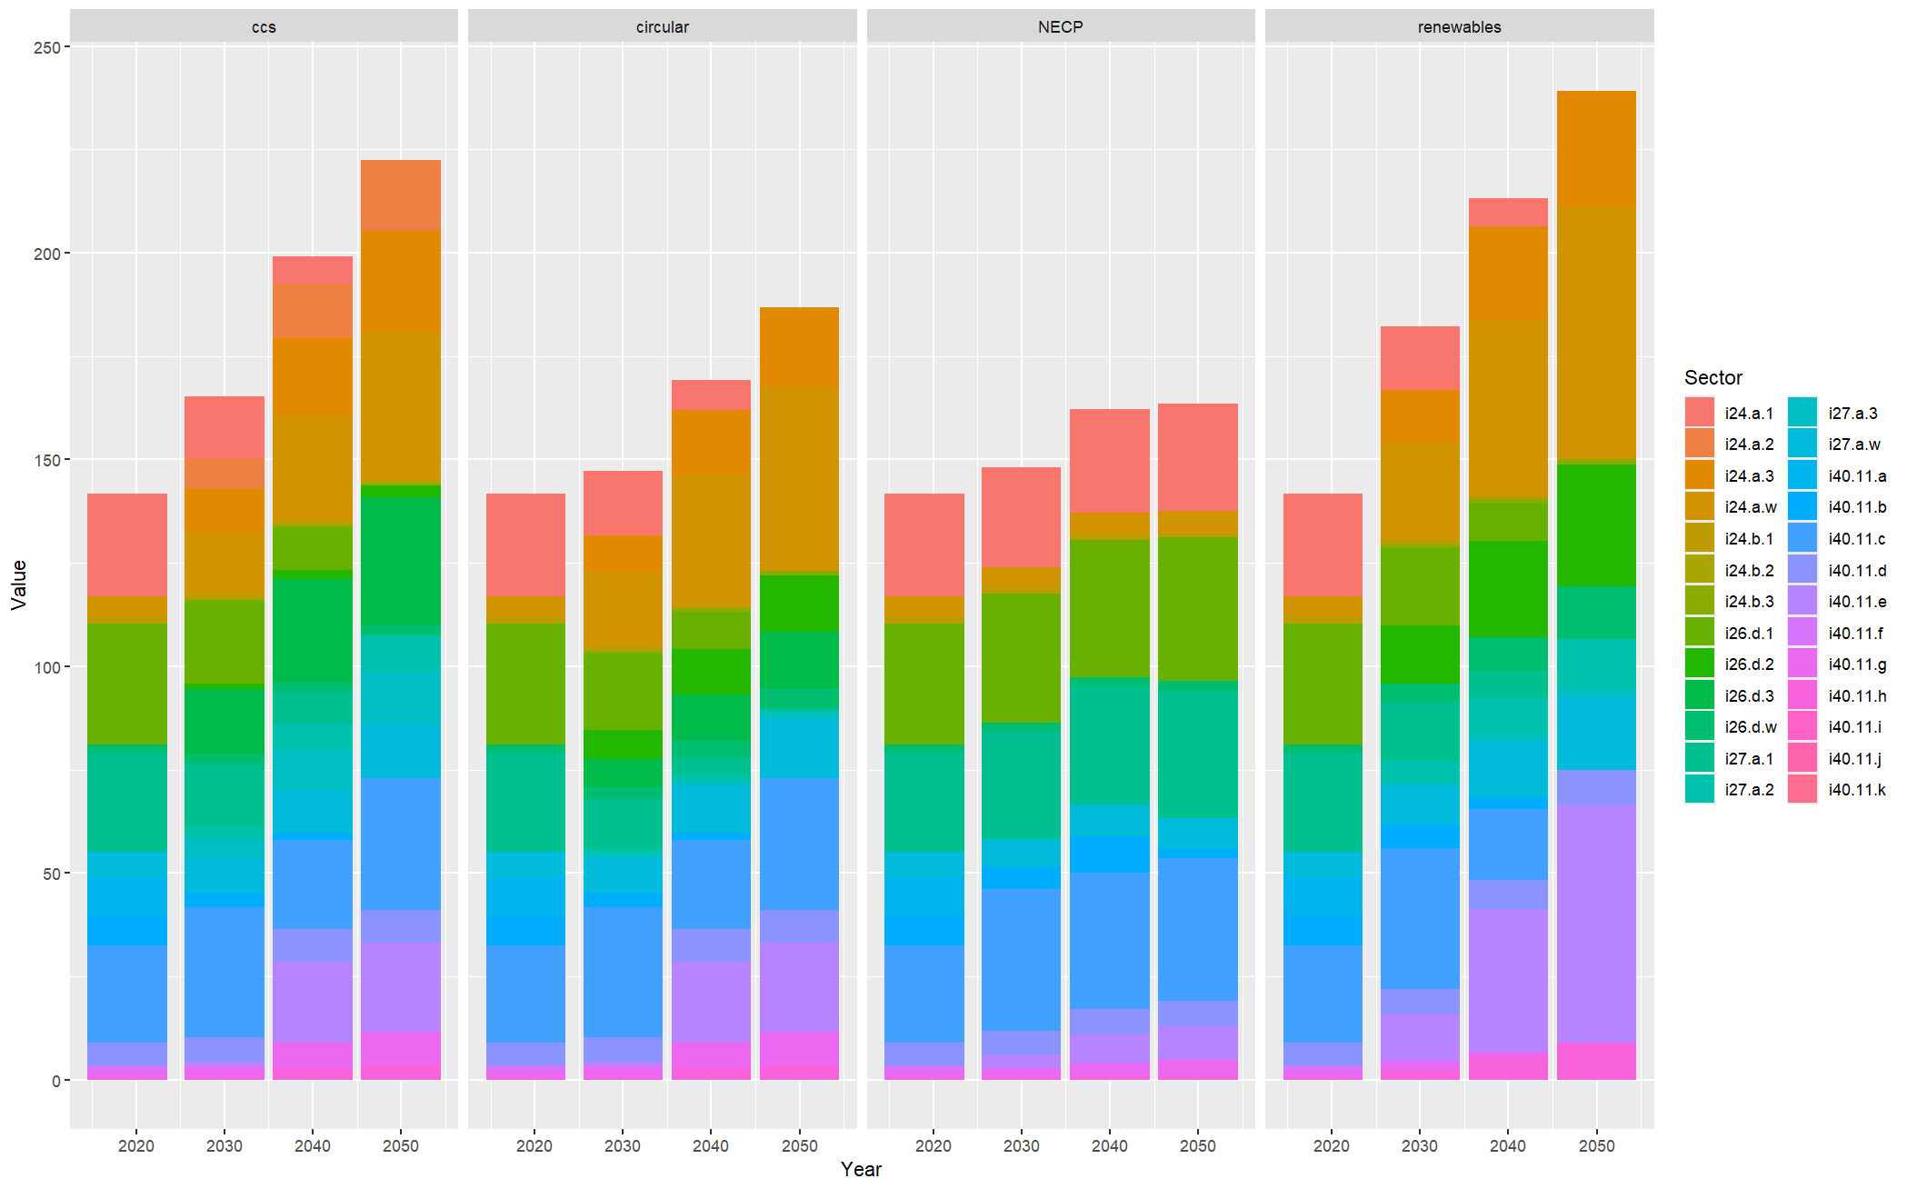
Results – no automotive

Slide 31
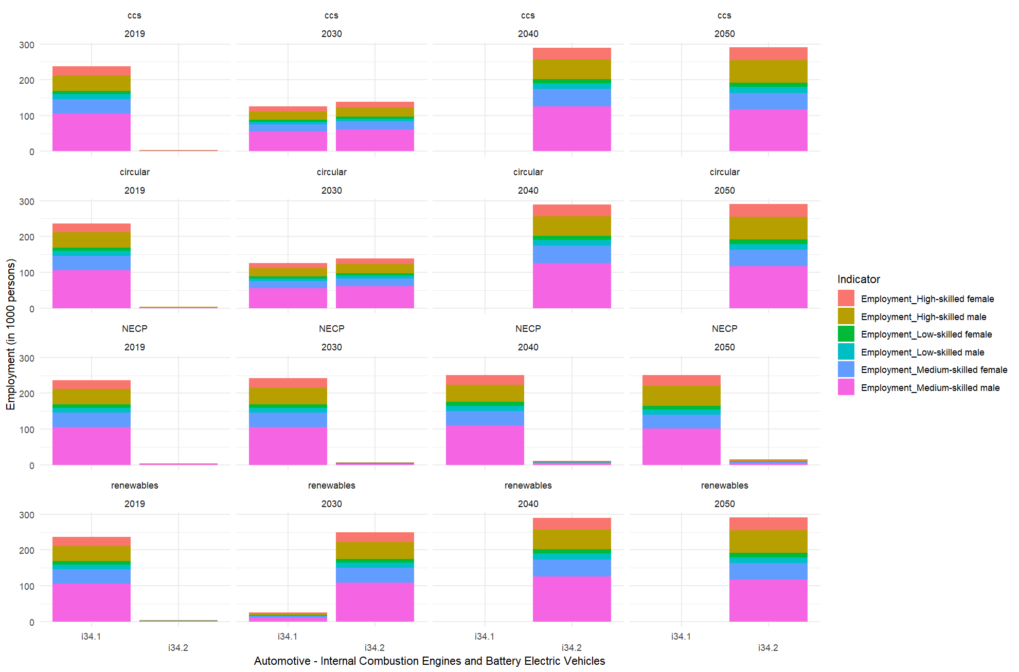

Slide 32
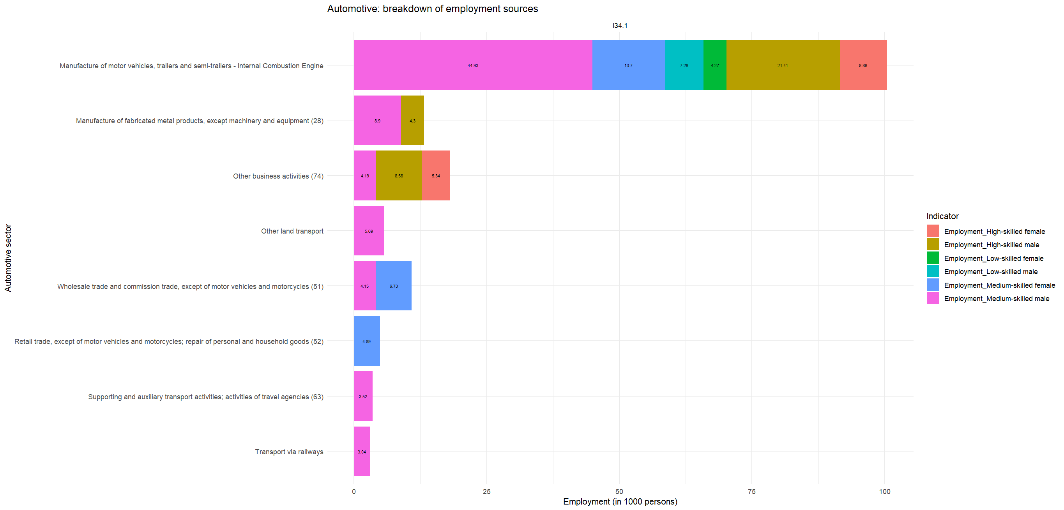

Slide 33
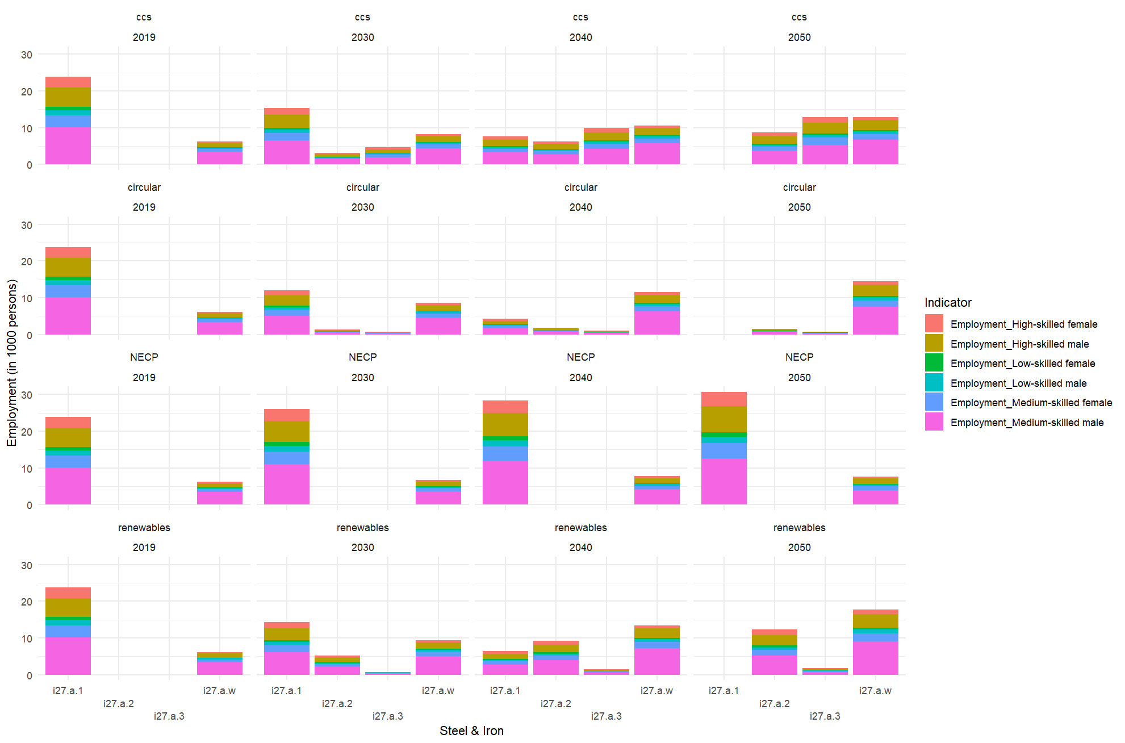

Slide 34
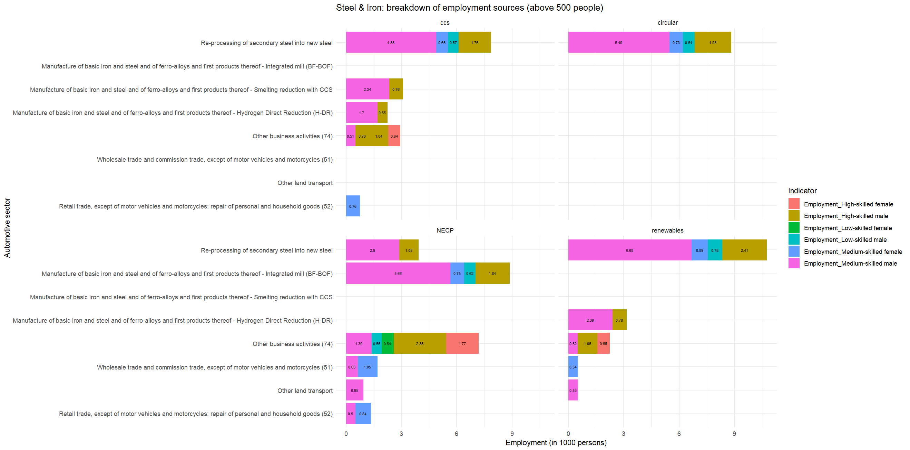

Slide 35
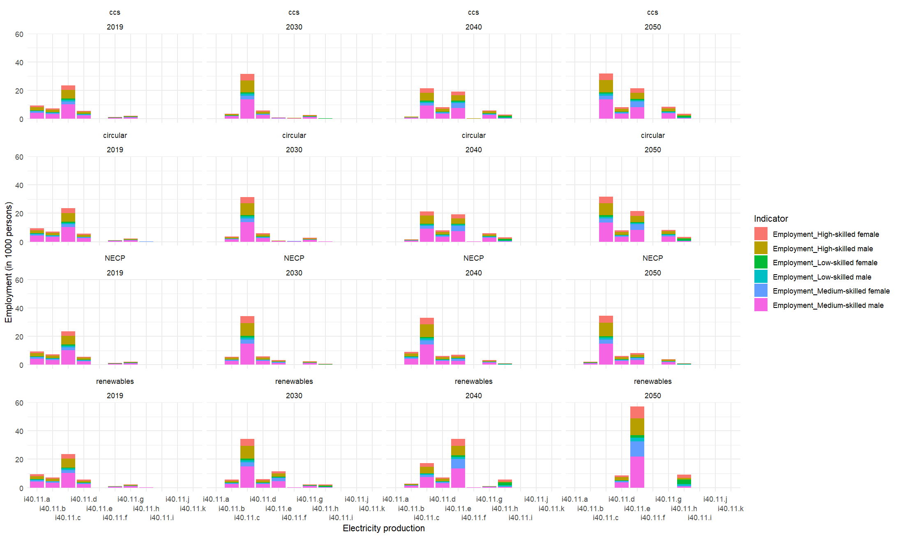

Slide 36
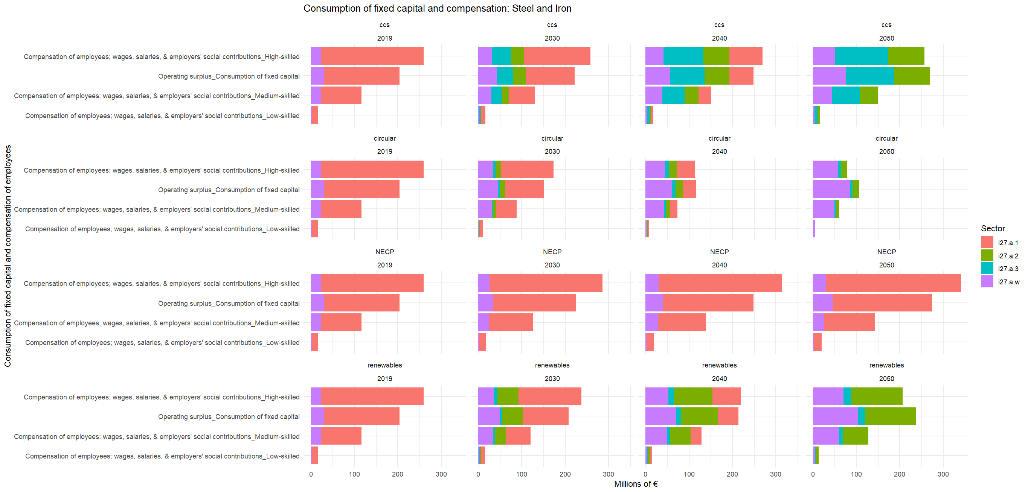

Slide 37
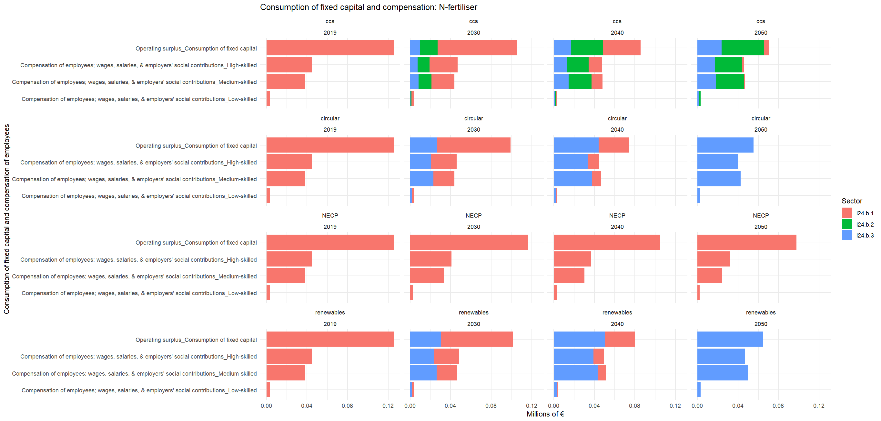

Slide 38
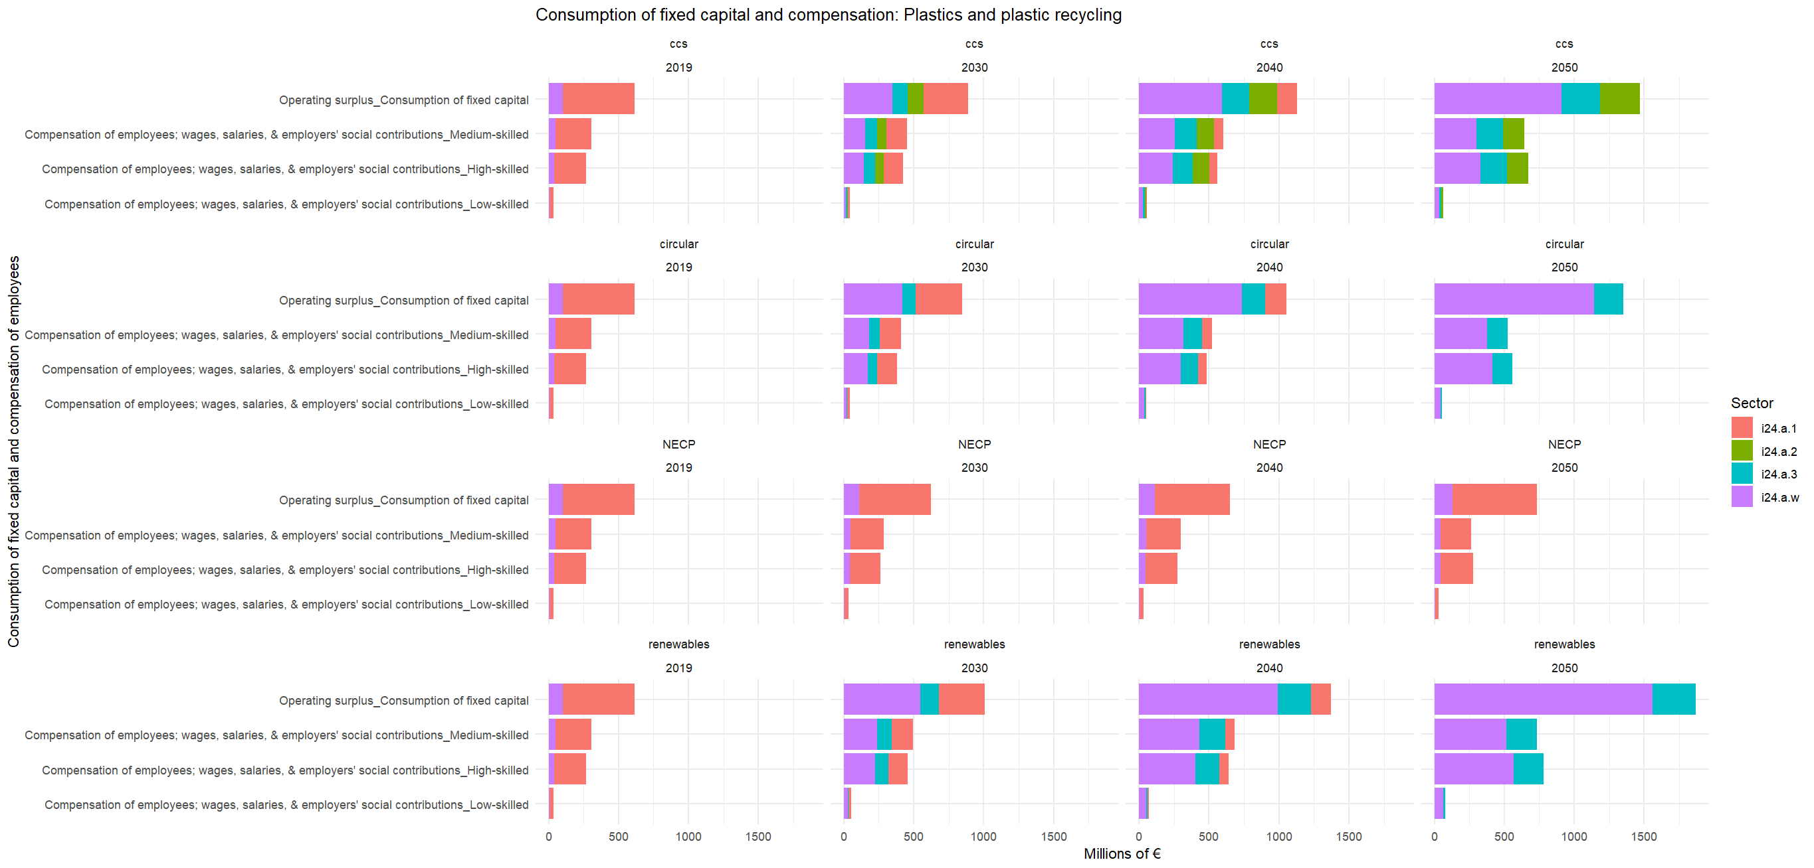

Slide 39
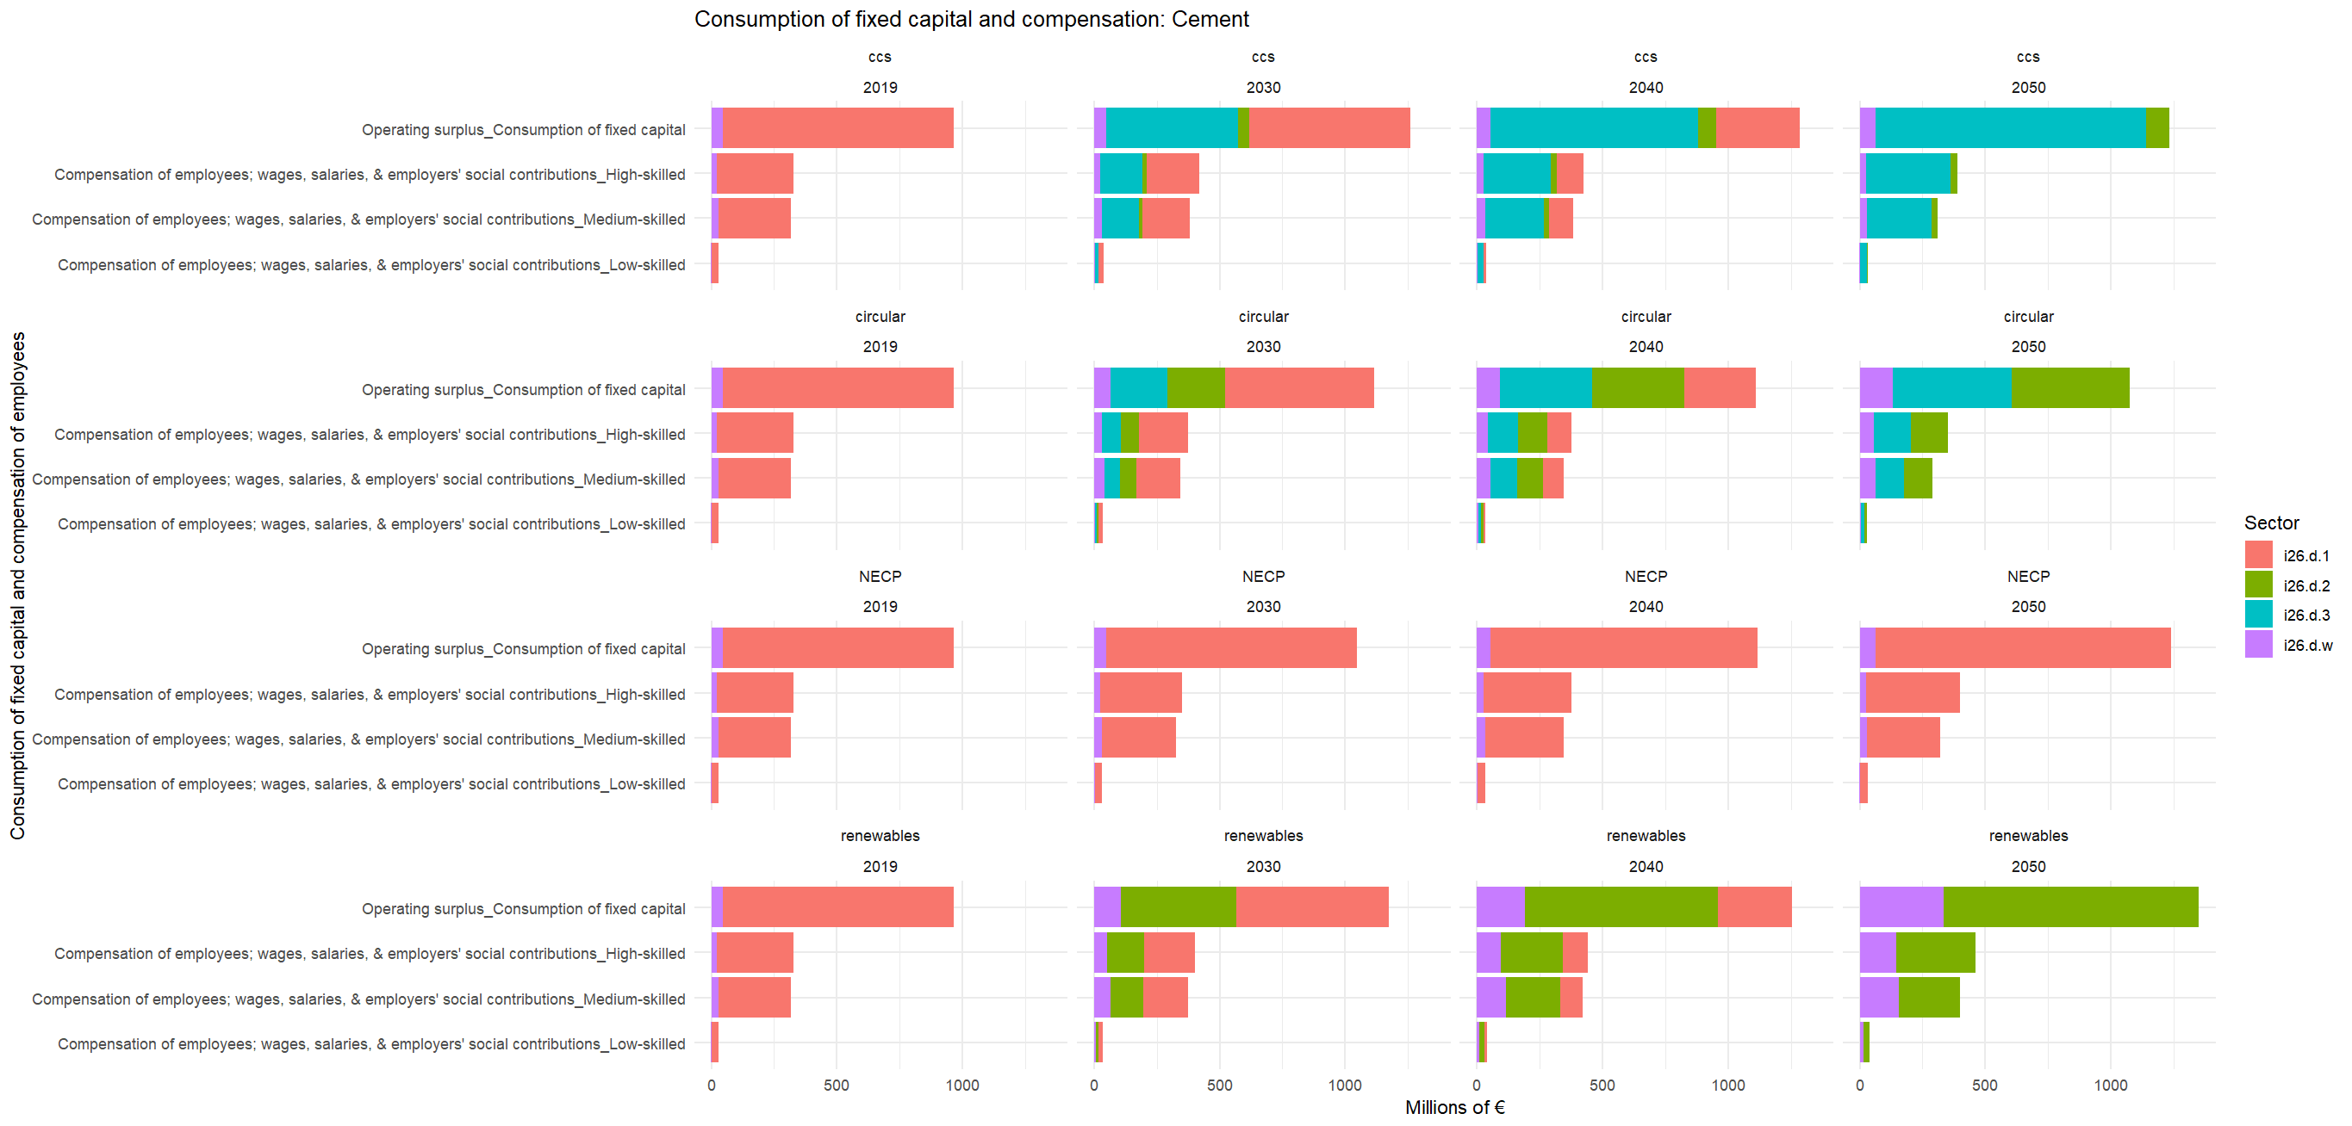

Slide 40
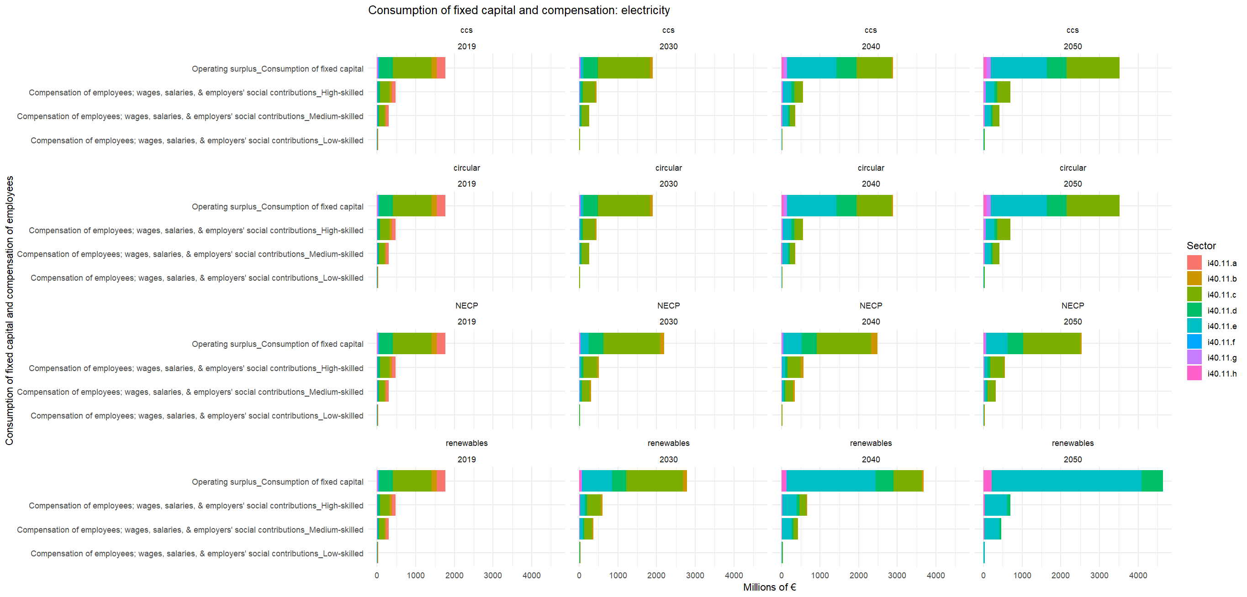

Slide 41
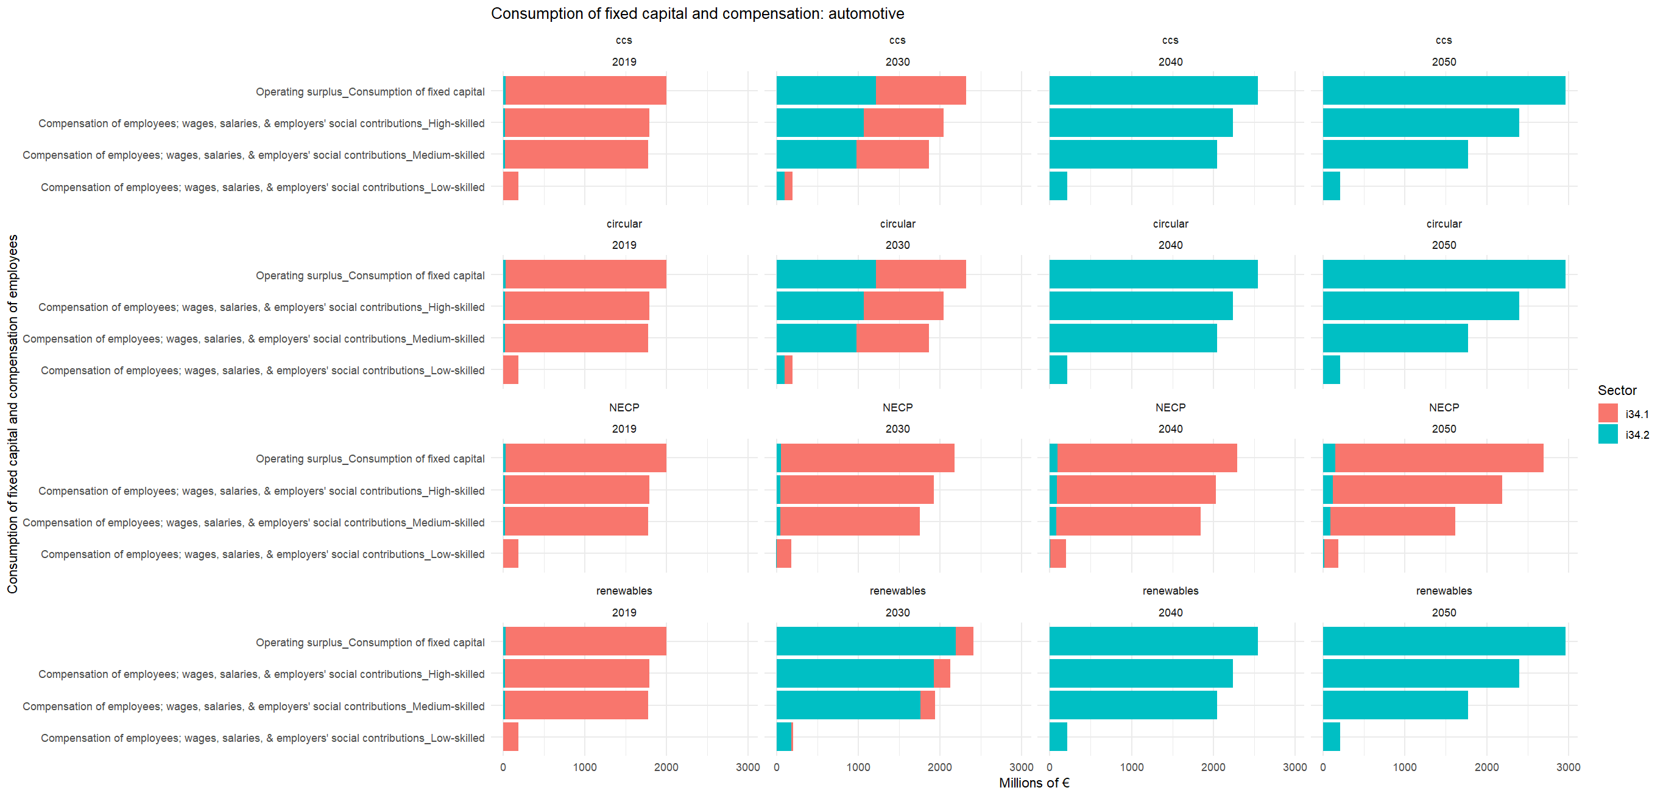

Slide 42
Immediate future: a) Incorporation of final sectors and tech. b) Finalization of interviews and CapEx c) Preparing dash-boards for stakeholders d) Workshops
In the (near distant) future: a) Model expansion (?) b) SFC-IO/SFC-ABM modelling?
What is next?

Slide 43
Thanks!
Do you have any questions?
monika.martiskova@celsi.sk
jakub.barszcz@celsi.sk
https://celsi.sk/deeplab
Financed by European Union NextGenerationEU via National Resilience and Recovery Fund of Slovakia
Project number:
09I03-03-V04-00768

